Slide 1
Thermodynamic Approach to Far from Equilibrium Nonlinear Systems
P K Kaw
Institute for Plasma Research
Bhat, Gandhinagar 382428

Slide 2
Introduction
Nature abounds in examples of nonlinear systems hung up in thermodynamically far from equilibrium states with a lot of complex structure.
Examples are a plasma born with a lot of free energy which drives up the amplitudes of collective modes of oscillation to nonlinear levels, where they saturate giving the observed complex structure. Conventional methods of understanding such systems rely on stability analysis of some assumed equilibrium, nonlinear growth of unstable waves and final saturation leading to the complex structure that is observed. This usually turns out to be tedious.
If the system can be considered as isolated for time scales of structure formation, thermodynamic arguments like minimization of free energy subject to dynamic constraints can often lead to some information about the final state.

Slide 3
Intro-contd..
There are other examples which can be called as driven far from equilibrium systems, where the system is connected to its environment and exchanges matter and energy with it. In such cases the system attempts to optimise some other quantity such as rate of entropy production etc. However, these optimisation principles are still controversial .
For qualitative considerations, a new concept namely that of negentropy machines which create internal structure by entropy efflux at the boundaries during their evolution, turns out to be useful. An outstanding example of such a negentropy machine is a piece of living matter.
We illustrate the above concepts with some well known and novel examples .

Slide 4
Plasma Current Filament in External Magnetic Fields: the RFP Configuration
An outstanding example of an isolated system which obtains its observed state by a minimization of its free energy subject to constraints is a fusion bottle created by driving toroidal plasma currents in a torus which is immersed in external magnetic fields with (B_{T} ~ B_{p}), the so called reversed field pinch configuration.
It is observed that once the discharge immersed in the toroidal field is subjected to intense Ohmic drive, it goes through a violent relaxation process typically in a millisecond time scale and then settles down into a relatively quiescent state with a characteristic profile of poloidal and toroidal fields, which includes reversal of toroidal field at the edge.

Slide 5
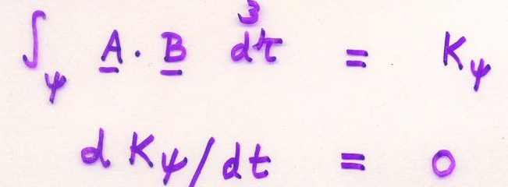
Plasma Current– contd...
For formation times of order few milliseconds these systems may be treated as isolated, since there is little exchange of matter and energy with external world.
Conventional approach to explain the observed state is to assume a characteristic solution of MHD equilibrium equation J X B = grad p as the initial state, and use ideal/resistive MHD theories to look for linear and nonlinear consequences of instabilities of this initial state in which pressure gradient, curvature of the field lines and force free current gradients all act as sources of free energy.
Ideal MHD, however, respects an infinity of topological constraints, viz. helicity conservation within each surface

Slide 6
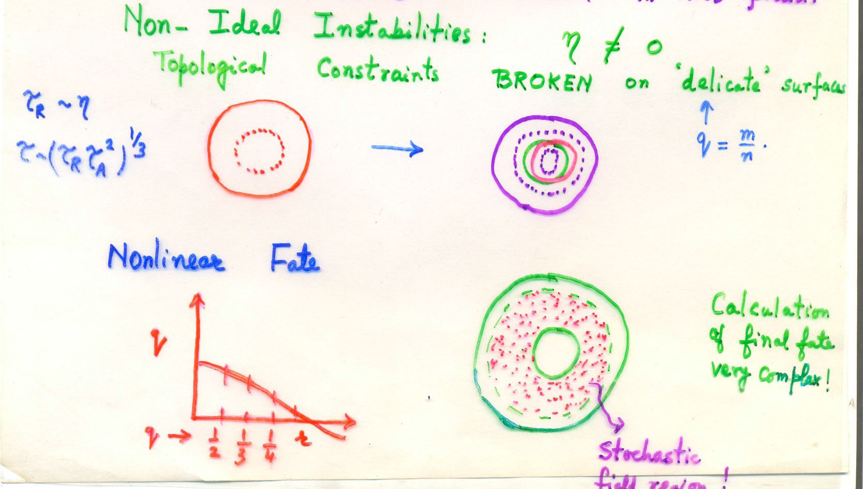
Relaxation of Topological constraints

Slide 7
Thermodynamics of Plasma Current Filaments
Taylor (1974,1986) showed how to make progress in this problem and get the final state of a reversed field pinch out of a thermodynamic argument.
He argued that the plasma is minimizing its magnetic field free energy subject to a single volume constraint
i.e.
The reason that it makes sense to keep only one out of a whole infinity of topological constraints from ideal MHD is that inner surfaces are all getting stochastasized by non ideal perturbations breaking rational magnetic surfaces everywhere in the interior.

Slide 8

Plasma Current– contd...
Minimize
Subject to Constancy of

Slide 9
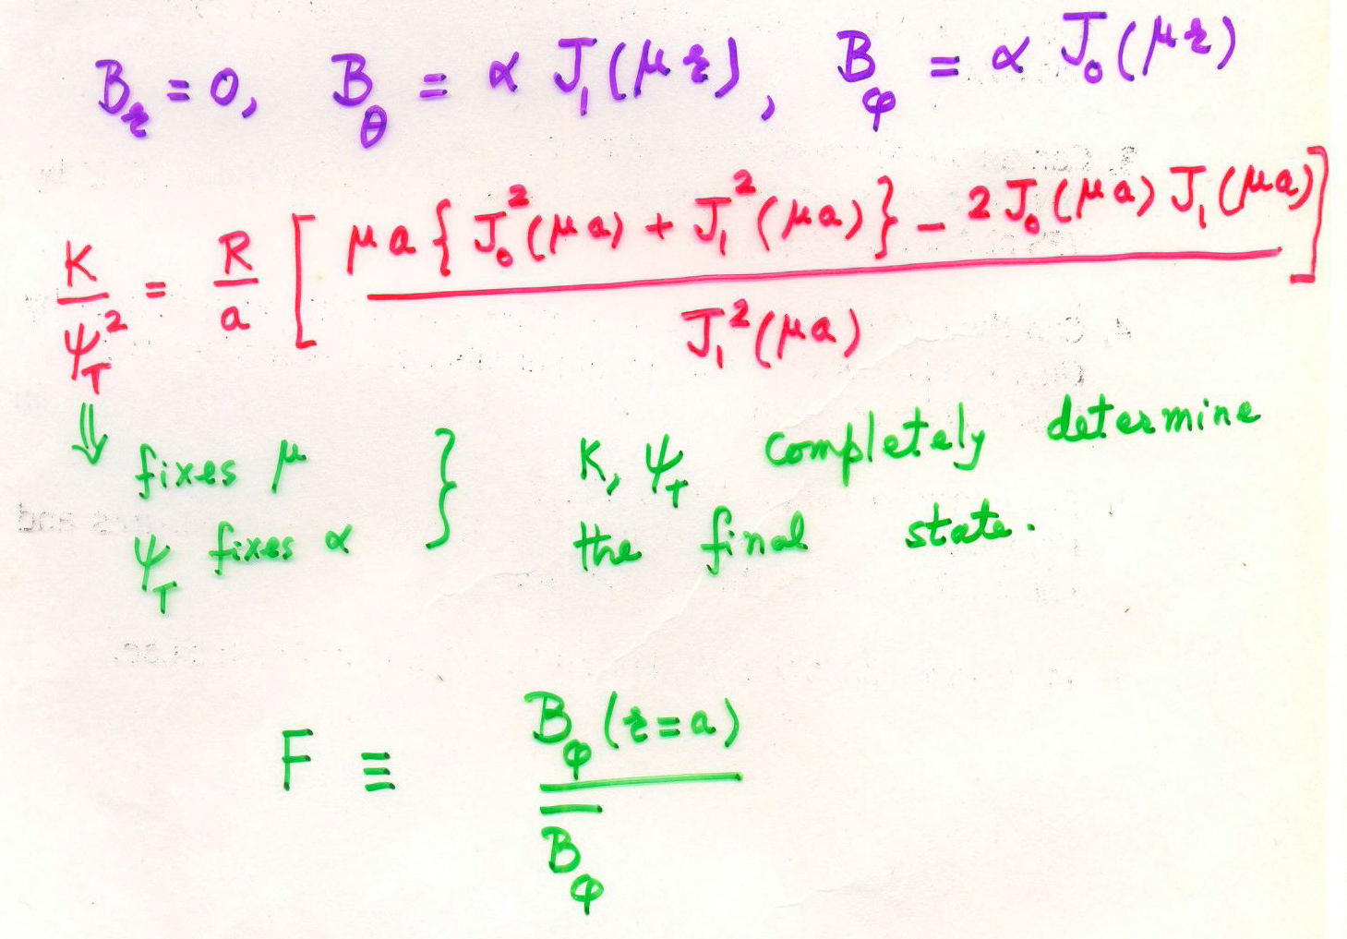
J.B. Taylor (Rev. Modern Physics 1986)

Slide 10
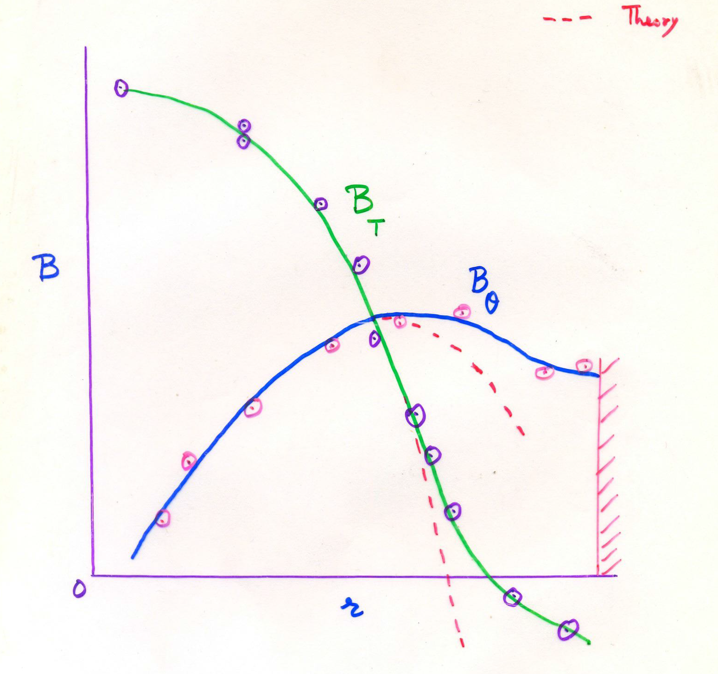
Pinch Experiments

Slide 11
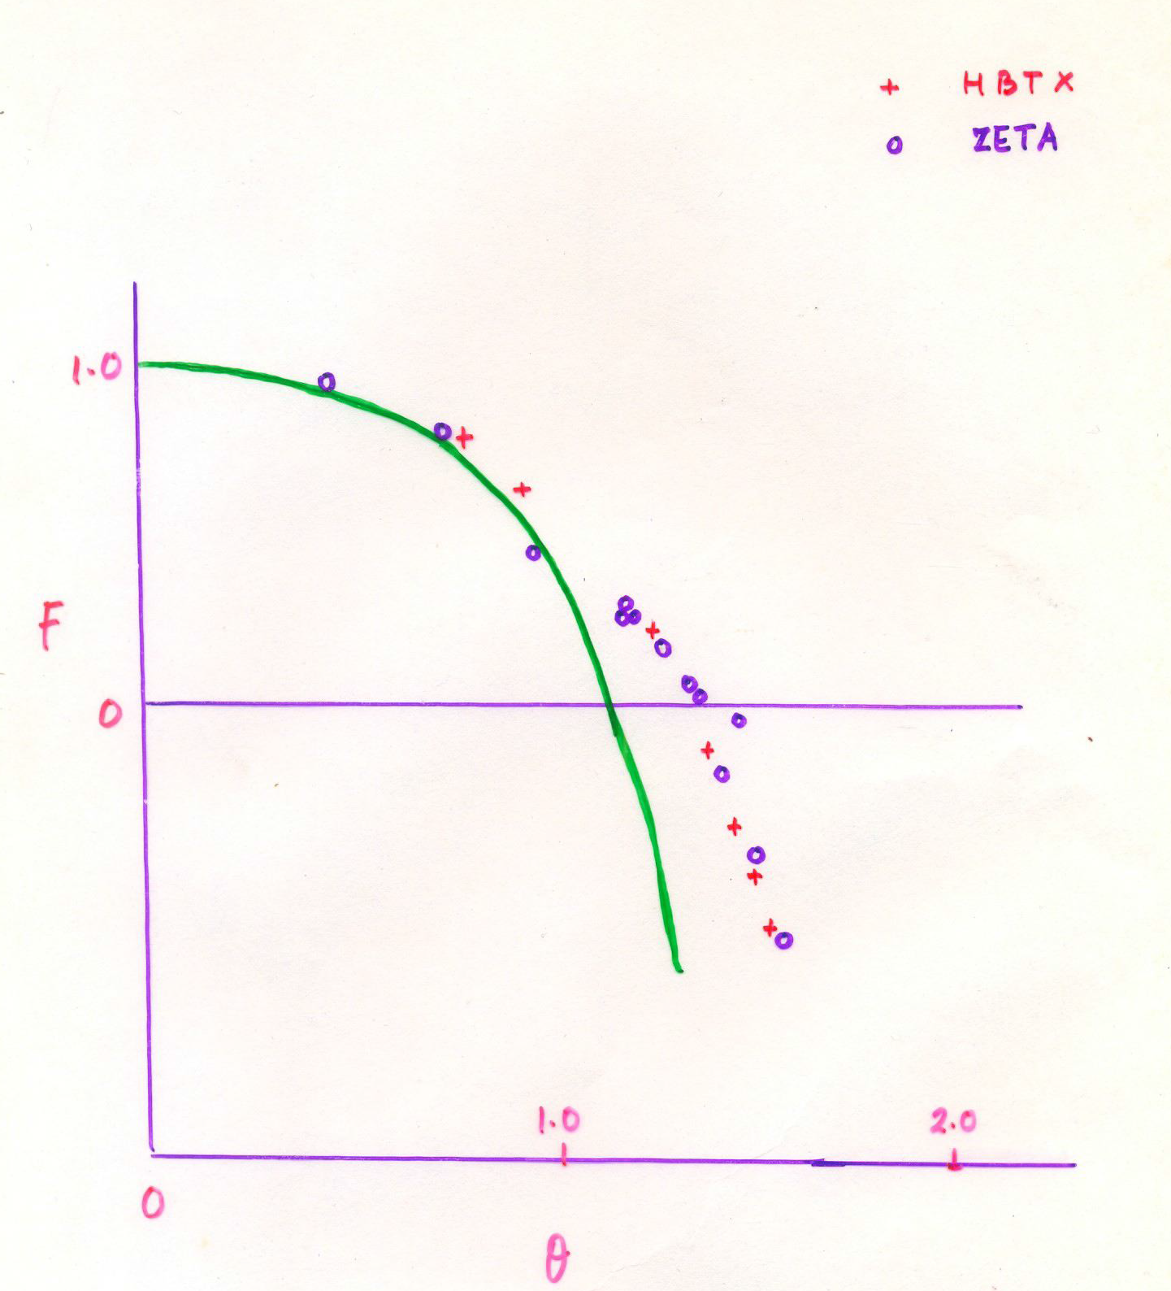
Pinch Experiments

Slide 12
Solved vs Unsolved Problem
Taylor’s theory of RFP’s is an example of a solved thermodynamic problem in plasma physics.
No,it is not perfect and does not explain finite pressure effects.
Applied to tokamaks blindly, it gives toroidal J ~ flat, something which happens at disruptions; this makes sense since that is when tokamak field lines are stochastic over the whole volume. Most of the time tokamak is protected by the barrier of stochasticity between q =1 and 2 surfaces !
Plasma current profile evolution in a tokamak is slow and energy/particle transport time scales are comparable.
Hence a driven steady state …. Unsolved problem in a thermodynamic sense. What is plasma optimising ?

Slide 13
Negentropy machines
Negentropy machine is a system which ingests matter and low entropy energy from its environment, creates and preserves internal structure or information during its growth and excretes matter and high entropy energy back into the environment.
The excess entropy efflux through the boundaries creates negentropy or information in the system.

Slide 14
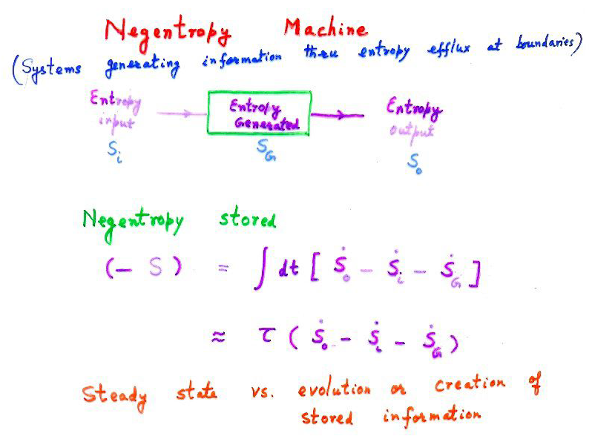

Slide 15
ADITYA
ADITYA is the First Indian Tokamak built in Institute for Plasma Research, Ahmedabad in 1989.
ADITYA plasma is formed by evacuating its toroidal vacuum vessel to 10⁻⁸ torr, filling it with hydrogen gas at 10⁻⁴ torr, producing a toroidal field of 1.5 Tesla inside it and by striking a toroidal current discharge in it with the help of voltage produced by an Ohmic transformer. Toroidal voltage of 20 volts around the machine breaks the gas down and produces a high conductivity plasma.
Resistive heating of the plasma (~ 250-300 Kilowatt) makes it more conducting and the plasma current increases to more than 100000 amperes. Sometimes we also put in extra rf power (~200 kilowatt) at tens of MHZ to heat the plasma to temperatures upto 7-8 million K.
Impurities are generated at the surfaces where the plasma leans on a graphite tiled steel limiter, diffuse inwards and radiate some energy in the form of visible, UV and soft Xrays

Slide 16
Tokamak : decent magnetic cage ?
A well confined tokamak discharge is to be thought of as a complex pattern of wiggling electromagnetic fields which includes the nested magnetic surfaces due to the mean currrent profile typically unstable to slowly evolving resistive tearing instabilities with low amplitude magnetic islands at low order rational surfaces.
At a microlevel, there are further electrostatic and electromagnetic structures called microturbulence which are driven by ion temperature gradients and density gradients. This turbulence in turn controls the plasma particle and heat loss from the bottle and ensures that the hot plasma core stays thermally isolated from the cold edge plasma for a typical energy confinement time.
The fact that in spite of instabilities, turbulence and nonlinear effects, the tokamak cage isolates heat for sufficient time to give temperatures in most successful devices like JT-60 upto about 40 keV and acceptable triple product (near ignition values) indicates it is a decent cage. It is not perfect e.g. we have to make it large due to anomalous transport and this adds to the cost. The possible control of turbulent transport by velocity shear promoted in various ways is a good thing.
One may wonder where does this macroscopic order in the tokamak come from ?
We only applied a breakdown voltage in a toroidal vacuum chamber and followed it up with heating by dc currents, RF and neutral beams.

Slide 17
Tokamak : Negentropy machine
Tokamak is able to create this order because it is a negentropy machine like us, living systems
Both tokamaks and liviing systems are driven dissipative systems with flux of matter and energy through them. Both ingest low entropy energy, produce a lot of entropy by dissipative processes inside and then expel this energy as high entropy heat/infrared radiation.
During the growth period, there is an imbalance with efflux exceeding what is generated and what came in. This then produces negentropy or order inside these machines.
One may show quantitatively that the amount of information stored in the ordered patterns of a tokamak plasma can be generated by an unbalanced efflux of high entropy radiation in time scales ~ tens of milliseconds, period of formation. On the other hand same exercise in a human being takes time ~ few years whereas the whole web of life takes hundreds of millions of years.

Slide 18
ADITYA-2
The approximately 500 kilowatt of Ohmic and RF power input in the central hot core of the tokamak is partially (say 30%) expelled by high Z impurity radiation in the core itself, partially radiated after conduction to the edge (~ 40 %) by low Z impurities in the less than 10-20 eV cold edge region and the rest by convection to the limiter/divertor region. The efflux of high entropy radiation/convection at the edge during the formation time (~ 30--40 msec) creates the negentropy in the tokamak plasma and should explain the amount of information, created and stored in it.(Kaw 1996)

Slide 19
ADITYA-3
Energy is input by the ohmic / RF fields – Highly organised form – neglect
Energy outflux at boundary is mostly due to low Z radiation/convection induced by ~ 10eV electrons:
The discharge evolution time is ~ 35msec. Hence the negentropy created during the formation of ADITYA is

Slide 20
ADITYA-3 contd…
We now estimate this number from other considerations. ADITYA plasma is made up of 10¹⁹ particles. One may roughly arrange them in (10¹⁹!) configurations. For a given configuration, which is representative of a relatively unique structure of electromagnetic patterns found in a given ADITYA discharge, the probability W ~ R/ (10¹⁹!), where R is a redundancy factor taking account of the fact that R different molecular configurations may lead to similar macroscopic electromagnetic configurations. This gives a rough estimate of maximum negentropy that may be stored in such tokamak configurations to be ( using Stirling’s Theorem and noting that ln R may be neglected until R exceeds 10¹⁸ ! ):
- S _{max}~ k ln W ~ 1.38 * 10⁻¹⁶ * 10¹⁹ *19 * ln 10
~ 10⁵ ergs/⁰K

Slide 21
ADITYA - FINAL
We see that the two estimates of the stored information are very close. If the stored information is less, it can be created more comfortably by using partial imbalance of input and outgoing entropy fluxes.
This favorable quantitative comparison shows that our basic thesis, viz. that the excess entropy efflux at the boundary during formation phase may be the source of information stored in the patterns of ADITYA discharge, is a viable idea. We now illustrate our basic thesis with two other examples.

Slide 22
What is living matter ?
A piece of living matter typically ingests matter and energy from its environment, uses it to maintain its internal structure and typically excretes waste products and waste heat (infrared radiation) back into the environment.
It is thus like a typical negentropy machine which sustains creation of information by an exccess efflux of entropy from its boundaries during its growth phase.
Let us see how to make a semi-quantitative assessment !

Slide 23
Sidhartha- a 10 year old
A ten year old Indian kid weighs nearly 40 kg. By the time he is twenty he weighs nearly seventy. Thus he adds about 30 Kgms in 10 years.
All the information stored in those 30 Kgms of growth is created by eating food, taking energetic input at low entropy through enzymatic chemical reactions in his body and radiating waste heat as infrared radiation.
His intake ~ 2500 K Cals / day and radiated power output of about ~ 100 watts from his body which is typically at about 300 ⁰K.

Slide 24
More on Sidhartha
In a steady state, the entropy efflux entirely balances the entropy production inside (entropy input is very low because food energy is low entropy energy). During growth period, there will be an imbalance between the two : a comfortable margin of imbalance is nearly 1%.
Thus ~ few watts of radiated power at 300 ⁰K maybe being used for negentropy creation.
Negentropy created in ten years
- S ~ 1 * 10⁷ * 3 * 10⁸/ 300 ergs/⁰K
~ 10¹³ ergs/⁰K

Slide 25
Sidhartha - 3
30 kgms of Sidhartha comprise of a unique configuration of about
{6*10²³/20} *30 * 10³ ~ 10²⁷ mols
Thus S < S_{max} ~ k ln W
~ 1.38 * 10⁻¹⁶ ln [ R/ 10²⁷ !]]
~ 10¹³ ergs / ⁰K
The two numbers are uncannily close to each other again reinforcing our view that the excess efflux of entropy from the boundaries may be responsible for the creation of information in as complex an organism as a human.
This also gives a raison de itre for the invention of a cell membrane or wall during evolution before the living systems could prosper on this planet

Slide 26
Entire Web of Life
Our Sun emits 10²⁵ Watts of low entropy photons, of which ~ 10¹⁷ Watts fall on earth
0.01 % of this energy is absorbed by photosynthesis and seems to have organized and sustained the complex web of life we see.
This 10¹³ watts is finally re emitted by the biological material as infrared photons at room temperature ~ 300⁰K.
For sustenance the entropy efflux balances entropy production due to dissipative processes. A small imbalance (say 1/100 %) may be available for creating new information .
Thus negentropy production/ year.
- S ~ 10⁹* 10⁷ *3*10⁷/300 ~ 10²¹ ergs/⁰K yr

Slide 27
Mass of Biological material
Estimate of the mass of biological material on earth ~ 10²⁰ gms [ ~ 3 * 10⁴² mols.]
This is consistent with the conversion of the top ~ 10 cm of the soil on earth into biological material by the cooking due to solar radiation
Negentropy storable in a unique configuration of these molecules ~ 10²⁹ ergs/⁰K
Number of years needed to create the information in the web of life ~ 10⁸ years which is eminently reasonable.

Slide 28
Thermodynamics of driven systems
I hope the above examples ranging in variety and scale from a tokamak to the entire web of life has intrigued you about the possible universality and quantitative viability of the basic principle of negentropy machines, viz
“Information (hence organization) may be created within nonlinear systems driven by energy flux through them, by the excess entropy flux radiating from their boundaries “

Slide 29
Conclusions
We advocate a thermodynamic approach to understand the complex features observed in nonlinear systems found in far from equilibrium states.
For isolated systems a lot can be understood by minimization of the free energy subject to appropriately determined constraints. Ingenuity lies in deciphering what these constraints are.

Slide 30
Conclusions
We found that tokamaks are negentropy machines creating order in their interior by a strategy similar to that used by living matter. For such far from equilibrium driven systems which are exchanging matter and energy with the external world, we found that an important role in explaining the creation of complex structure in the interior is played by the excess entropy flux radiated at the boundaries.
What are the optimization principles directing the magnitude of the radiated excess entropy flux is something we still do not know ! Perhaps it is related to some generalized stability criterion for these fragile though tenacious configurations. Perhaps feedback control to improve performance is a natural path for either of them. Whether we can use these insights to improve the performance of tokamaks/living beings is left for future investigation

Slide 31
Thank You

