Slide 1
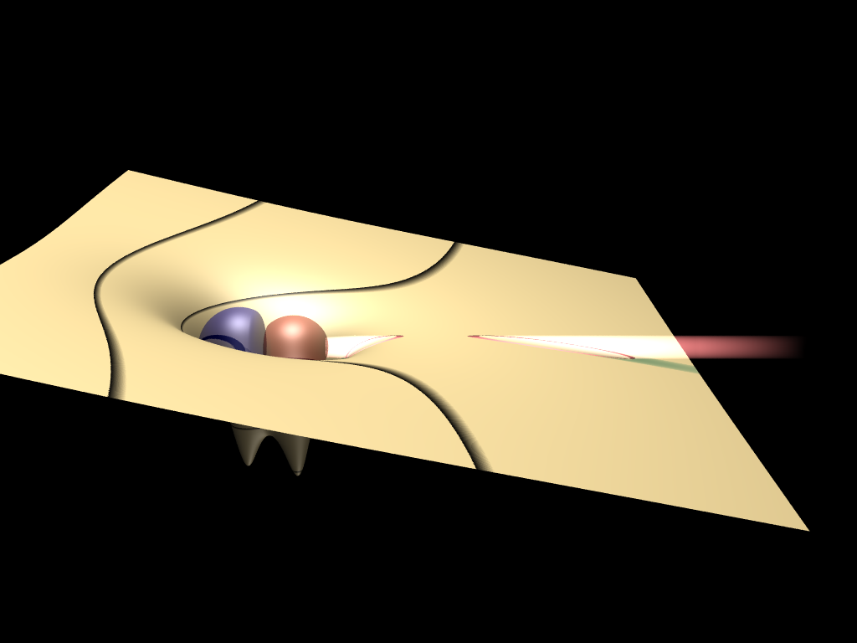
Ionization in atomic and solid state physics.
Paul Corkum
Joint Attosecond Science Lab
University of Ottawa and National Research Council of Canada
Tunneling –
A beam splitter for electrons!
L. V. Keldysh, Sov. Phys. JETP 20, 1307 (1965). "Ionization in the field of a strong electromagnetic wave" (solids and gases)

Slide 2
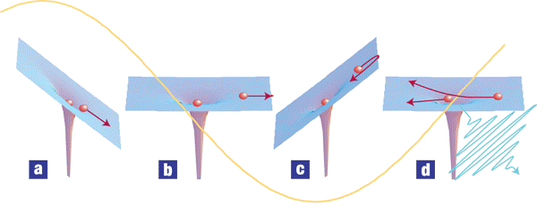

Completing the ionization event
– the fundamental attosecond idea
Removing
the electron
F=ma
Recombination
hν=25 eV
hν=100 eV

Slide 3
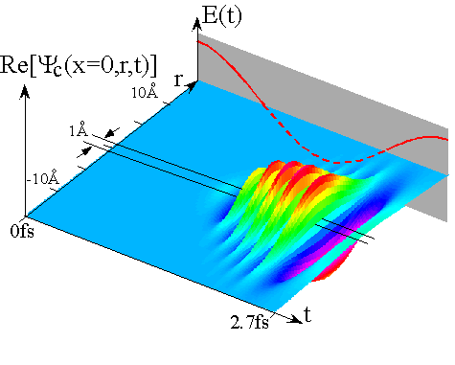
An Atto-Nano e-beam
Nature, 417, 917, (2002)

Slide 4
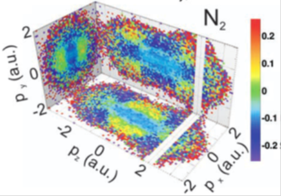
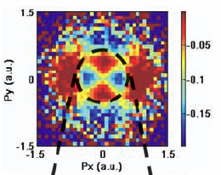
An atom or molecule probes itself.
The re-collision electron diffracts from the parent ion.
Tunnelling is like a filter through which an orbital can be viewed.
N₂ as seen by Laser Induced Electron Diffraction
Orbital structure of O₂ as seen by tunnelling
Probing quantum systems from the inside

Slide 5
Completing the ionization event – re-collision
overlap
Delay line
Ψ_{g}
30 Å
Beam splitter
Keldysh’s idea produces a (nonlinear) interferometer made from a molecule’s electrons

Slide 6
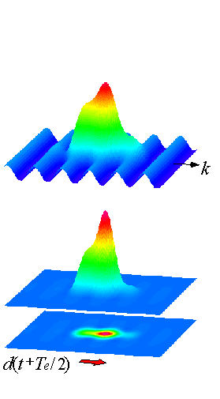
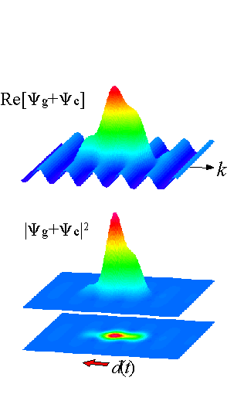
Reading the interferometer; Producing high harmonics/attosecond pulses
Amplitude and phase of the re-collision electron is transferred to light through d(t).
λ_{e}~0.1-3Å
λ_{p}~10-1000Å
Notes:
6

Slide 7
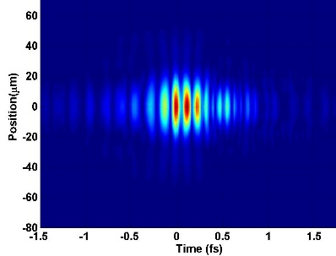
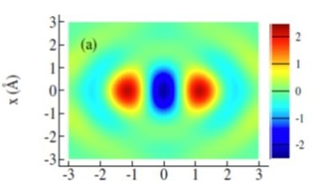
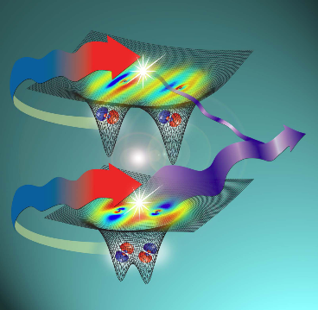
The emitted light tells us about the self-probing electron
We can make measurements of all of the wave packets involved!
re-collision electron (and attosecond pulses)
molecular orbitals
molecular dynamics
Probing quantum systems from the inside

Slide 8
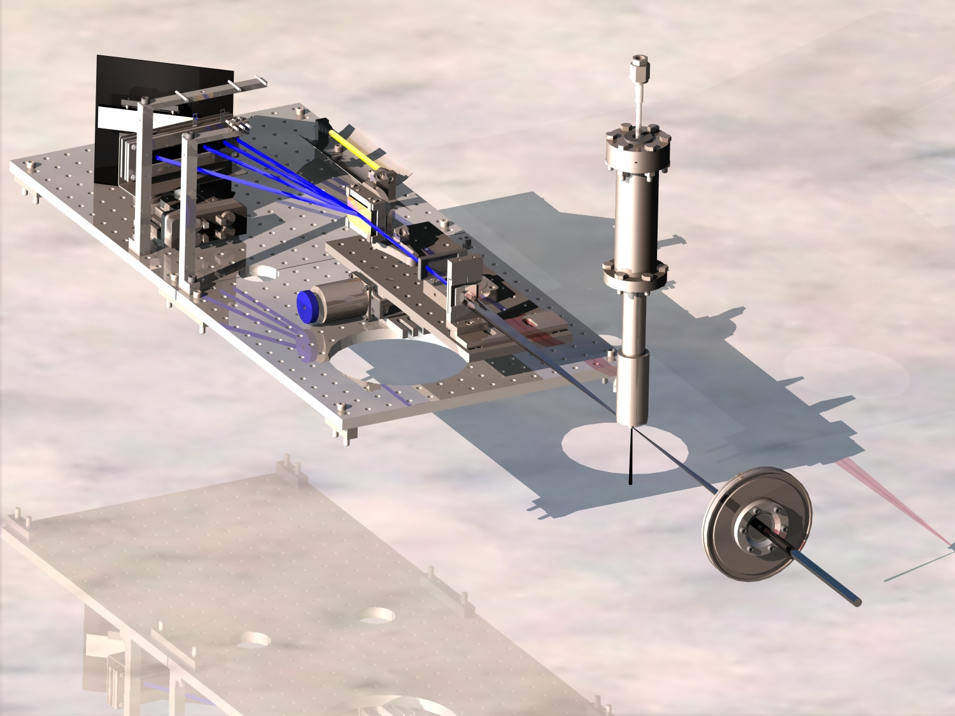

The system
25 eV
50 eV
800nm

Slide 9
Review since the laser
– A story of two nonlinear theories
The world’s shortest light flashes
Laser based source of X-rays
Self-probing, including imaging orbitals
Perturbative nonlinear optics involves just a few photons

Slide 10

Keldysh’s 1965 paper treated atoms and solids together. In momentum-energy language, gas harmonics are created by transitions between two bands:
– one the massive holes; the other the electrons.
energy
momentum
Re-collision harmonics
d(t) is a two-band transition effect.

Slide 11
Two-band harmonic emission – simulation and recollision.
White – Energy as a function of phase
Obtained using semi-classical electron-hole trajectory moving with band corrected mass
Harmonic #
Phase
Vampa et al, PRL 113, 073911, (2014)
Vampa et al, PRB 91, 064302 (2015)

Slide 12
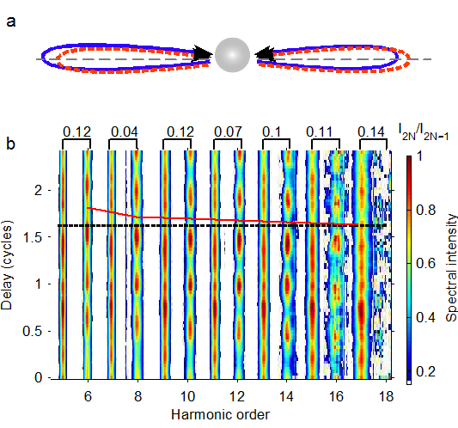
Experiment – In-situ measurement of harmonics generated from ZnO
Note: Typical HHG pulse duration = 1.7 fs
I_{ω}=10¹² W/cm²; I_{2ω}=10⁷ W/cm²
Vampa et al, Nature, 522, 462 (2015)

Slide 13
From identifying the process
To measuring band structure

Slide 14
Reconstructed k-dependent band difference --
Photoelectron spectroscopy in reverse
Simulated spectrum for ZnO
Vampa et al, PRL. 115, 193603 (2015)

Slide 15
Summing up:
Re-collision seems to be more general than many of us thought.
There is a lot left to be learned about competing mechanisms in solids.
Two color (2-D) measurement can:
  characterize pulses
  distinguish the underlying physics
  characterize media (from orbitals to band structure)

Slide 16
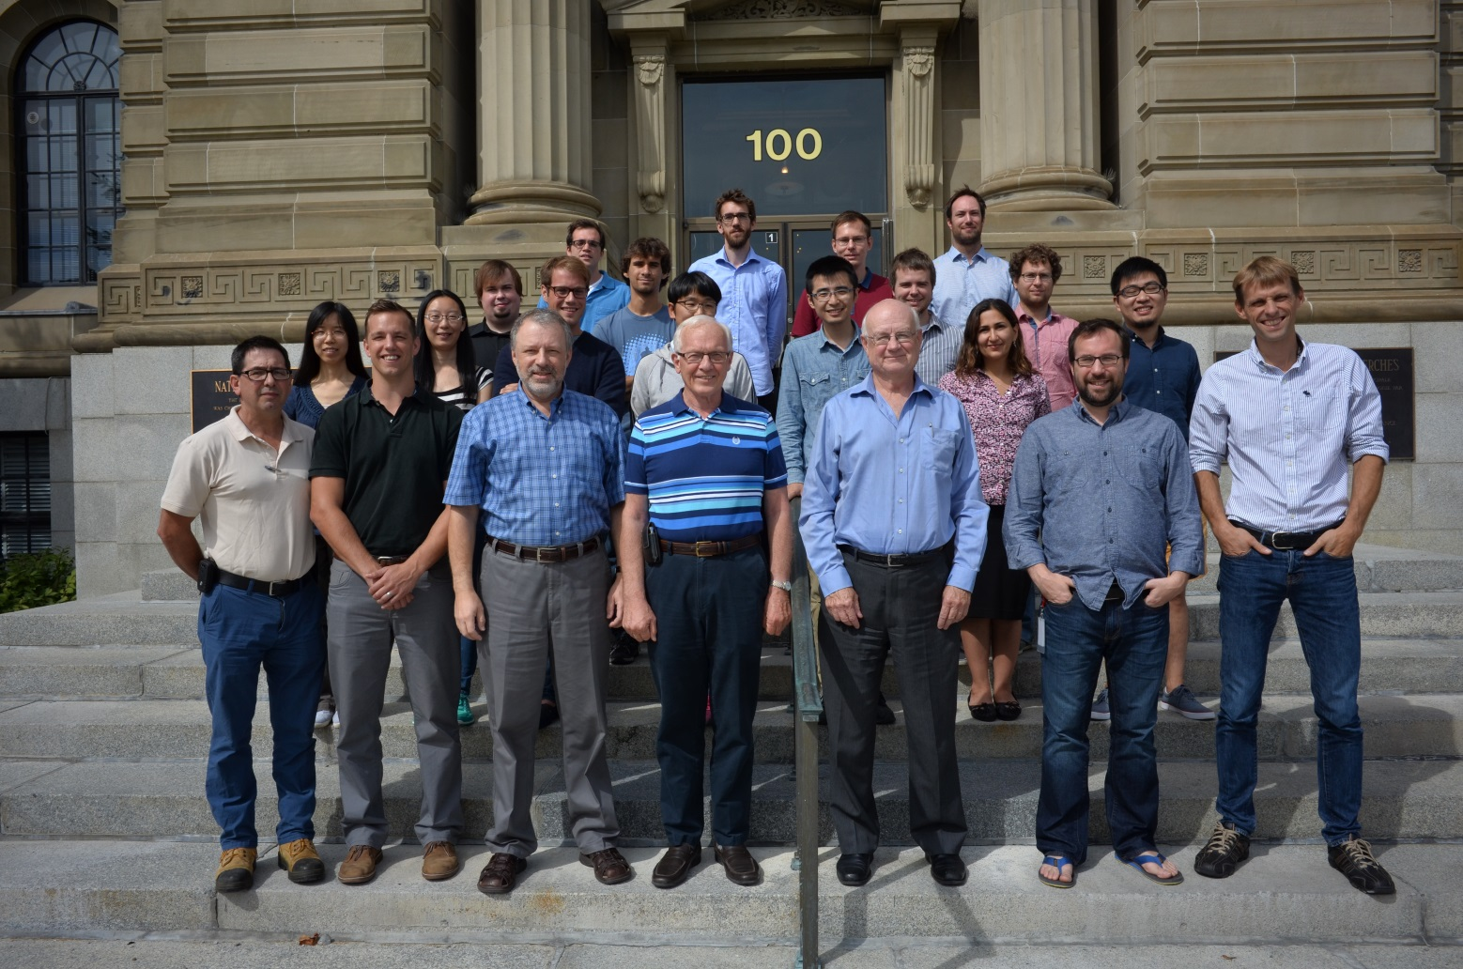
JASLab group 2015
Canada, China, France, Germany, Italy, Iran, Korea, USA
Funds:
NRC
NSERC
CRC
CFI/ORF
US AFOSR
US Army
US DARPA

