Slide 1
Why compute? Robert Rosner Depts. of Astronomy & Astrophysics and Physics The University of Chicago Nat Fisch Festschrift Princeton Plasma Physics Laboratory Princeton, NJ 30 March 2016

Slide 2
Setting the stage: the core question to be answered
Computational fluid dynamics (CFD) differs from most of the rest of theoretical physics in the fundamental sense that appeal to fundamental principles – “first principles” – is not always possible …
This means that CFD must proceed – in cases where a first principles approach cannot be carried through – by constructing “models” that necessarily replace what we cannot as yet capture from a fundamental understanding of the physics.
Indeed: The non-dimensional numbers characterizing most macroscopic fluid dynamical phenomena are sufficiently large that “direct” numerical simulations describing these phenomena – for terrestrial or astrophysical fluids – are not just difficult – they are most likely even in principle impossible.
Despite this inconvenient fact, modern CFD clearly revels in numerically modeling such phenomena – from the Earth’s atmosphere and oceans to stars. The skeptical observer might well ask, “to what effect?”
This is the question I’d like to address during this talk.
Notes:
Comment about Saha: astrophysics got started via spectroscopy and QM … and the success in these realms perhaps encouraged an optimism about doing similarly in realms where the translation from terrestrially-experienced physics and the physics of space may not be so straightforward …

Slide 3
Let’s get specific!
The connections between the range of spatial/temporal dynamic scales of fluid dynamical processes, the Reynolds numbers, and “turbulence” are well-understood:
Start with Navier-Stokes
ρdv/dt = p + ρg + (1/Re) ² v
The Reynolds number-spatial range scaling goes as:
Re ~ 2 (L_{max}/L_{min})^{4/3}, where Re = uL/ >> 1 ( the viscosity)
In the real world
Fully developed turbulence in laboratory experiments typically appears at Re ~ 10,000-20,000; this corresponds to L_{max}/L_{min} ~ 600-1000
For a large ship (viz., QE2), Re > 10⁹,
For the atmosphere (u ~ 10 m s⁻¹, L ~ 1 km, ~ 1.5 x 10⁻⁵ m² s⁻¹), Re >> 10⁸
For typical astrophysical plasmas, L_{max}/L_{min} >> 10^{4.5} , i.e., Re >> 10⁶
In the computational world, the largest currently feasible uniform grid calculations have L_{max}/L_{min} ~ 10^{3.5}
This corresponds to Re ~ 9 x 10⁴ for the most ambitious calculations
We conclude:
Direct numerical simulations can capture the onset of (some!) laboratory turbulence
Direct numerical simulations can not capture most terrestrial or astrophysical fluid behavior
Δ
Δ
μ
μ
μ
Notes:
A lab example of turbulence at Re ~ 10,000-20,000 includes plumes
SO: WHY DO WE DO ASTROPHYSICAL SIMULATIONS???????

Slide 4
Computational (physical) science in a nutshell … is it physics, or is it engineering, or … ?
Computational domain
Subgrid models
Direct numerical simulation
(‘DNS’)
Dimensionless
spatial/temporal scale
Physically
smallest
scale
Smallest
‘DNS’
scale
Physically
largest
scale
The subgrid models describe physical processes which cannot be captured from first principles by the simulation – either because of limitations on the dynamic range of the calculation, or because the small-scale physical processes are not well understood … and often this is done in an informal, implicit way … for example, we solve
Dc/Dt = κ_{effective}∇²c

Slide 5
Such issues are commonplace in computational science …
Many domains of fluid dynamics share the difficulty that calibrating models via experimentation (in the traditional sense of the engineering sciences) is either not possible or extremely difficult …
Prominent examples in the natural sciences include
Astrophysics
Climate modeling: atmospheric and ocean sciences
Systems-level engineering
Loss-of-coolant (LOC) nuclear reactor accident scenarios …
‘Science-based Stockpile Stewardship’

Slide 6
In any event, the key question is always …
Is it in principle possible to calibrate the model parameter(s)?
If yes: How?
This is “tuning” the dials on the model …
With sufficient calibration data, we can then construct model errors, and use the calculations to predict the system’s evolution ...
If maybe: It could be possible to tune parameters under present conditions, but perhaps not as the system evolves into the future …
In that case, we will not be able to construct model errors for computational results well into the future …
That is, we will not be making predictions, but constructing “scenarios” ...
If no: We cannot predict – meaning, we cannot bound model errors.
In that case, the usefulness of the calculations must rest on grounds other than “prediction” ...
My claim: In the latter two cases, computations can nevertheless provide a “third path”, i.e., a way of supplementing observations/experimentation and theory, and in some cases lead to scientific discovery … as I’ll now illustrate ...

Slide 7
Let me then turn to …
Two examples
A heavy fluid overlying a lighter fluid: Rayleigh-Taylor instability …
Explosive nucleosynthesis: Type Ia supernovae …
I’d like to answer the question:
In each of these 2 cases, in what ways do computer simulations help our understanding of the physical phenomena under study?

Slide 8
Rayleigh-Taylor instability
Work led by G. Dimonte, in collaboration with the “alpha” collaboration

Slide 9
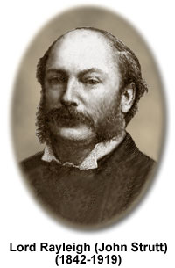
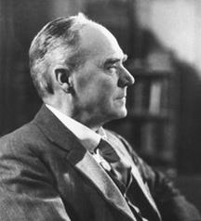
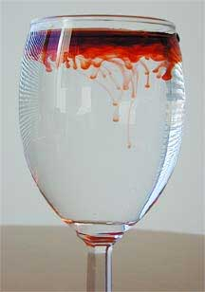
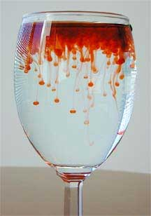
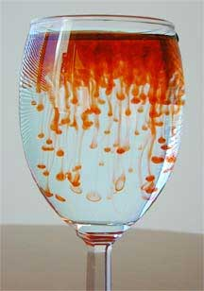
A bit of history, about an instability which looks simple, but is really quite complicated …
The instability of a heavy fluid lying on top of a light fluid
First studied by Lord Rayleigh
Linear theory fully worked out by G.I. Taylor
Non-linear (analytical) theory first described by D. Layzer (published finally in the mid1950s), working w/ John Wheeler at Princeton …
Heavy fluid
gravity
Light fluid
J. Riordon (2010)

Slide 10
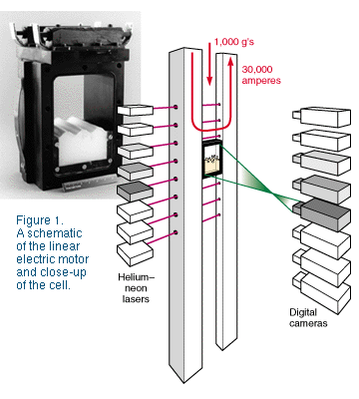
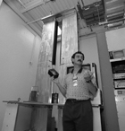
The experiment …
The ‘alpha group’ code focused on the nonlinear evolution of the Rayleigh-Taylor (R-T) instability, with highly reproducible initial conditions
Heavy fluid
g
Light fluid
Guy Dimonte
Linear Electric Motor (LEM), or rail gun

Slide 11
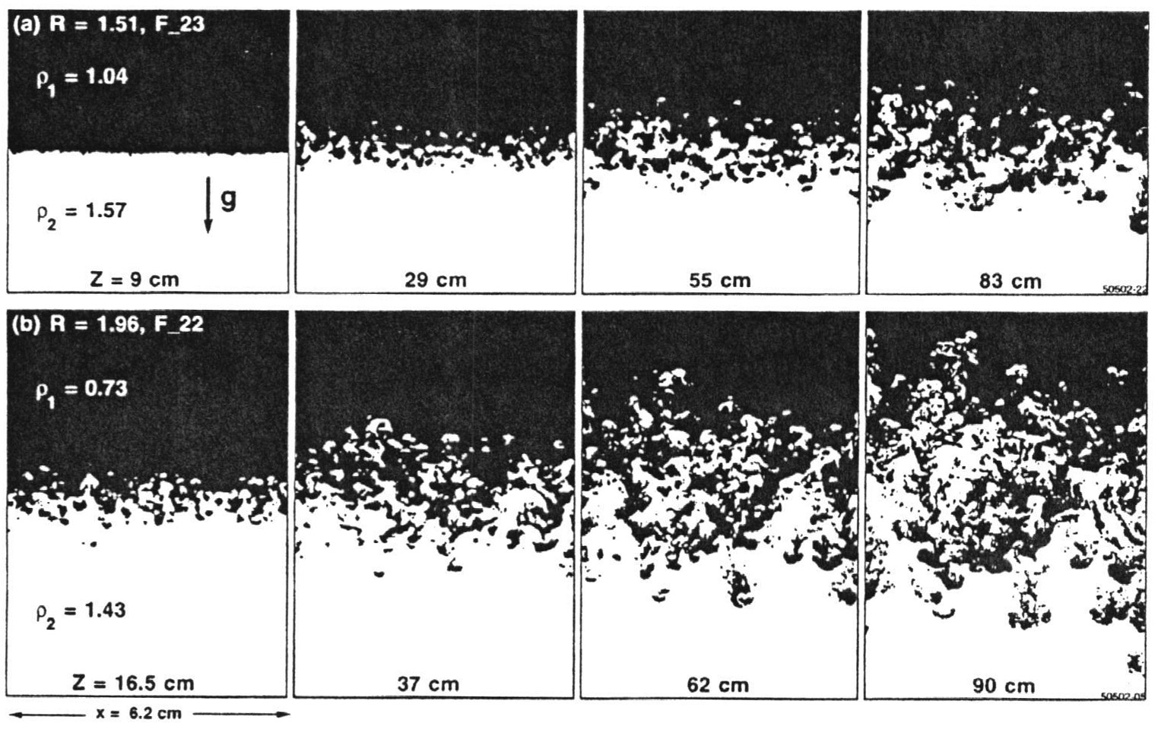
The idea of the “alpha collaboration” …
Guy Dimonte designed the experiment, and carried it out. He measured the width of the mixing zone as a function of time.
Six different code groups simulated this experiment, and computed the mixing layer width as a function of time
We then compared (by overlaying transparent foils/viewgraphs)
The 6 code results
The 6 code results with the experimental data
h(t)
The mixing layer width: h ~ αgAt² g = gravitational acceleration
A ~ “density ratio”

Slide 12
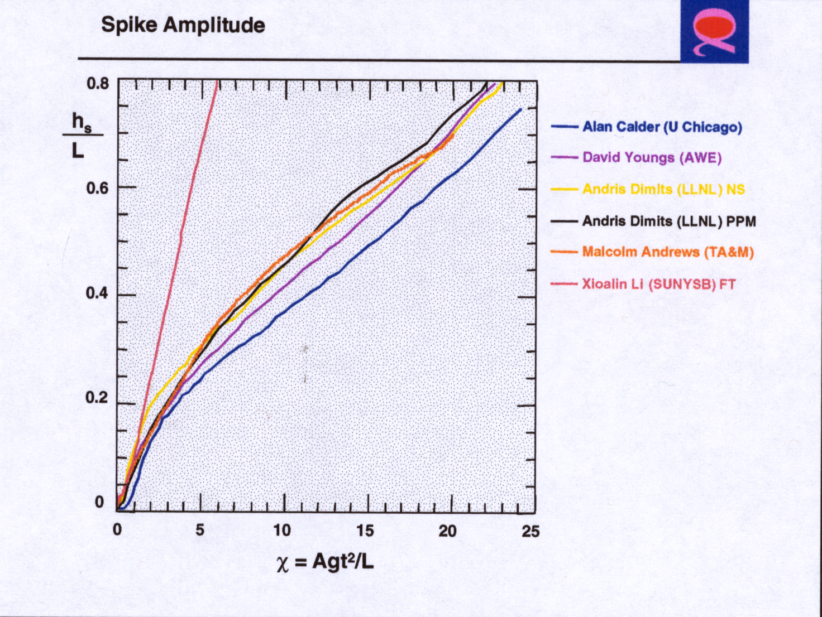
The results:
A Comparative Study of the Turbulent Rayleigh-Taylor (RT) Instability Using High-Resolution 3D Numerical Simulations: The Alpha-Group Collaboration Dimonte, G., Youngs, D.L., Dimits, A., Weber, S., Marinak, M., Wunsch, S., Garasi, C., Robinson, A., Andrews, M.J., Ramaprabhu, P., Calder, A.C., Fryxell, B., Biello, J., Dursi, L.J., MacNeice, P., Olson, K., Ricker, P., Rosner, R., Timmes, F.X., Tufo, H., Young, Y.-N., & Zingale, M. 2004, Phys. Fluids, 16(5), 1668-1693.

Slide 13
Unfortunately: Successful comparison of codes cannot increase confidence in the results …
… but it can identify specific issues in the physics that we’re all not getting right ...
In the case at hand, what was realized is that
We were systematically underestimating the “driving force” once the system became nonlinear …
Since the driving force was buoyancy, we were underestimating the effective density contrast ...
… and the most likely reason was that material diffused (our 2 fluids were miscible ...) as fingers interpenetrated, and thus reduced the density contrast that falling and rising fingers “saw” ...
Thus: we need to reduce the “subgrid” diffusion to values consistent with experiment – for example, via interface tracking ...
Thus, simulations can inform our understanding of physical processes that matter in describing nature …

Slide 14
Type Ia supernovae
Work led by T. Plewa, in collaboration with the Flash Center group

Slide 15
The “standard model” for Type Ia SNe …
R. Hynes (2000)
Thermonuclear explosions in the cores of white dwarfs in close binary systems.
Due to accretion, white dwarf approaches Chandrasekhar mass, and a thermonuclear runaway ensues.
Pure detonation would burn everything to Ni, but since intermediate mass elements are also found, models must include a deflagration phase, and therefore there must be a Deflagration-to-Detonation transition (a DDT).

Slide 16
The physics ingredients are wide-ranging and complex …
EOS for degenerate matter
Initiation of interior convection
Nuclear Energetics: ¹²C+¹²C ²⁴Mg;
²⁴Mg, ¹⁶O NSQE NSE
Flame model
Ignition
DDT/deflagration-detonation sequence
Neutrinos energy loss, ΔY_{e} (neutronization)
Complete models would also include:
Realistic progenitor models
Magnetic fields
Rotation
The ‘players’: T. Plewa, A.C. Calder, D.Q. Lamb, B.O. Messer, J.W. Truran
Prior to the ASC/Flash Center simulations, all Type Ia calculations inserted an ad hoc deflagration-to-detonation transition (DDT)
Notes:
Flame model derived from models of chemical flames, based on ‘pre-mixed’ combustion

Slide 17
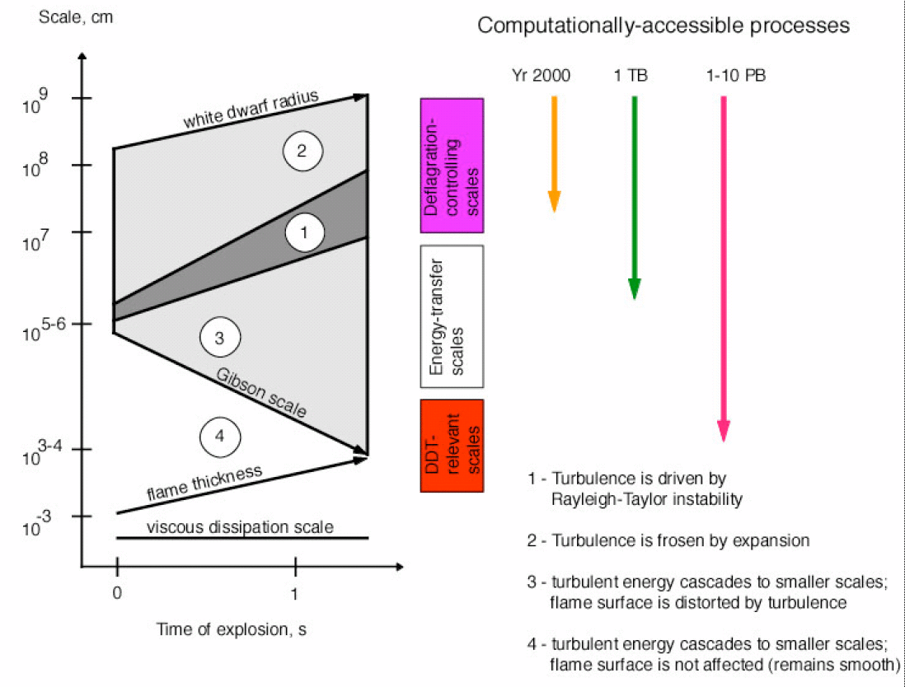
Length scales in white dwarf deflagration…
Computationally-accessible processes
Before
2000
2005
BG/L
BG/P
1- Turbulence is driven by
Rayleigh-Taylor instability
BG/Q (now)
2- Turbulence is frozen by expansion
3- Turbulent energy cascade to smaller scales; flame surface distorted by turbulence
4- Turbulent energy cascade to smaller scales; flame surface is not affected (remains smooth)

Slide 19
What was discovered?
The importance of off-center ignition …
The vigorous localized excitation of surface gravity waves upon burst-out of the flame bubble …
The first-ever fully consistent deflagration/detonation of a white dwarf
No ‘deus-ex-machina’ deflagration-detonation
Shock formation at the antipode of the flame bubble emergence, and consequent re-ignition and detonation of entire star: here there is no strict “DDT” …
Opens the way to a systematic exploration of the ‘scenario’, based on detailed comparisons with astronomical observations
Thus, simulations can, despite reliance on modeling of physics that cannot yet - or perhaps ever - be “directly” simulated,
Build our physical intuition about phenomena that are too complex to be fully grasped by analytical methods
Allow for discovery of new phenomena and new phenomenologies

Slide 20
What can we conclude?
Computer-based simulations can serve many different purposes …
The ‘usual’:
Science-based prediction …
Design: rapid prototyping and optimization …
The less-expected:
Discovery: Uncovering unsuspected physical effects …
Discovering novel behaviors of highly complex multi-physics systems
Intuition-building:
Quantitative exploration of ‘arm-chair experiments’, in cases for which laboratory (or any other) experimentation is not feasible …
Exploring “what if’s”:
What if the laws of physics were different?
What if the constants of nature are not constant?
…

Slide 21
And that brings us to …
Questions and Discussion

