Slide 1
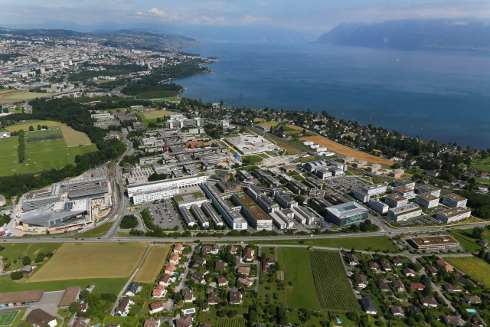

Basic aspects of fast ion transport in burning plasmas
Ambrogio Fasoli
F. Avino, A. Bovet, I. Furno, K. Gustafson,
P. Ricci, C. Theiler
Swiss Plasma Center (SPC)
École Polytechnique Fédérale de Lausanne, Switzerland
Solved and Unsolved Problems in Plasma Physics
Symposium in honor of Nathaniel J. Fisch

Slide 2
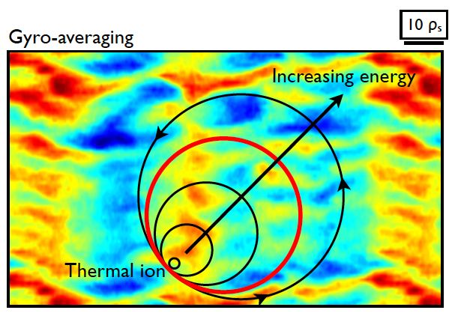
Fast ion transport in burning plasmas
A key feature of the burning plasma regime is the self-heating process via the suprathermal α-particles
In addition to (resonant) low and high frequency coherent modes, turbulence could cause transport of fast ions
Large fast ion orbits are expected to
average out the effect of turbulence,
depending on E_{fast}/T_{e}
The verification of the orbit averaging effect and of the character of the fast ion transport is a basic plasma physics questions of general interest
2

Slide 3
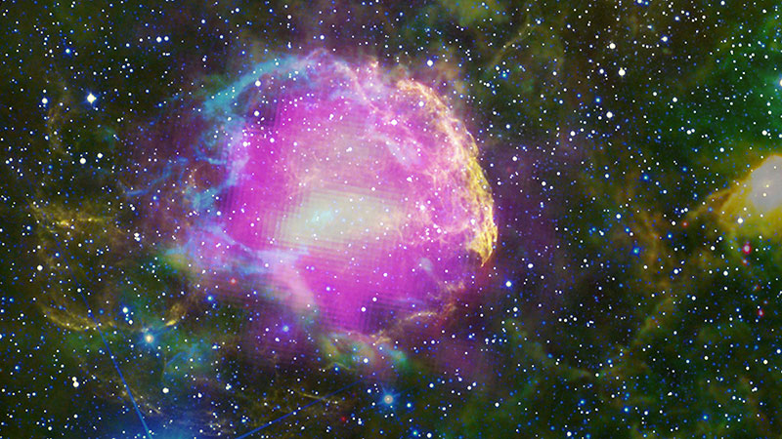
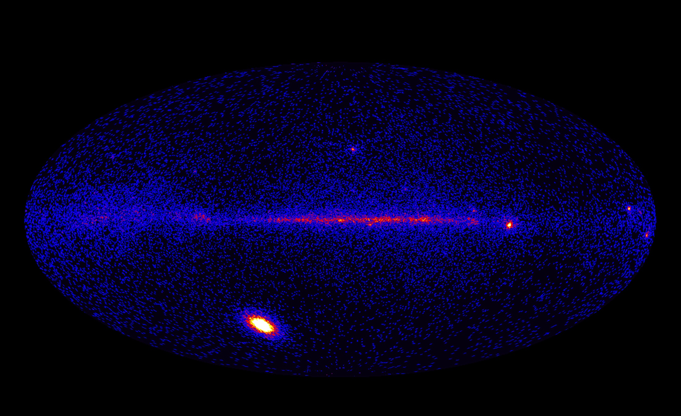
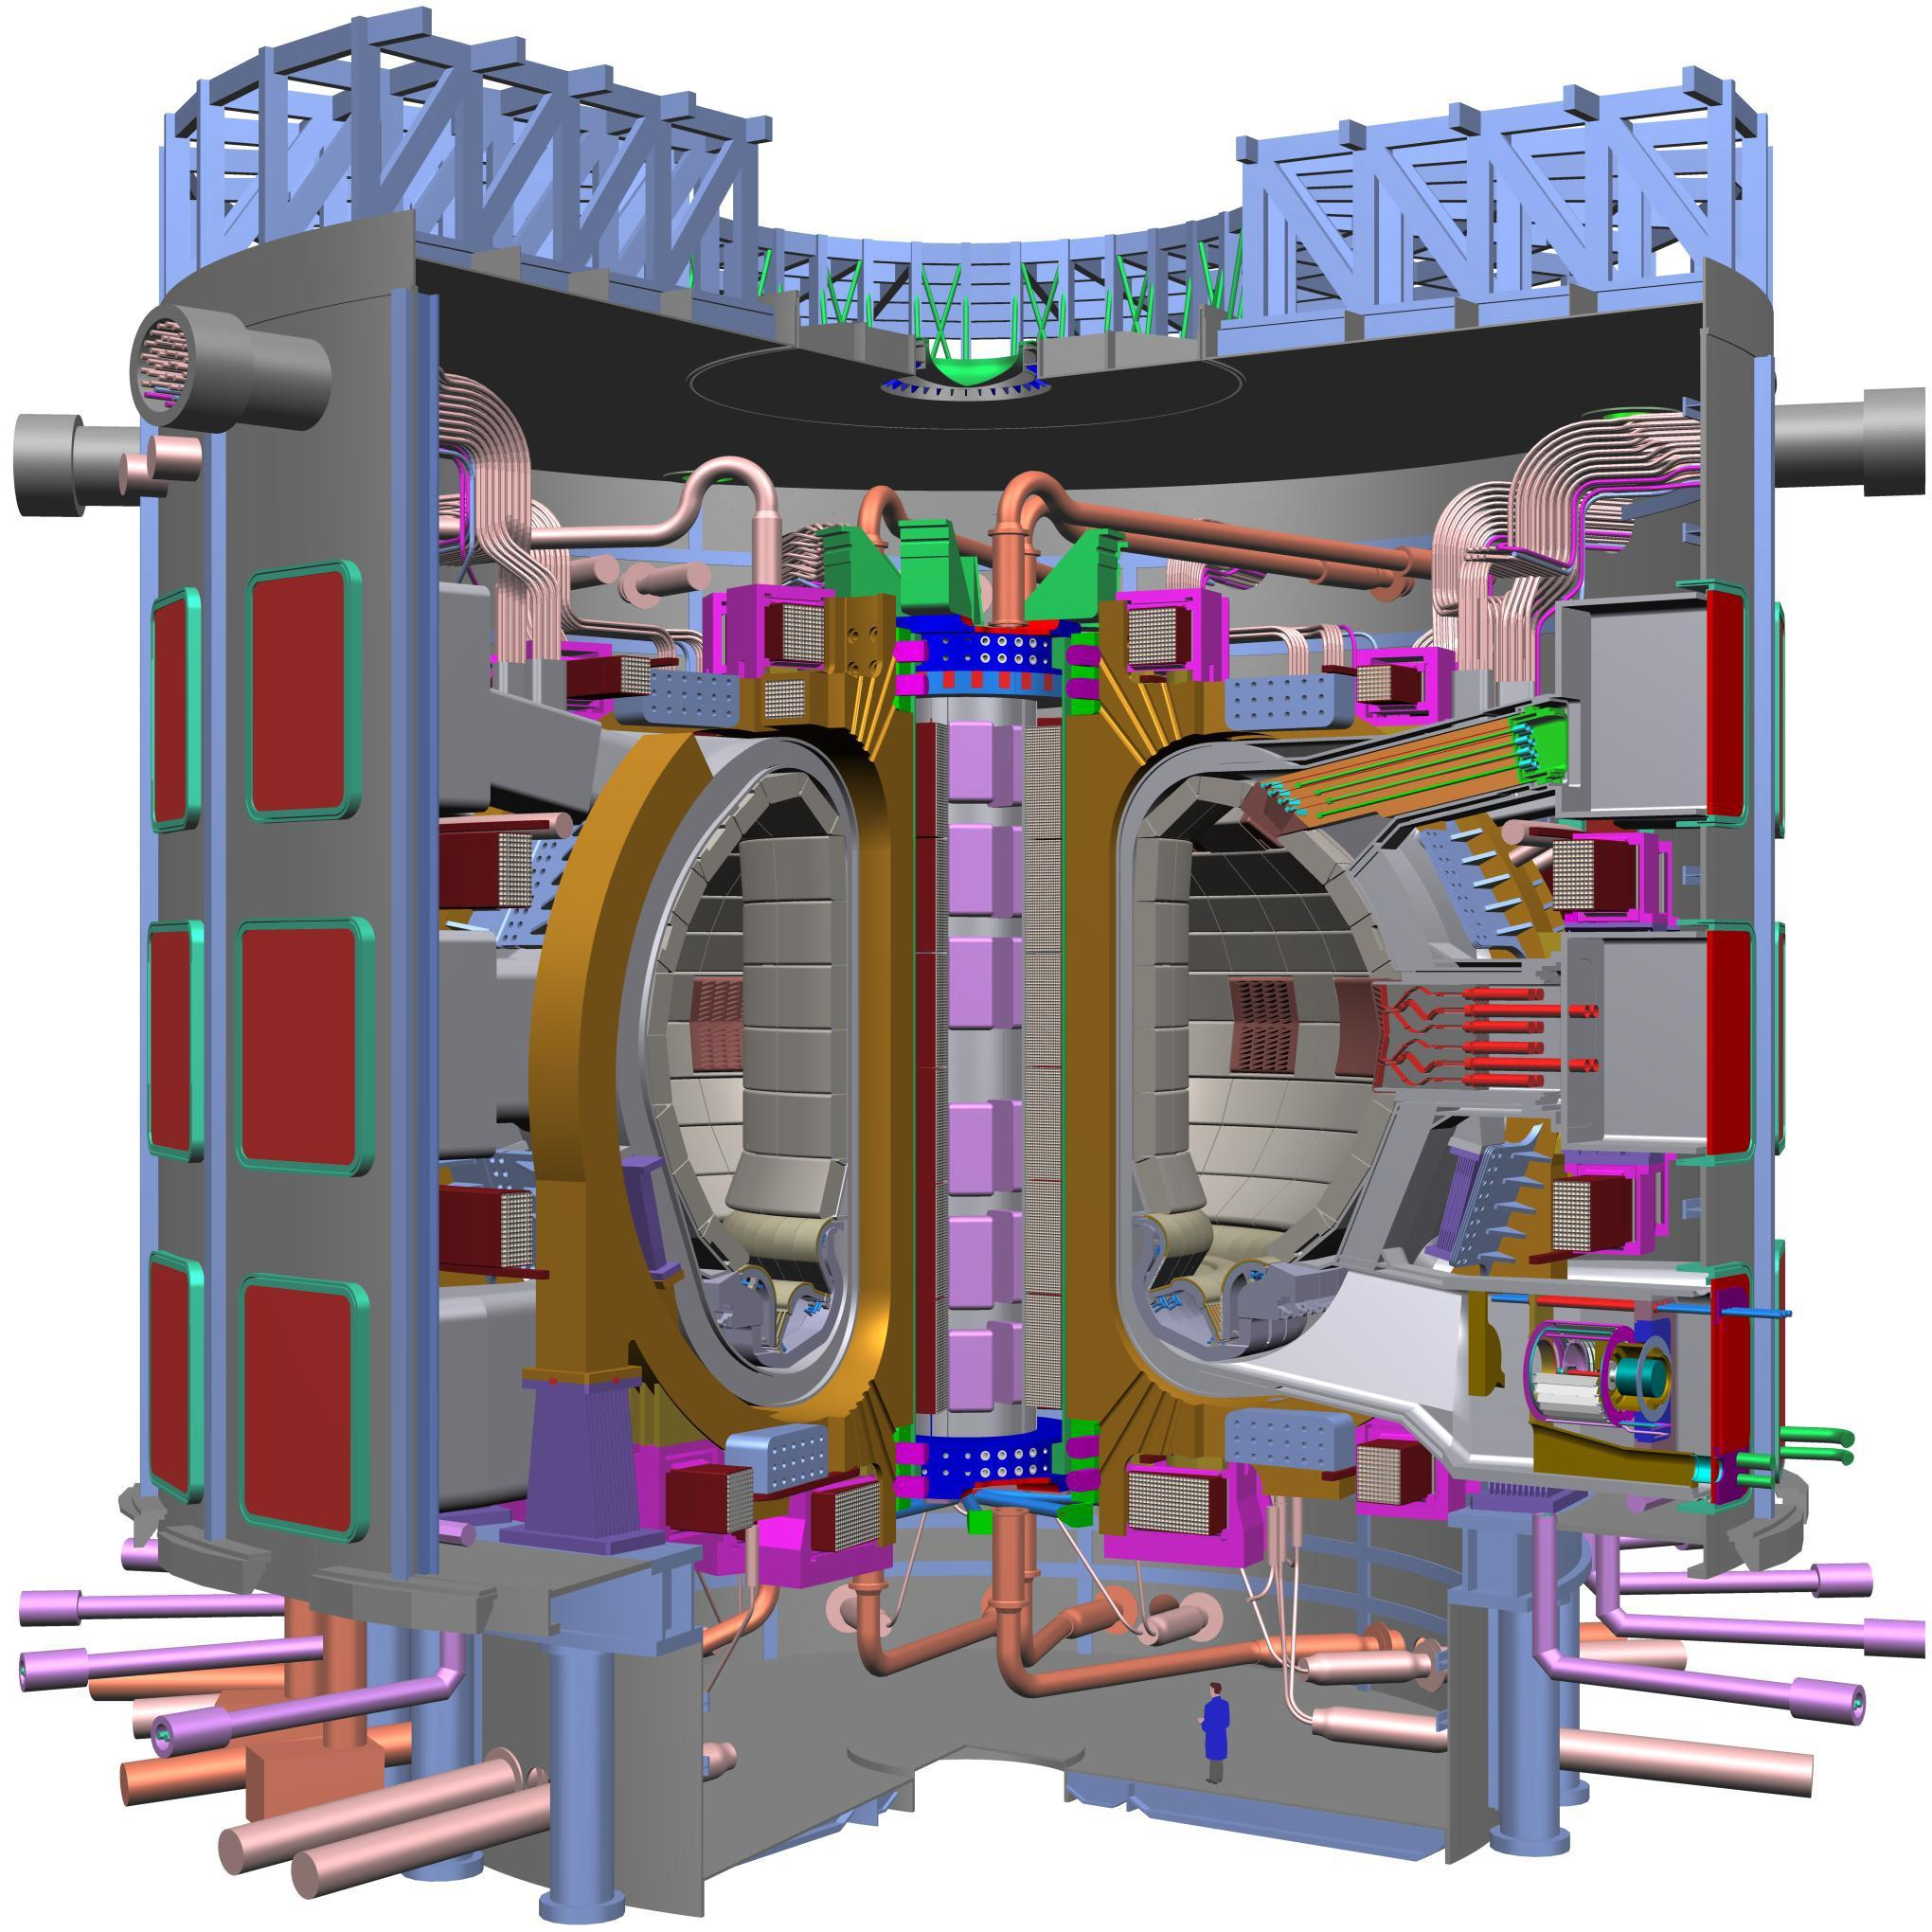
Transport and acceleration of fast ions in turbulent plasmas may occur in different physical systems
Supernova remnants accelerate protons to ~c
Solar flares accelerate protons to ~2/3c in less than 3s
ITER: 100MW of 3.5MeV α’s and 50MW of 1MeV ions
T_{plasma}~1keV; E_{fast}>100MeV; B~10⁻⁷ T
T_{plasma}~20keV; B~5T
3
Notes:
https://www.nasa.gov/mission_pages/GLAST/news/supernova-cosmic-rays.html#.VtRtrxjnXdd
This multiwavelength composite shows the supernova remnant, the Jellyfish Nebula. Fermi GeV gamma-ray emission is shown in magenta, optical wavelengths as yellow, and infrared data from NASA's Wide-field Infrared Survey Explorer (WISE) mission is shown as blue (3.4 microns), cyan (4.6 microns), green (12 microns) and red (22 microns). Cyan loops indicate where the remnant is interacting with a dense cloud of interstellar gas. Credit: NASA/DOE/Fermi LAT Collaboration, NOAO/AURA/NSF, JPL-Caltech/UCLA
The supernova remnant IC 443, popularly known as the Jellyfish Nebula, is located 5,000 light-years away toward the constellation Gemini and is thought to be about 10,000 years old. W44 lies about 9,500 light-years away toward the constellation Aquila and is estimated to be 20,000 years old. Each is the expanding shock wave and debris formed when a massive star exploded.
SUN http://www.nasa.gov/mission_pages/GLAST/news/highest-energy.html
This image from Fermi's Large Area Telescope (LAT) shows how the entire sky looked on March 7 in the light of gamma rays with energies beyond 100 MeV. Although the Vela pulsar is the brightest continuous LAT source, it was outmatched this day by the X5.4 solar flare, which brightened the gamma-ray sun by 1,000 times.
Flares and other eruptive solar events produce gamma rays by accelerating charged particles, which then collide with matter in the sun's atmosphere and visible surface. For instance, interactions among protons result in short-lived subatomic particles called pions, which produce high-energy gamma rays when they decay. Nuclei excited by collisions with lower-energy ions give off characteristic gamma rays as they settle down. Accelerated electrons emit gamma rays as they collide with protons and atomic nuclei.

Slide 4

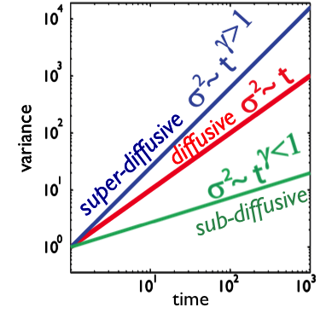

Diffusive and non-diffusive transport
variance
Which regimes (and determined by which physics) for fast ions in turbulent plasmas?
A simple ‘interdiscipinary’ question à la Nat Fisch ….
4

Slide 5
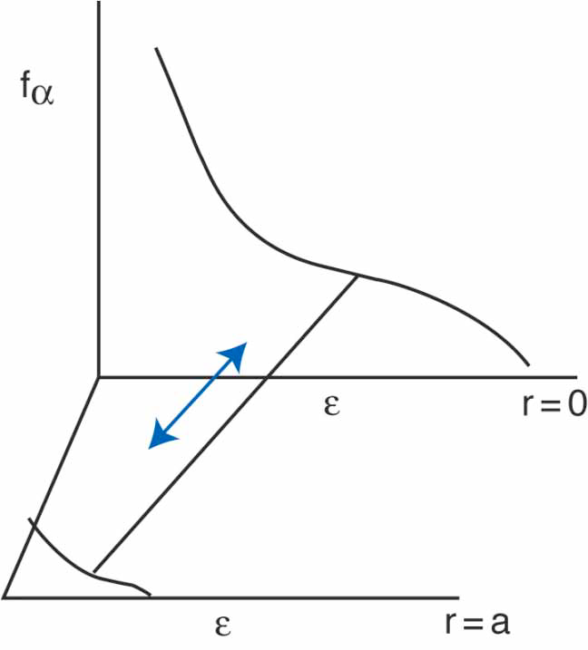
Transport and acceleration of fast ions in turbulent plasmas may occur in different physical systems
Supernova remnants accelerate protons to ~c
Solar flares accelerate protons to ~2/3c in less than 3s
ITER: 100MW of 3.5MeV α’s and 50MW of 1MeV ions
T_{plasma}~1keV; E_{fast}>100MeV; B~10⁻⁷ T
T_{plasma}~20keV; B~5T
Also of interest for Nat’s α-channeling scenarios?
N.J.Fisch and M.C.Herrmann
PPCF 1999
5
Notes:
https://www.nasa.gov/mission_pages/GLAST/news/supernova-cosmic-rays.html#.VtRtrxjnXdd
This multiwavelength composite shows the supernova remnant, the Jellyfish Nebula. Fermi GeV gamma-ray emission is shown in magenta, optical wavelengths as yellow, and infrared data from NASA's Wide-field Infrared Survey Explorer (WISE) mission is shown as blue (3.4 microns), cyan (4.6 microns), green (12 microns) and red (22 microns). Cyan loops indicate where the remnant is interacting with a dense cloud of interstellar gas. Credit: NASA/DOE/Fermi LAT Collaboration, NOAO/AURA/NSF, JPL-Caltech/UCLA
The supernova remnant IC 443, popularly known as the Jellyfish Nebula, is located 5,000 light-years away toward the constellation Gemini and is thought to be about 10,000 years old. W44 lies about 9,500 light-years away toward the constellation Aquila and is estimated to be 20,000 years old. Each is the expanding shock wave and debris formed when a massive star exploded.
SUN http://www.nasa.gov/mission_pages/GLAST/news/highest-energy.html
This image from Fermi's Large Area Telescope (LAT) shows how the entire sky looked on March 7 in the light of gamma rays with energies beyond 100 MeV. Although the Vela pulsar is the brightest continuous LAT source, it was outmatched this day by the X5.4 solar flare, which brightened the gamma-ray sun by 1,000 times.
Flares and other eruptive solar events produce gamma rays by accelerating charged particles, which then collide with matter in the sun's atmosphere and visible surface. For instance, interactions among protons result in short-lived subatomic particles called pions, which produce high-energy gamma rays when they decay. Nuclei excited by collisions with lower-energy ions give off characteristic gamma rays as they settle down. Accelerated electrons emit gamma rays as they collide with protons and atomic nuclei.

Slide 6
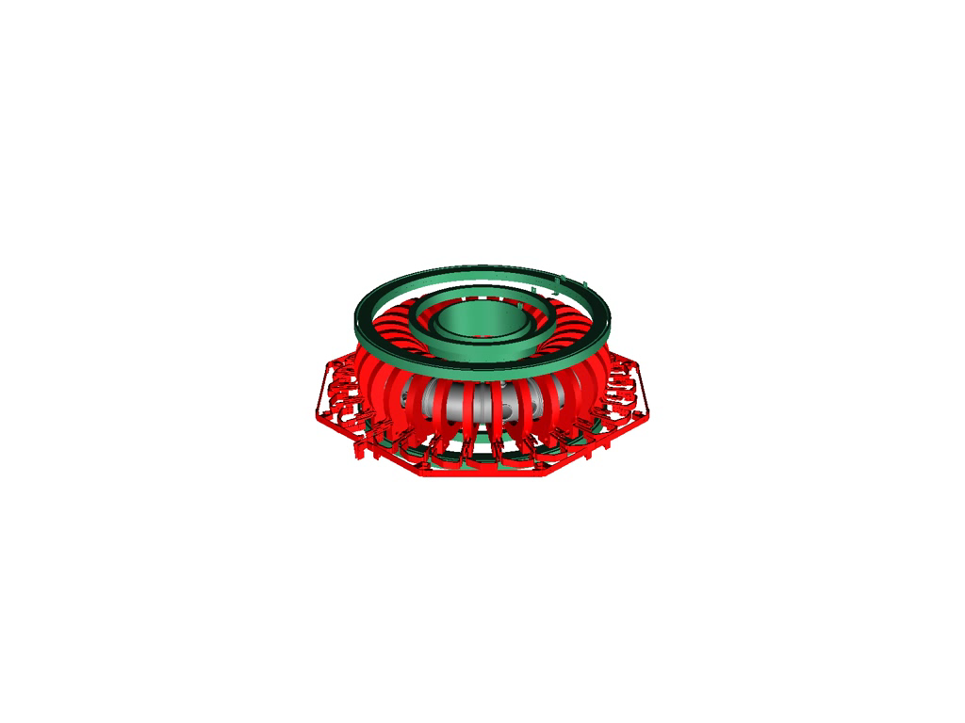
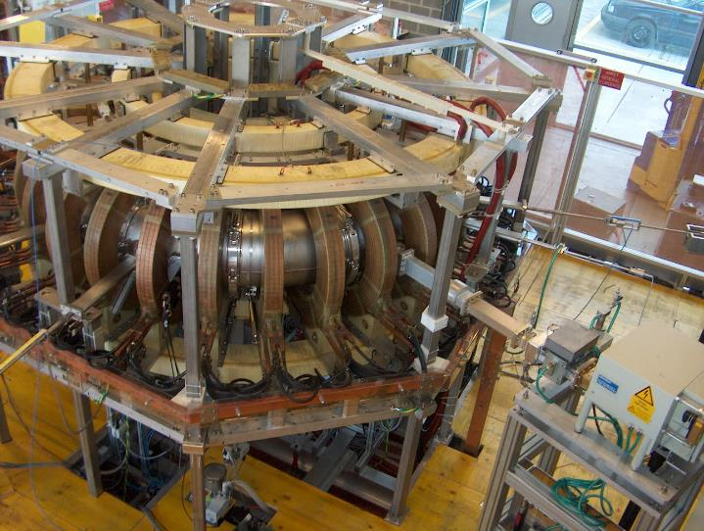
TORPEX and the simple magnetized torus
major radius = 1m, minor radius = 20cm
6

Slide 7
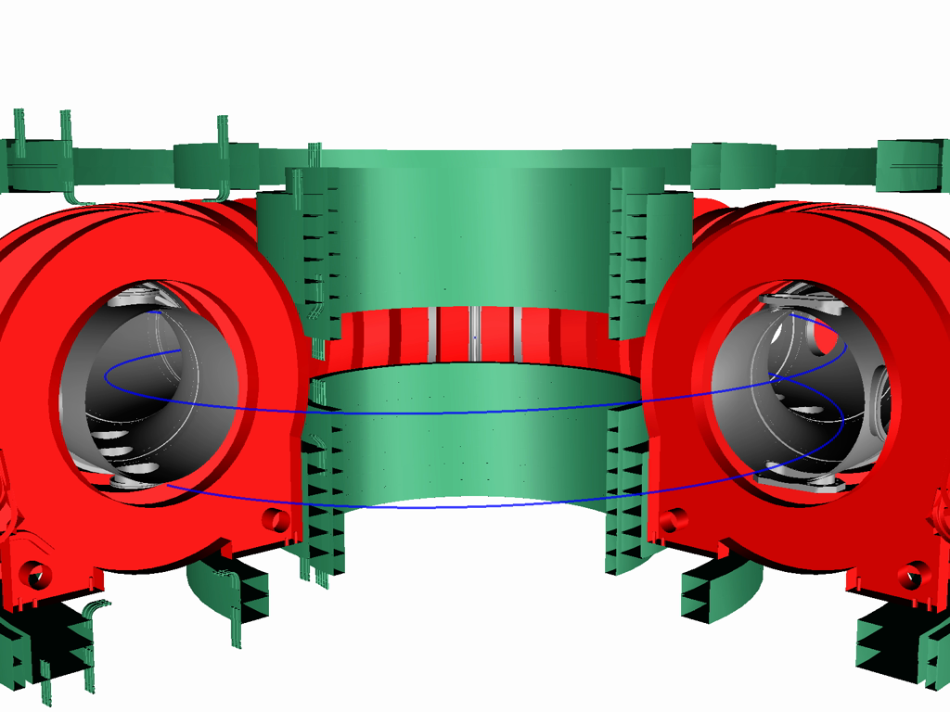
TORPEX and the simple magnetized torus
Helical field lines winding N times around the torus
open field lines, B and curvature
7

Slide 8
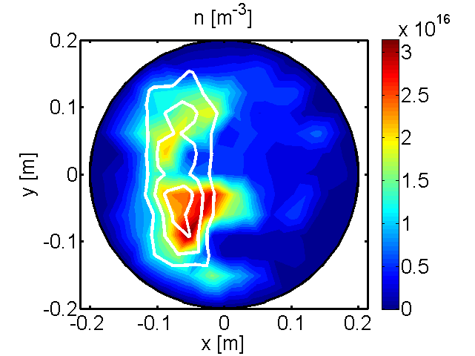
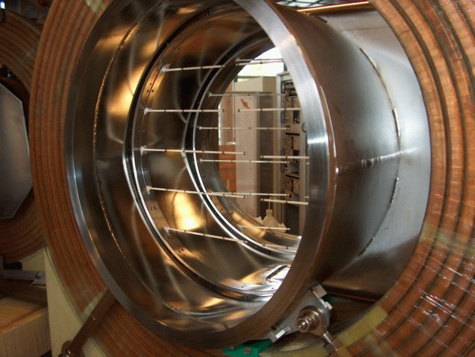
Experimental scenario
8

Slide 9
Experimental scenario
High field side
Low field side
9

Slide 10
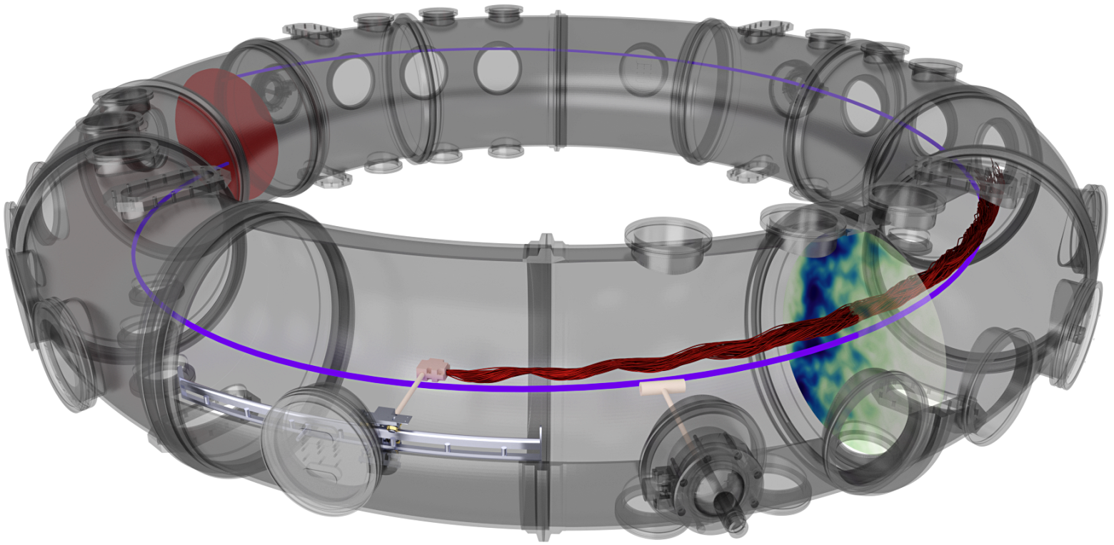
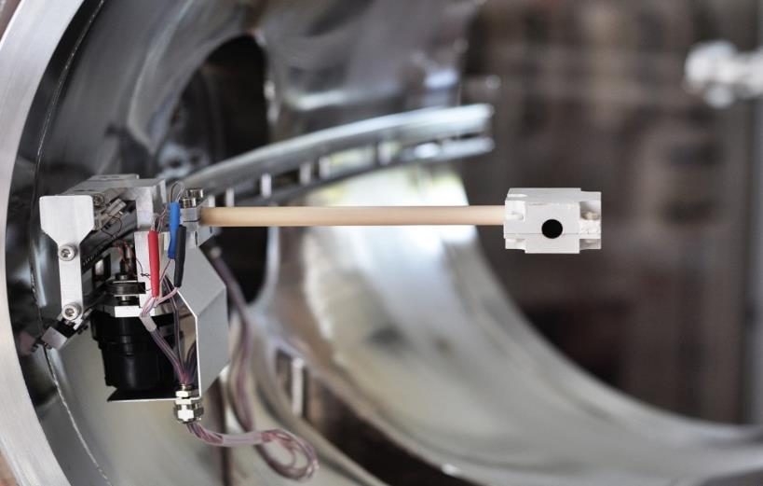
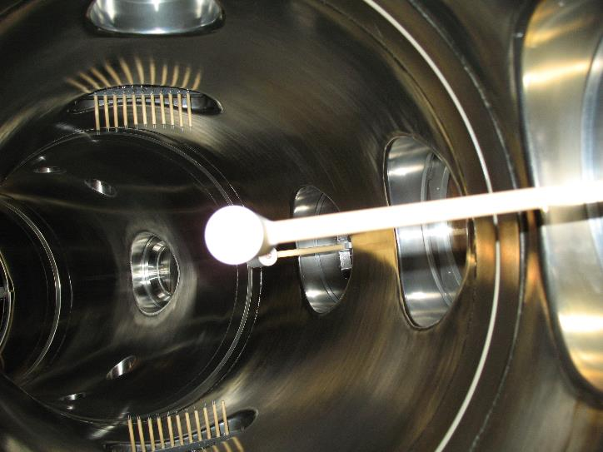
  Fast ion source and detector
Fast ion source
Gridded energy analyzer
y
Tracer Li6+ ions
10eV-1keV
x
Notes:
Thermo-ionic effect (~1200º); Ion current ~ 10μA; Lifetime ~ 20 h

Slide 11
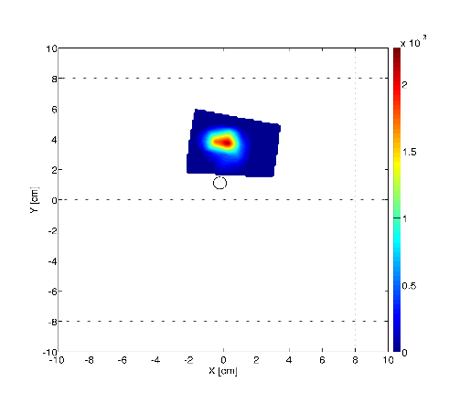
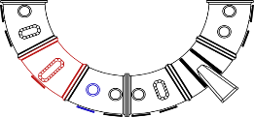
Time-averaged profile at two ion energies
E = 70 eV
E/T_{e} ≈ 46
Fast ion injection location
detector
Distance from the source = 0.2 m
source
11

Slide 12
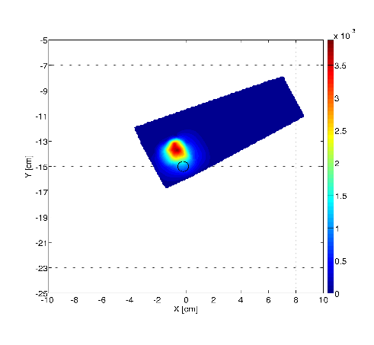
Time-averaged profile at two ion energies
E = 70 eV
E = 30 eV
E/T_{e} ≈ 46
E/T_{e} ≈ 20
Fast ion injection location
detector
Distance from the source = 0.2 m
source
12

Slide 13
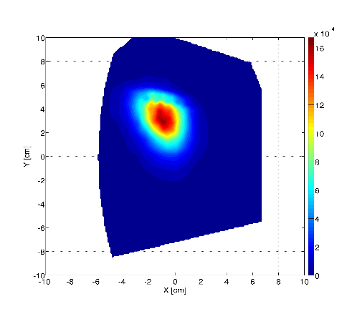
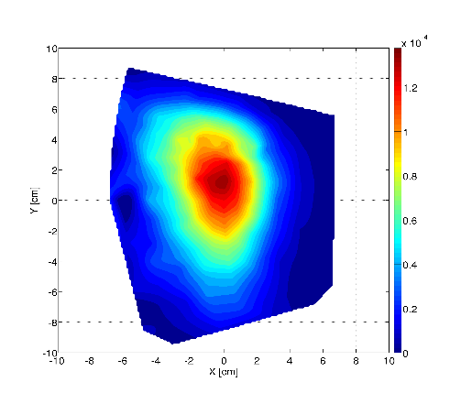
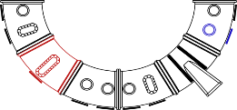
Time-averaged profile at two ion energies
E = 70 eV
E = 30 eV
E/T_{e} ≈ 46
E/T_{e} ≈ 20
detector
Distance from the source = 2.2 m
source
13

Slide 14
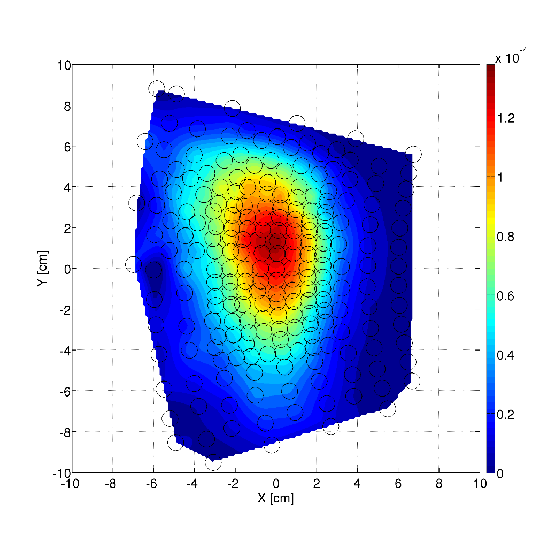
Time-averaged profile at two ion energies
E = 70 eV
E = 30 eV
E/T_{e} ≈ 46
E/T_{e} ≈ 20
variance
detector
Distance from the source = 2.2 m
source
14

Slide 15
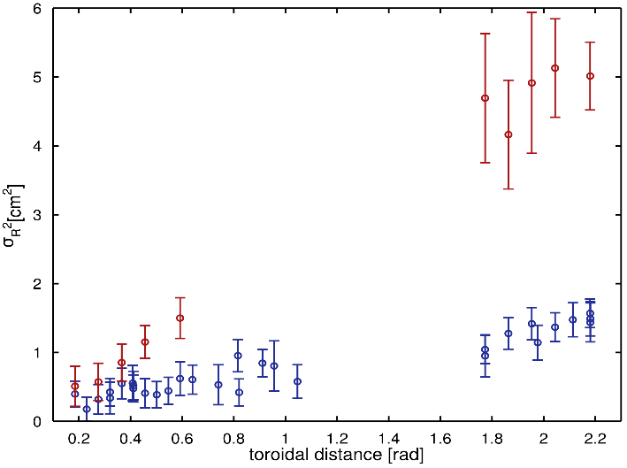
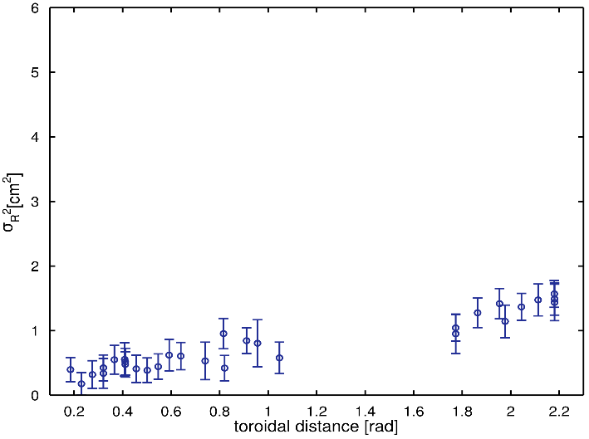
The beam spreading is different for different energies
E = 70 eV
E = 30 eV
Radial variance of the beam
15

Slide 16
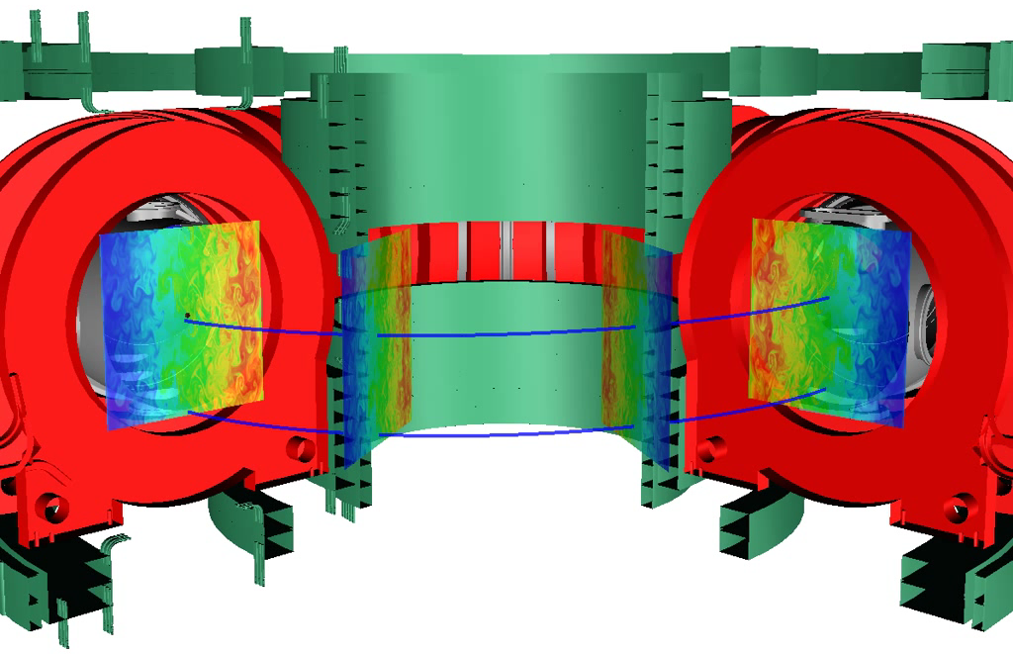
Ion tracers in simulated turbulent fields
GBS 3D fluid code
Electrostatic, drift-reduced Braginskii equations
Tracer trajectory solver
P. Ricci, PoP 2009
16

Slide 17
Observation of non-diffusive transport regimes
A synthetic diagnostic is applied to code output to map the measured spreading with distance to the particle spreading in time
K. Gustafson et al., PRL 2012; A. Bovet et al., PRL 2014
17
27
Notes:
We produce the first experimental evidence of different transport regimes in turbulence plasmas.
This is shown in this picture where the spreading of the ion beam is shown for two different energies.

Slide 18
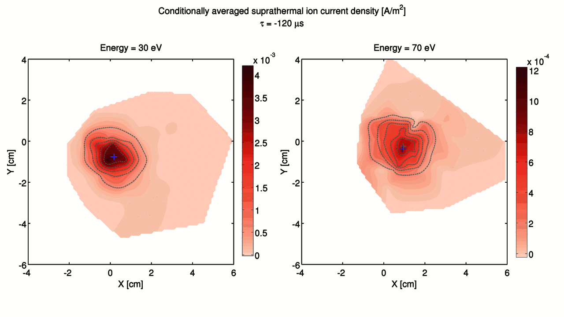
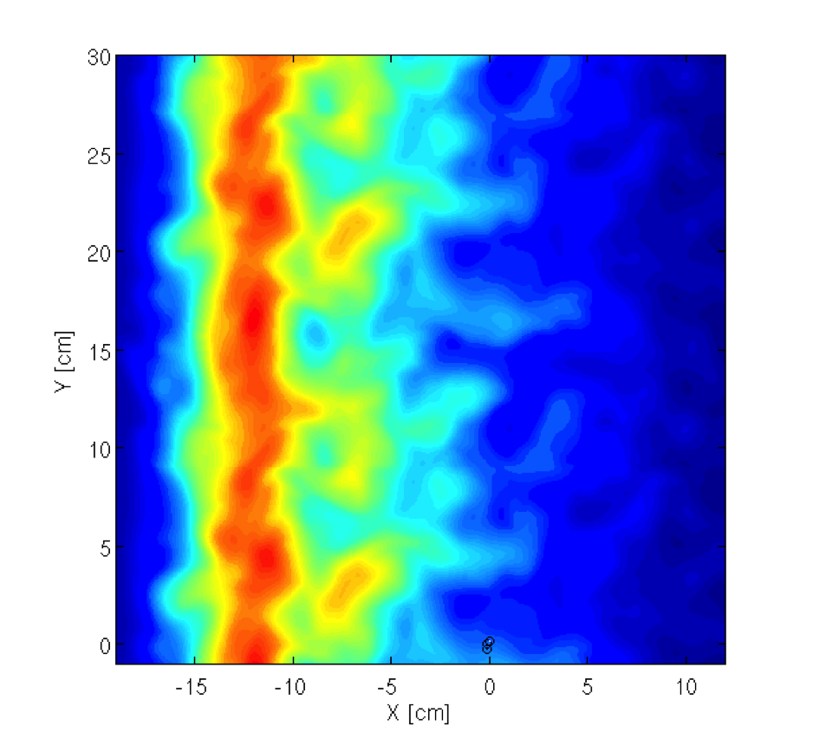
Super-diffusion is caused by intermittent blobs
E = 30 eV
Super-diffusive
E = 70 eV
Sub-diffusive
A. Bovet et al., PRL 2014
18
Notes:
The beam is displaced inwards / outwards by the blob ExB

Slide 19
Conclusions
  In a simple magnetised plasma different non-diffusive regimes for suprathermal ions depending on their energy and turbulence amplitude
  Transport regimes of fast ions are associated with turbulence orbit averaging effects
  Intermittent blobs give rise to fast ion super-diffusion
19

Slide 20
Outlook - some open questions
  Are fast ion transport mechanisms the same in closed field line configurations ?
Experiments are planned on TORPEX
I_{wire}~1kA
20

Slide 21
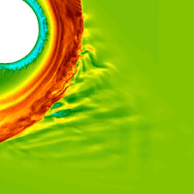
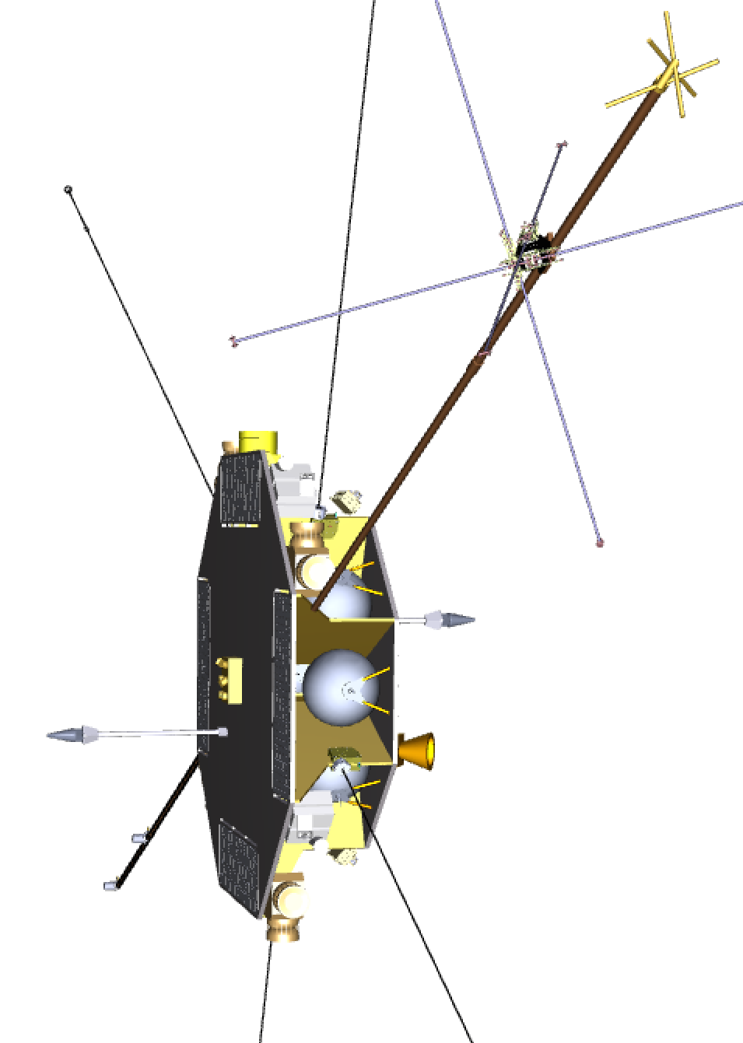


Outlook - some open questions
  Is the link between intermittency and superdiffusion general ?
  Can transport be (sub-)diffusive in the presence of intermittency ?
  Are fast ions accelerated in turbulence regime with k||≠0 ?
  It is necessary to measure both the turbulent fields and the fast ions in differnt regimes
  Future ESA mission:
  Turbulence Heating ObserveR - THOR
  « To resolve the processes responsible for plasma heating and particle acceleration due to turbulent fluctuations, in solar wind, bow shock and interplanetary shocks, magnetosheath »
Turbulence formation at shock, Vlasiator
21
Notes:
THOR is a sun-pointing spacecraft spinning with 2 rpm. The instruments are mounted on the platform of the spacecraft, on two solid booms and there are wire booms for the electric field measurements.
The sun-pointing orientation gives several critical advantages: a constant solar illumination of the spacecraft throughout the spin allowing high accuracy electric field and satellite potential measurements; it allows high resolution solar wind measurements using Farady Cup; it allows particle instrument design reducing solar wind UV pollution and solar wind ion saturation effects.
The Finnish Meteorological Institute is developing a 6-dimensional Vlasov theory-based simulation called Vlasiator. The focus is to simulate the entire near-Earth space at a global scale using the kinetic hybrid-Vlasov approach, to study fundamental plasma processes (reconnection, particle acceleration, shocks) and gain a deeper understanding of space weather.
TORPEX: GBS says that if k_par is not 0 there can be acceleration (Resistive interchange)

Slide 22
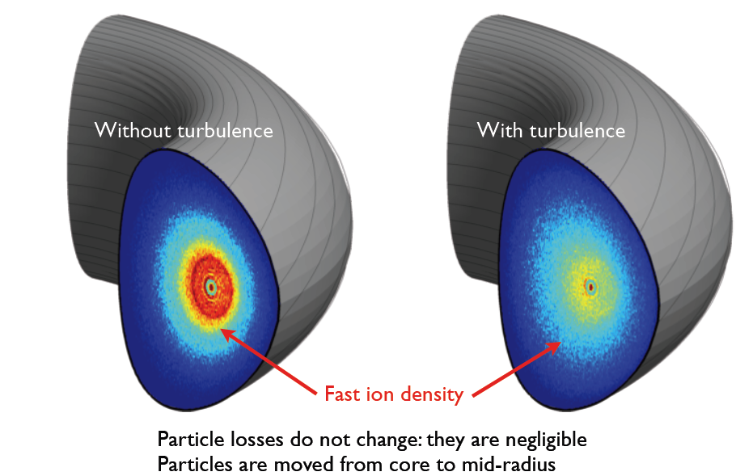
Outlook - some open questions
  Is orbit averaging of turbulence in fusion devices so efficient that no significant fast ion transport (losses, effect on current drive) occur ?
Gyrokinetic simulations with fast ion tracers
  Present devices (low values of E_{fast}/T_{e}): some anomalous transport of NB ions, anomalous heating / CD
  ITER: negligible effect for α’s or NB ions (E_{fast}^{NBI}/T_{e}>30)
  DEMO (R=8.5m, 6T):
  NB ions can be redistributed
  due to lower E_{fast}^{NBI}/T_{e} (~20),
  longer τ_{SD}
M.Albergante
22
Notes:
THOR is a sun-pointing spacecraft spinning with 2 rpm. The instruments are mounted on the platform of the spacecraft, on two solid booms and there are wire booms for the electric field measurements.
The sun-pointing orientation gives several critical advantages: a constant solar illumination of the spacecraft throughout the spin allowing high accuracy electric field and satellite potential measurements; it allows high resolution solar wind measurements using Farady Cup; it allows particle instrument design reducing solar wind UV pollution and solar wind ion saturation effects.
The Finnish Meteorological Institute is developing a 6-dimensional Vlasov theory-based simulation called Vlasiator. The focus is to simulate the entire near-Earth space at a global scale using the kinetic hybrid-Vlasov approach, to study fundamental plasma processes (reconnection, particle acceleration, shocks) and gain a deeper understanding of space weather.

Slide 23
Outlook - some open questions
  Is orbit averaging of turbulence in fusion devices so efficient that no significant fast ion transport (losses, effect on current drive) occur ?
Gyrokinetic simulations with fast ion tracers
  Present devices (low values of E_{fast}/T_{e}): some anomalous transport of NB ions, anomalous heating / CD
  ITER: negligible effect for α’s or NB ions (E_{fast}^{NBI}/T_{e}>30)
  DEMO (R=8.5m, 6T):
  NB ions can be redistributed
  due to lower E_{fast}^{NBI}/T_{e} (~20),
  longer τ_{SD}
  Experiments on tokamaks with
  DEMO-like values of E_{fast}^{NBI}/T_{e}
M.Albergante
23
Notes:
THOR is a sun-pointing spacecraft spinning with 2 rpm. The instruments are mounted on the platform of the spacecraft, on two solid booms and there are wire booms for the electric field measurements.
The sun-pointing orientation gives several critical advantages: a constant solar illumination of the spacecraft throughout the spin allowing high accuracy electric field and satellite potential measurements; it allows high resolution solar wind measurements using Farady Cup; it allows particle instrument design reducing solar wind UV pollution and solar wind ion saturation effects.
The Finnish Meteorological Institute is developing a 6-dimensional Vlasov theory-based simulation called Vlasiator. The focus is to simulate the entire near-Earth space at a global scale using the kinetic hybrid-Vlasov approach, to study fundamental plasma processes (reconnection, particle acceleration, shocks) and gain a deeper understanding of space weather.

Slide 24
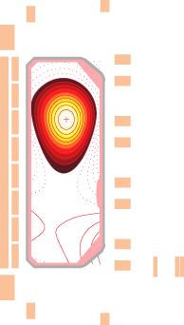
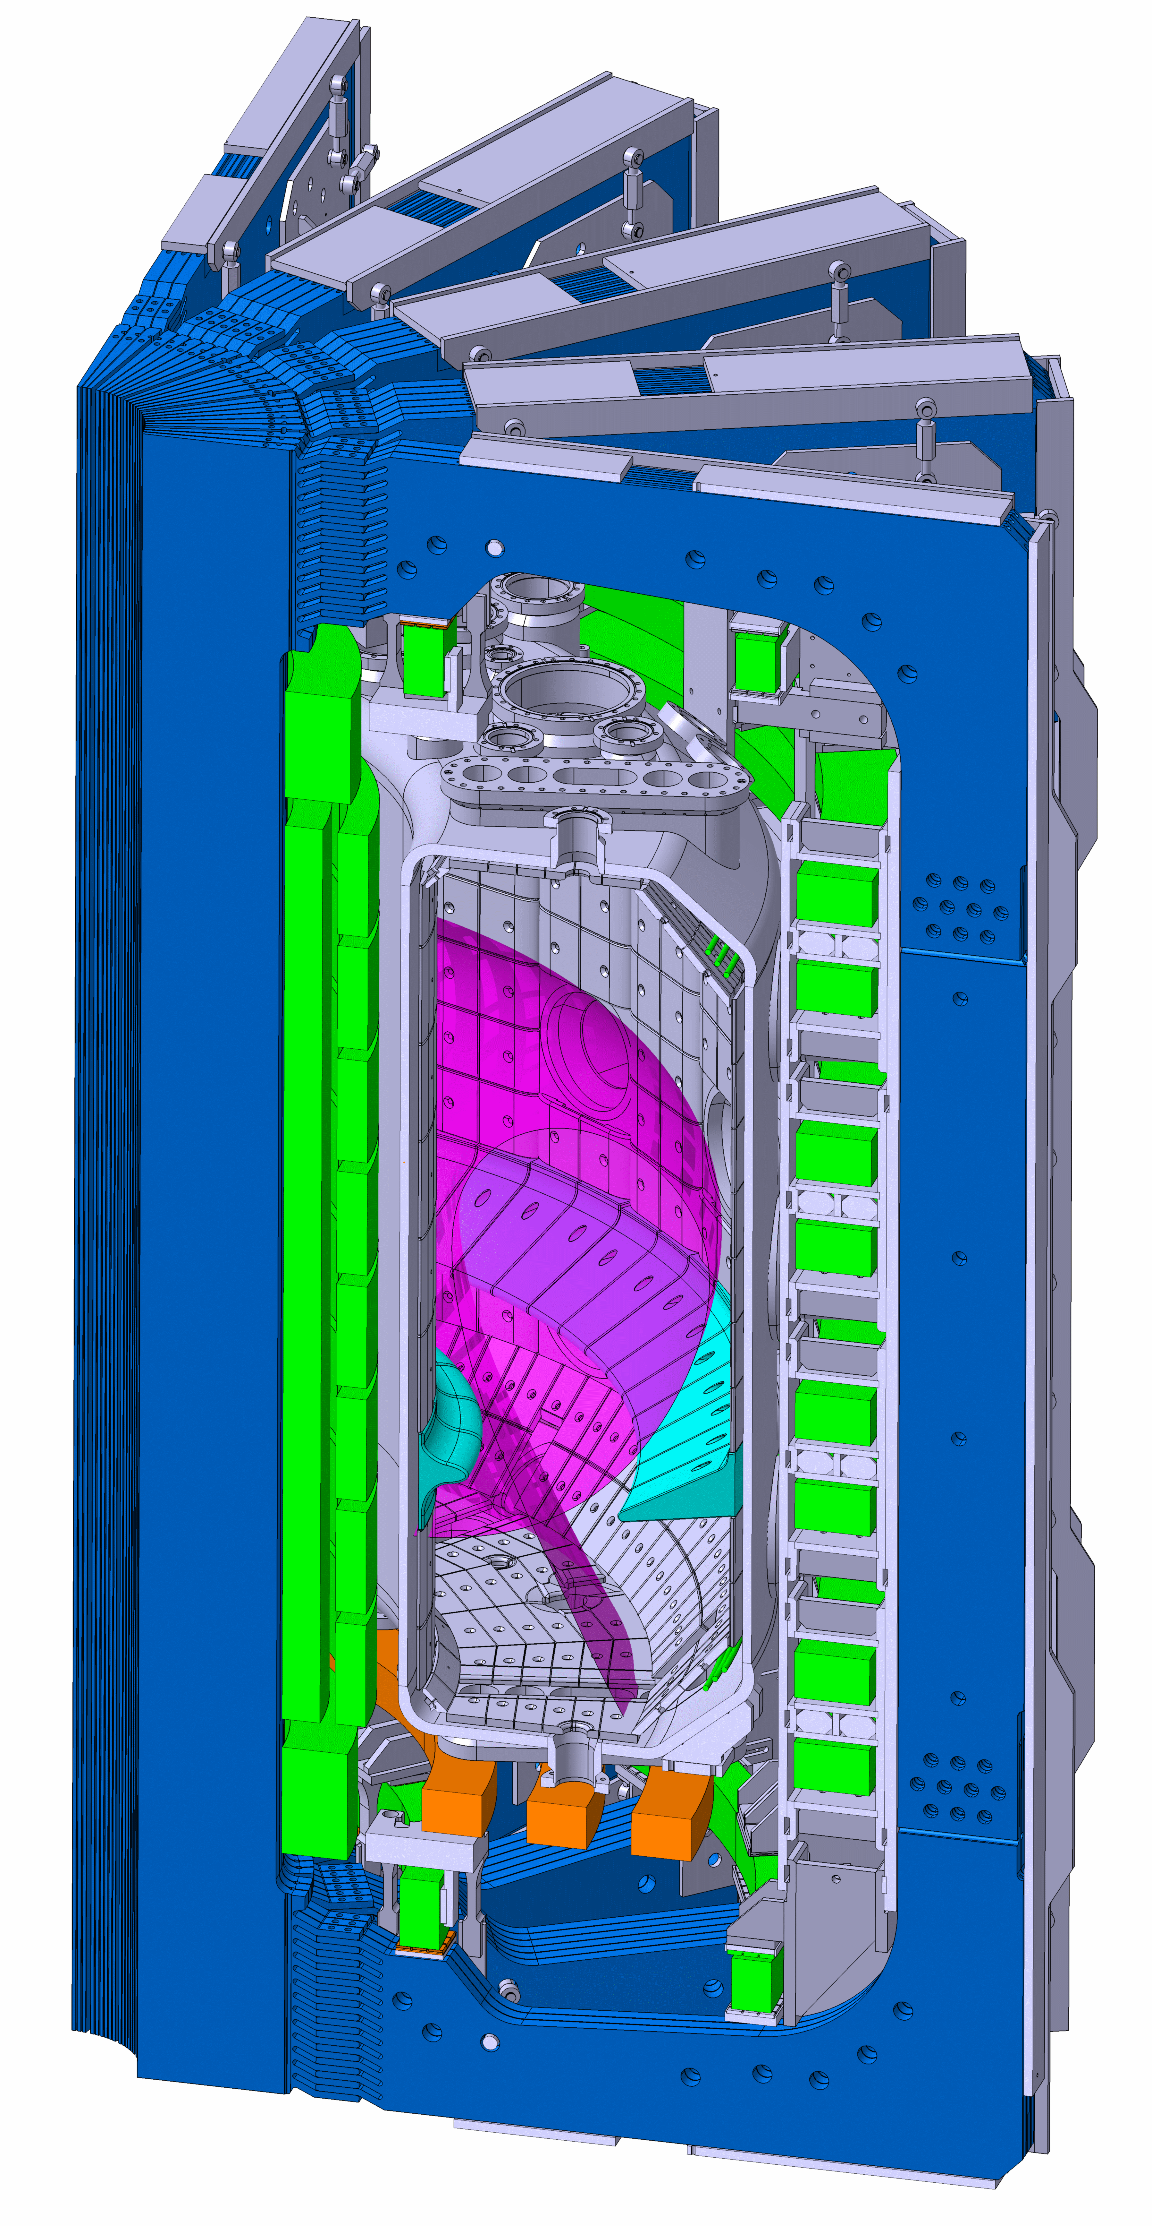
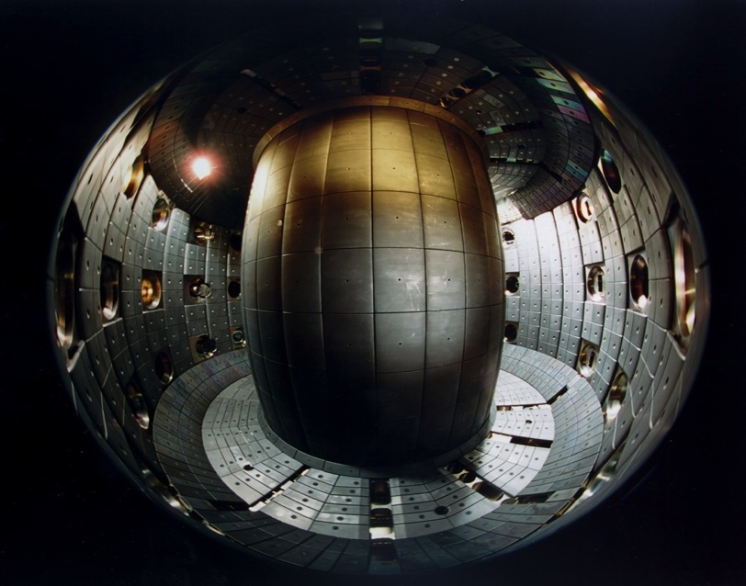

NB fast ion transport on upgraded TCV tokamak
Ongoing: 1MW 30keV NB and two dual-frequency (X2-X3) 1MW gyrotrons
Later: second 1MW 50keV counter NB, variable closure divertor structure
24

Slide 25
Thank you Nat

