Slide 1

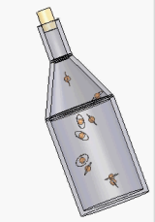



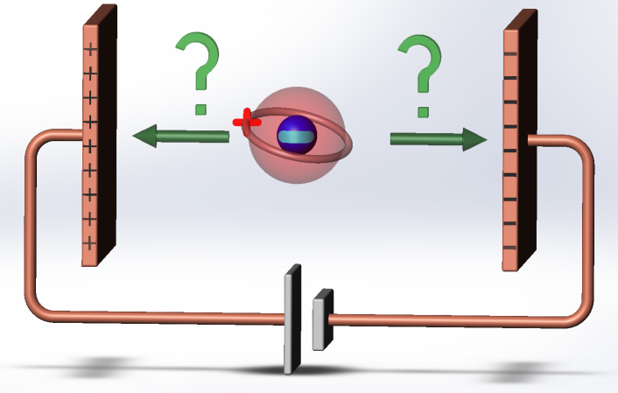
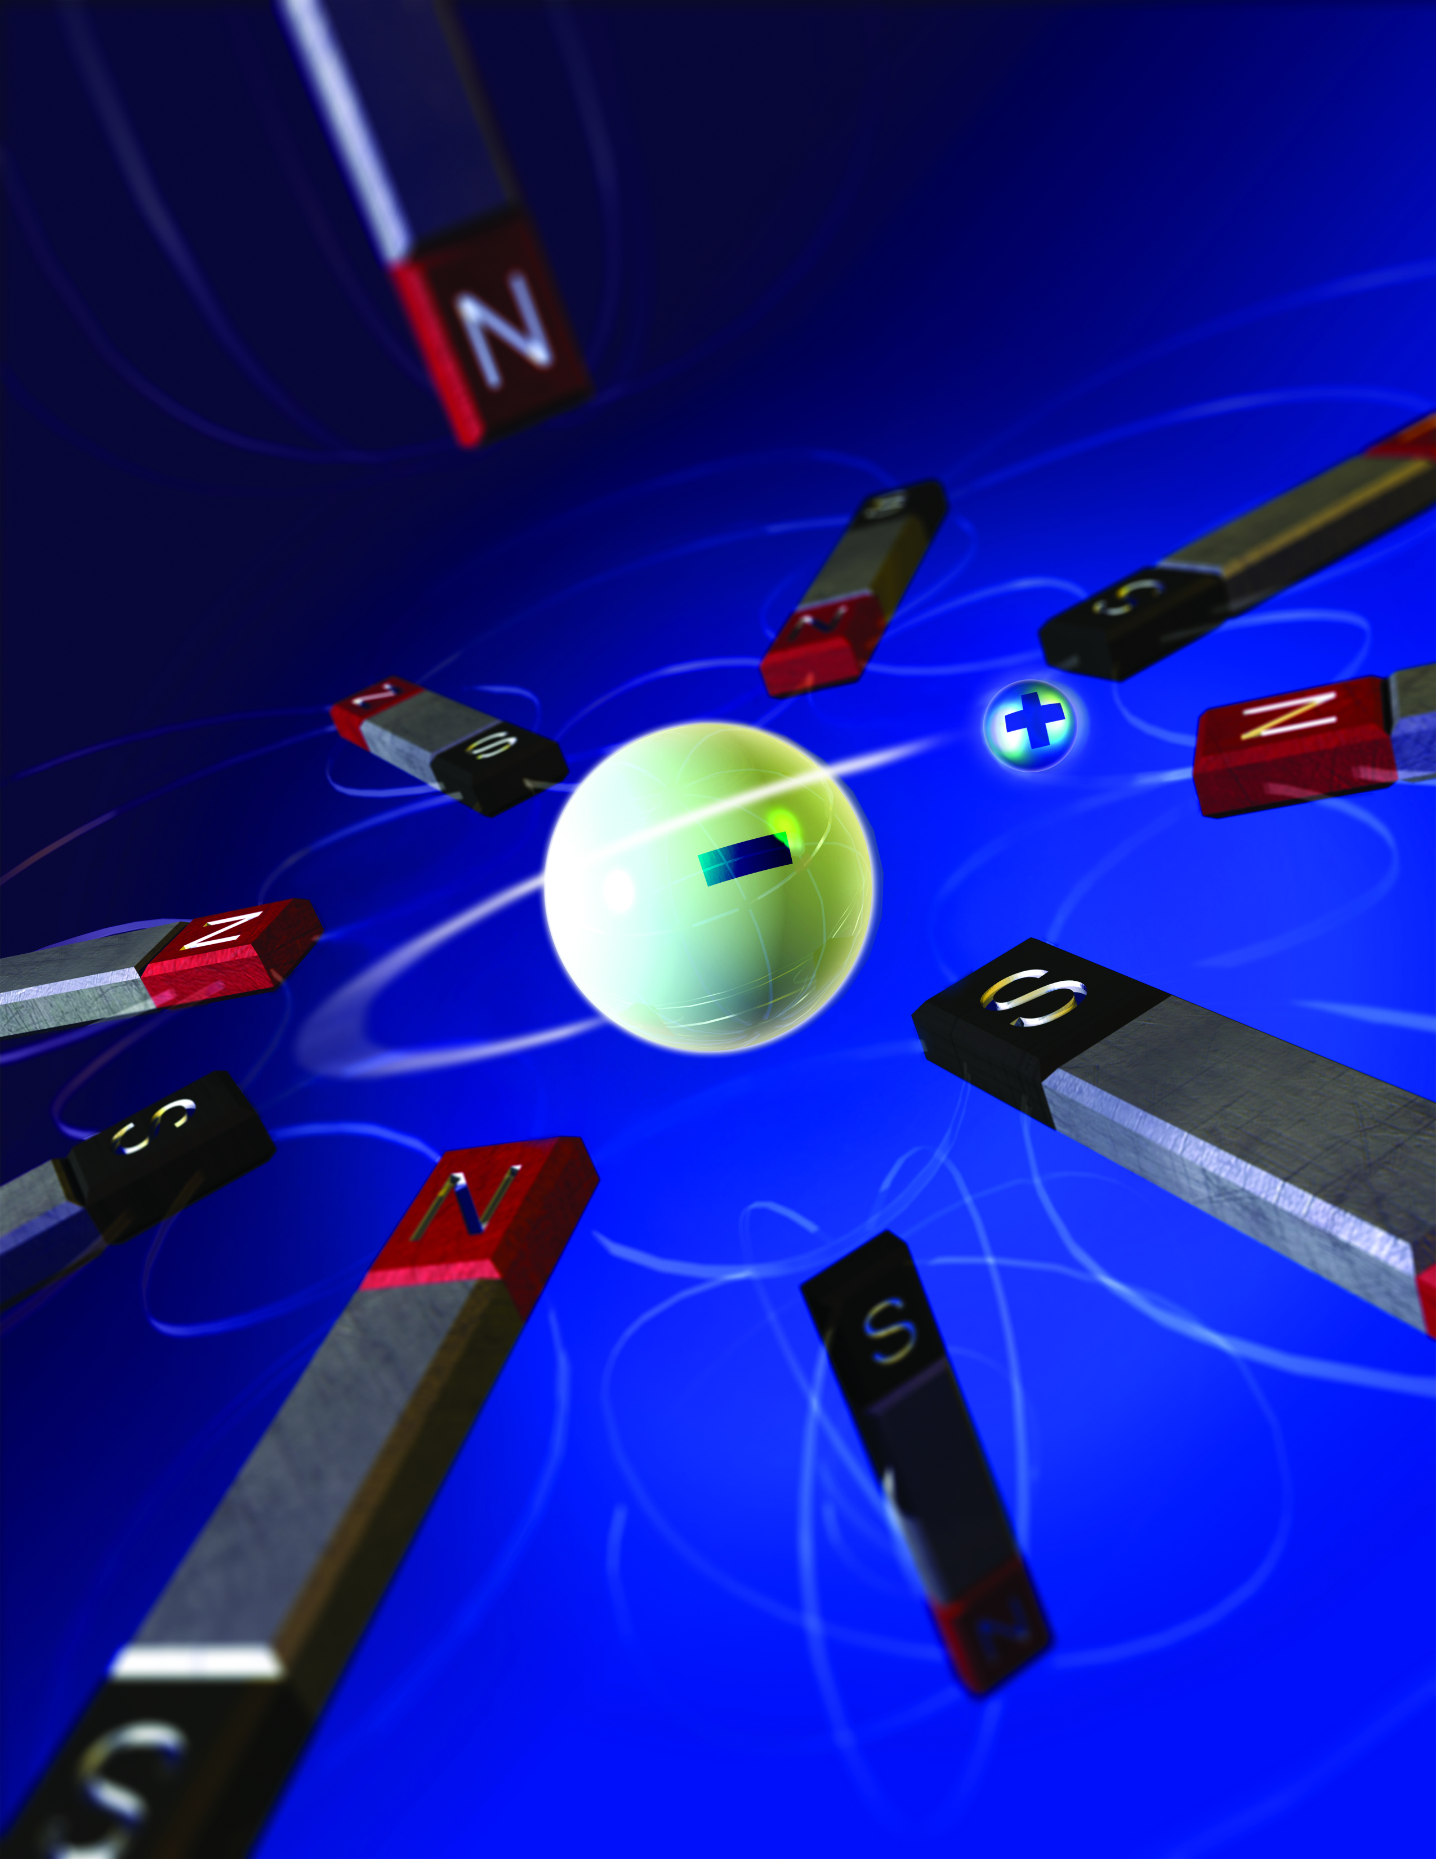
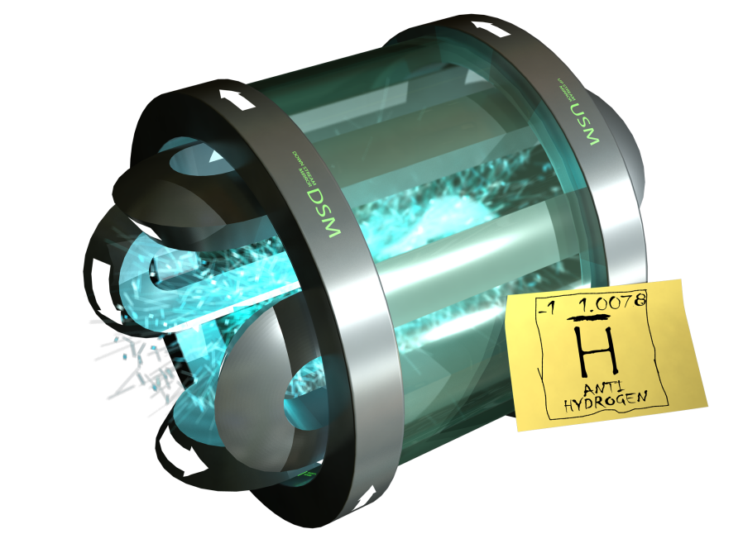
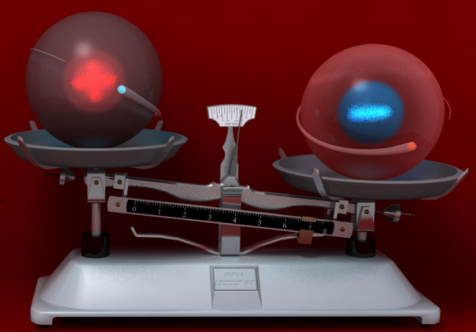
The ALPHA Collaboration
16 Institutions, ~40 researchers
Plasma Techniques Enabling CPT and Gravity Tests with Antihydrogen
Symposium in Honor of Nat Fisch
Solved and Unsolved Problems in
Plasma Physics
Jonathan Wurtele
U.C.Berkeley
US support:
DOE OFES & NSF
Notes:
Understanding plasma physics is at the core of antihydrogen experiments.
Overview of the tricks of our trade.
Connections to Nat???
Physics achievements and plans: trapping, microwaves, gravity ALPHA-II plans

Slide 2

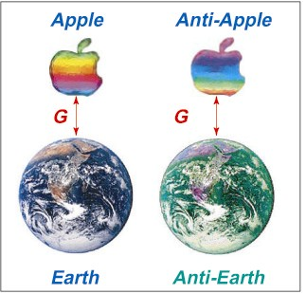
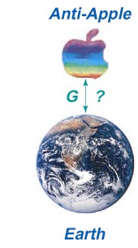
Why Study Antihydrogen?
The universe almost entirely of matter. Why?
CPT Theorem: Physical laws identical under CPT transformations. Exceptions?
  1s-2s spectral comparison of hydrogen and antihydrogen.
  Microwave studies of hyperfine transition
Gravity and Antimatter: Weak equivalence principle.
CPT Tests
Weak Equivalence
?
Courtesy Tom Roberts
Notes:
Key points here:
meson-antimeson systems ( q q − q q ) are inherently different from baryon-antibaryon ( qqq − q q q ) or lepton-antilepton ( l − l ) systems, and could have different patterns of symmetry violation.
Given the fundamental importance of CPT symmetry, it should be tested in all particle sectorsIn addition to the relative precision, one can consider the absolute energy precision
An alternative figure of merit . In precision measurements, typical energy corrections
from short distance effects may have the form [20]:
∆ Energy ~ m^(n+1) /\Lambda^n
where n depends on the theory and is typically > 0, and m is the characteristic energy
scale of the system, while ΛNP is the high energy scale applicable to the CPT violating
new physics.
Take m~1GeV, \Lambda~planck scale or 10^{-19}GeV=10^{-10}eV n=1
Get 10^{-19} GeV to see effects. This is about 1 micronx10^10 or 10^4 m
Wavelength---or 30kHz. We can get there.
The K0 − K0 comparison, taken at face value, is constrained only to ~ 100 kHz in
frequency or 5 x 10-19 GeV in terms of the absolute energy scale.
Since direct CPT tests challenge the entire framework of (effective) field theory, one has to be cautious in
applying the language of field theory as in Eq. 1.
17. M. Kobayashi and A.I. Sanda, Phys. Rev. Lett. 69, 3139 (1992).
18. Y. Takeuchi, S.Y. Tsai, Int. J. Mod. Phys. A18, 1551 (2003): arxiv:hep-ph/0208148.
19. I.I. Bigi, Nucl. Phys. A692, 227c (2001).

Slide 3

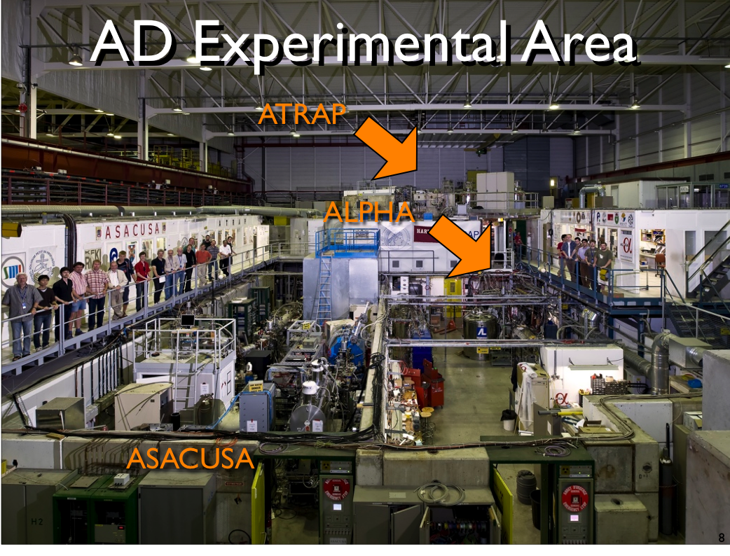
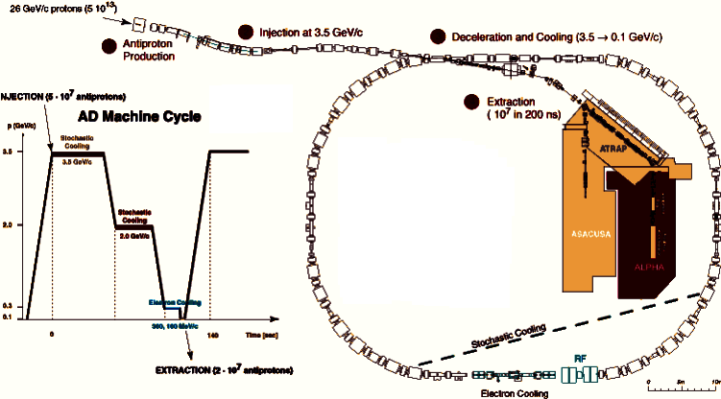
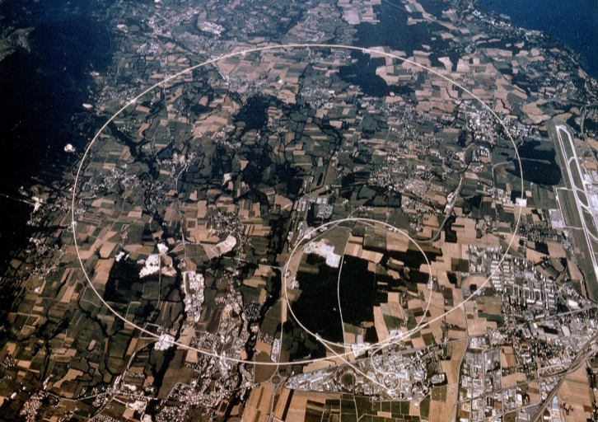
Plasma and beam physics enable this reseach
CERN
ALPHA located at CERN
Antiproton Deccelerator
AD
Antiproton Decelerator (AD)
Notes:
Andy was very supportive of the careers of Jeff Hangst, starting from his work on crystal beams, and Joel Fajans, my Berkeley collaborator, as well as myself.

Slide 4
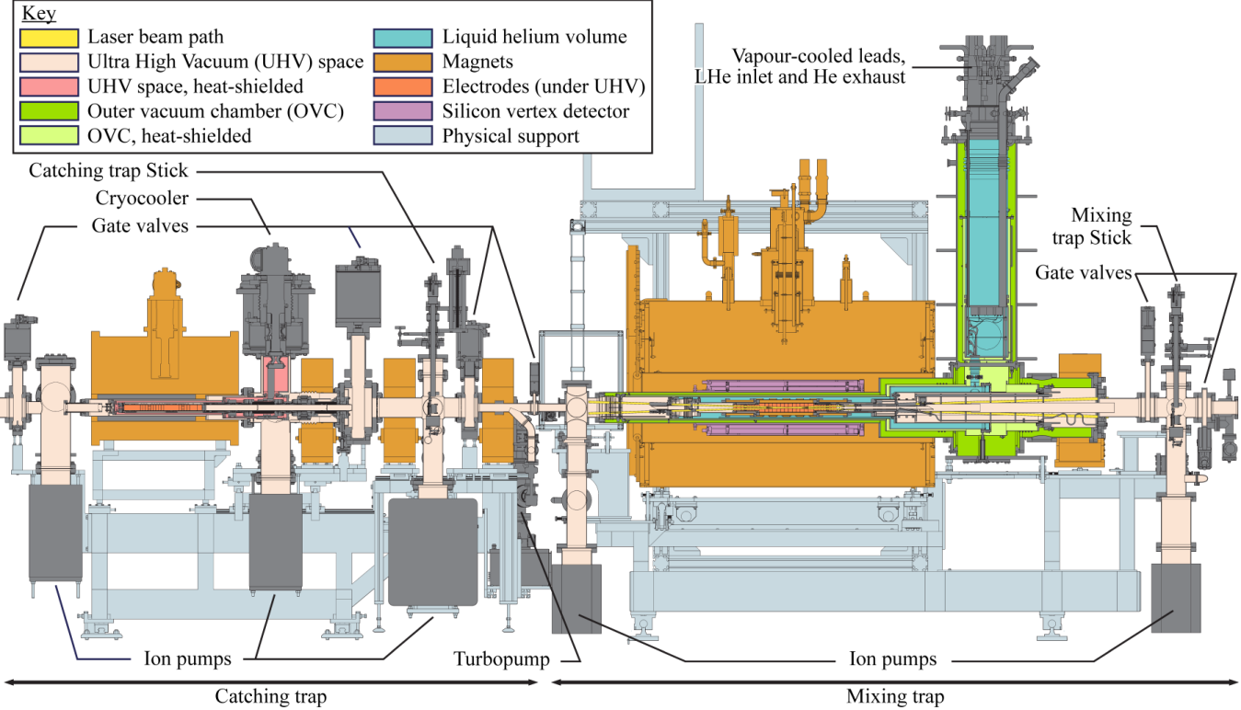
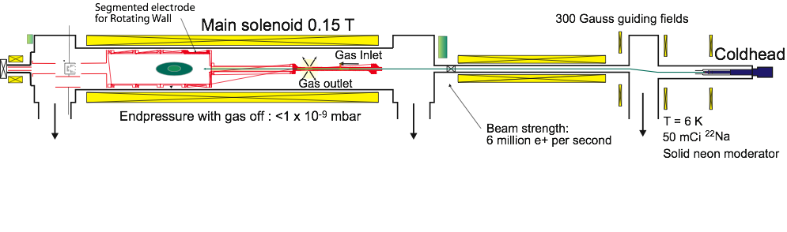
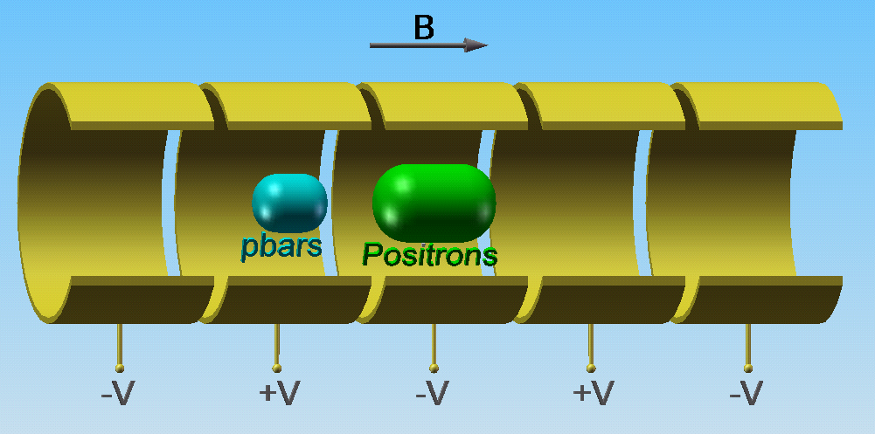
ALPHA2 Apparatus
Positron Accumulator
Penning-Malmberg PlasmaTrap
Notes:
We have 3T in catching region and 1T in mixing region. Various diagnostics move in and out on a stick. Si-Vertex detector.
Operate with electrons positrons and antiprotons. Use a slew of tricks from nonneutral plasma physics to manipulate the species and
Much simulation of antihydrogen orbits to exploit the position-time sensitivity of the detector.
An entire trapping cycle runs for about 15 minutes and we trap 1, 2 and on rare instances 3 antihydrogen atoms per attempt.
We call this rate the ‘Intensity Frontier’ of antihydrogen production. I am not sure DOE agrees. One of the remarkable aspects of what I present is that with 434 antiatoms we can perform measurements –induced spin flip, bound on gravitational to inertial mass ratio, and precision charge neutrality.

Slide 5
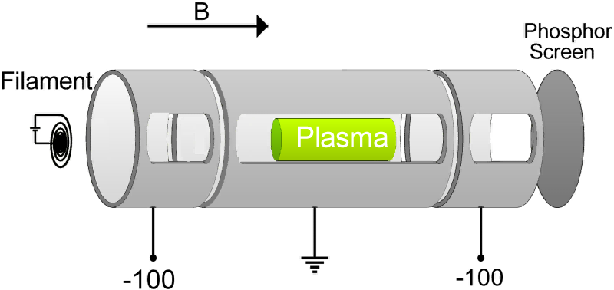
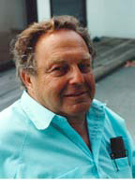
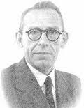
Penning-Malmberg Trap
Axial confinement produced by electrostatic well.
Radial confinement produced by axial magnetic field.
Work for single-sign-of-charge plasmas.
J. H. Malmberg and J.S. deGrassie, Properties of Nonneutral Plasma, Phys. Rev. Lett 35 1975.
John Malmberg
1927-1992
Frans Michel Penning
1894-1953

Slide 6
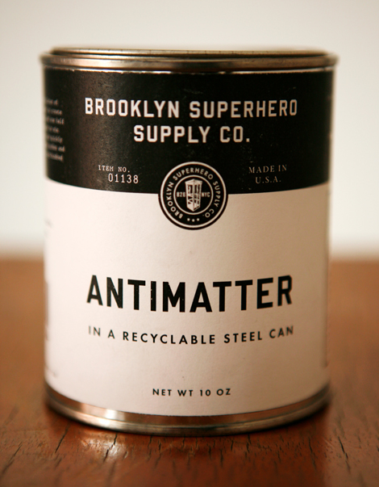
Plasma and Neutral Traps
Antimatter can only be confined in a “can” with no material walls.
Only permitted walls are electric and magnetic fields---plasmas.
Vacuum requirements:
  ALPHA: 10⁻¹⁴torr.
  ATRAP, BASE: 10⁻¹⁸torr.
  Vacuums obtained in nearly sealed, cryogenic chambers.
Notes:
The potential from the charge of the positron and antiproton plasmas is equivalent to tens of thousand of degrees. We have to prevent the transfer of this potential to kinetic energy to have any chance of trapping.

Slide 7
Notes:
Figure 1: (a) A schematic view of the ALPHA trap. The radial and axial confinement of antihydrogen atoms is given by the octupole magnet (not shown) and mirror magnets, respectively. The Penning trap electrodes are held at ~9 K, and have an inner diameter of 44.5 mm. A 3-layer Si vertex detector surrounds the magnets and the cryostat. A 1 T base field is provided by an external solenoid (not shown). An antiproton beam is introduced from the right, while positrons from an accumulator are brought from the left. (b) The magnetic field strength in the y-z plane (z is along the trap axis, with z=0 at the center of the magnetic trap). Green dashed lines in this and other figures depict the inner walls of the electrodes. (c) The axial field profile, with an effective trap length of ~270 mm. (d) The field strength in the x-y plane. (e) The field strength profile along the x-axis.

Slide 8
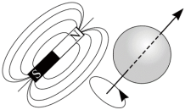
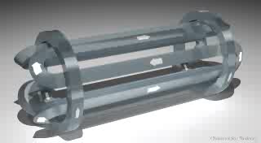
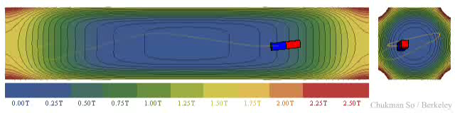
Antihydrogen Confinement in the Magnetic Trap
Experiments are done on trapped antihydrogen atoms
Antihydrogen has a small magnetic moment.
Can be confined in a magnetic minimum.
  Mirror coils to create an axial minimum.
  Multipole (quadrupole, octupole etc.) coils to create a radial minimum.
Force on a magnet moment from a magnetic gradient:
Magnetic Field Magnitude

Slide 9
We create ~10,000 from ~2x10⁴ antiprotons per attempt
Of these, we trap ~1-2 antihydrogen atoms.
Energy Scales:
  Antiproton Creation Energy: 1.7GeV
Self-Potential: 30mV-10V
  Trap Depth: 0.5K or 40μeV
Antiproton Creation Energy
Trap Depth
= 10¹⁴
LHC Energy Increase
Free Protons on Creation
= 10⁸
Collective Potential
Neutral Trap Depth
= 10³ - 10⁵
ALPHA’s physics measurement techniques were enabled by beam and plasma physics concepts and techniques.
Notes:
Cooling-parallel=.3m*3kV to .01m*1mV=10^8
Cooling perp=.5cmx.5cm*E_perp to .1cm/Eprerp=25*10^6.
Why is 1 antiatom/attempt the Intensity frontier? Look at the energy scale.
The energy scale is daunting in quite a few ways. First, we must lower the temperature from the MeV level to keV via 99.9% losses through a degrader. We cool on cryogenic preplaced electrons which are for unknown reasons at 10K not 4K –though we have ideas since there is a path to higher T down the beam pipe and there is amplifier noise. But unlike a typical accelerator where self fields are a correction—here they are dominant.
Note that we have to create antihydrogen with energy less than that of the neutral well since its energy is that of the antiproton this is hard.

Slide 10
The Problem
Formation of antihydrogen is a 3-body process.
Antihydrogen must have KE<~.5K to be trapped.
Favors high density positrons and low temperature antiprotons. Mixing (e.g., positrons and antiprotons in the same place at the same times) cannot introduce too much energy spread. But It does…
We manipulate plasma phase space to solve this problem.

Slide 11
ALPHA Plasma and Antihydrogen Manipulations
Radiative Cooling: Electrons and Positrons
Sympathetic Cooling: Antiprotons cool on electrons [ATRAP]
Evaporative cooling: Prepare low temperature bunches,
Buffer gas slowing: Surko-style positron trapping.
Microwave mode excitation: Measure plasma parameters
Species separation (heats): E-kick. Remove electrons from antiproton. Cutting (number reduction).
Species mixing (heats): Autoresonance drives antiprotons into positrons.
Rotating wall compression (heats): Apply torque to compress plasma.
Cavity-enhanced radiative cooling: CERES experiment underway at Berkeley
Stochastic Acceleration: Bound on antihydrogen charge [NJP 2014, & in preparation]
Proposed atomic fountain and interferometer: Precision gravity—requires a new, vertical, trap [PRL, 2014].
Alpha.web.cern.ch has links to papers on these topics;
Danielson et al, RMP, 2015 (Positron traps). Lots of UCSD-developed ideas are implemented
Notes:
We want low temperature to create trappable antihydrogen. Smaller radius since rate goes as n_pos^2.

Slide 12
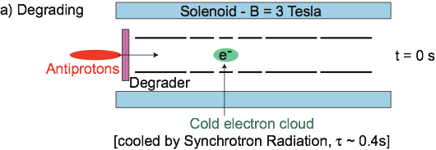


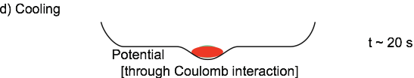
Antiproton Capture
~30k antiprotons captured per AD shot (every 100s)
G. Gabrielse et al. First capture of antiprotons in a Penning trap: A kiloelectronvolt source, Phys. Rev. Lett. 57, 2504 (1986).
G. Gabrilese et al. Cooling and slowing of trapped antiprotons below 100meV, Phys. Rev. Lett., 63 1360 (1989).

Slide 13
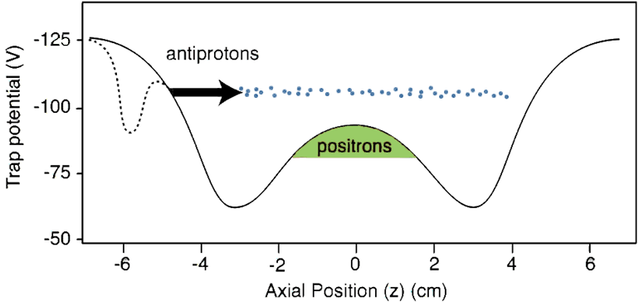
Energy Gain on Mixing Injection
Standard mixing techniques impart too much energy to antiprotons.
Notes:
One way not to do it is with old-fashioned mixing.
It’s a little too easy to make antihydrogen. When the antiprotons start out this far above the positrons, they form antihydrogen before they thermalize, and so the resulting antihydrogen is too hot.
Further, the energetic antiprotons heat the positron plasma.

Slide 14
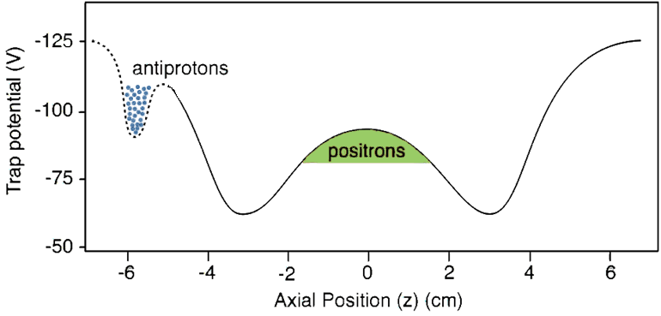
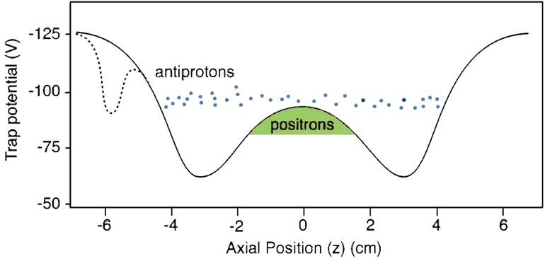
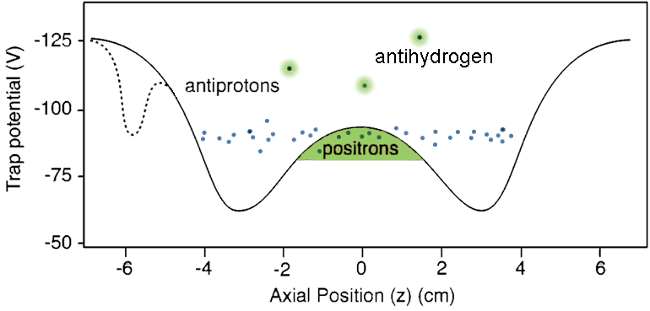
Mixing
M. Amoretti,et al. (ATHENA), Production and detection of cold antihydrogen atoms, Nature 419, 456 (2002).
G. Gabrielse, et al., Background-free observation of cold antihydrogen with field-ionization analysis of its states, Phys. Rev. Lett. 89, 213401 (2002).

Slide 15
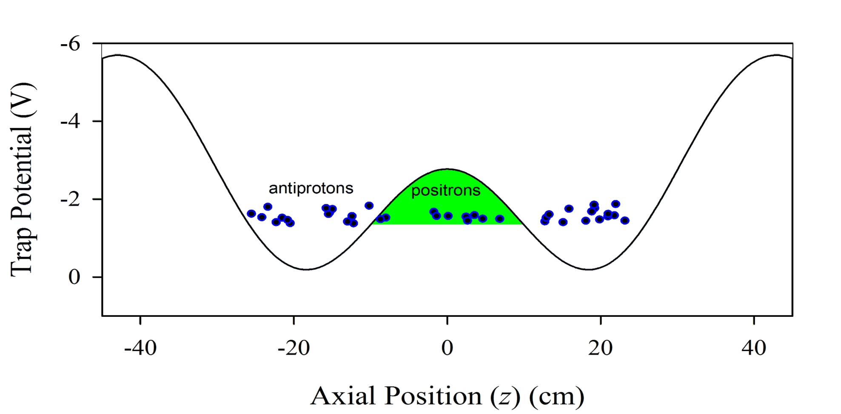
Thermalization after mixing
With low energy injection, the thermalization time scale is less than the synthesis time scale.
Antihydrogen atoms will be created at approximately the same temperature as the positrons.

Slide 16
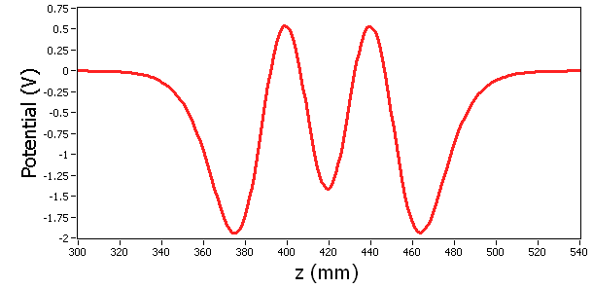
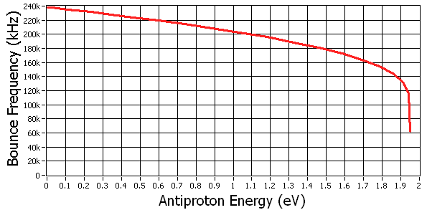
Antiproton Oscillations
Antiproton well
Positron well

Slide 17
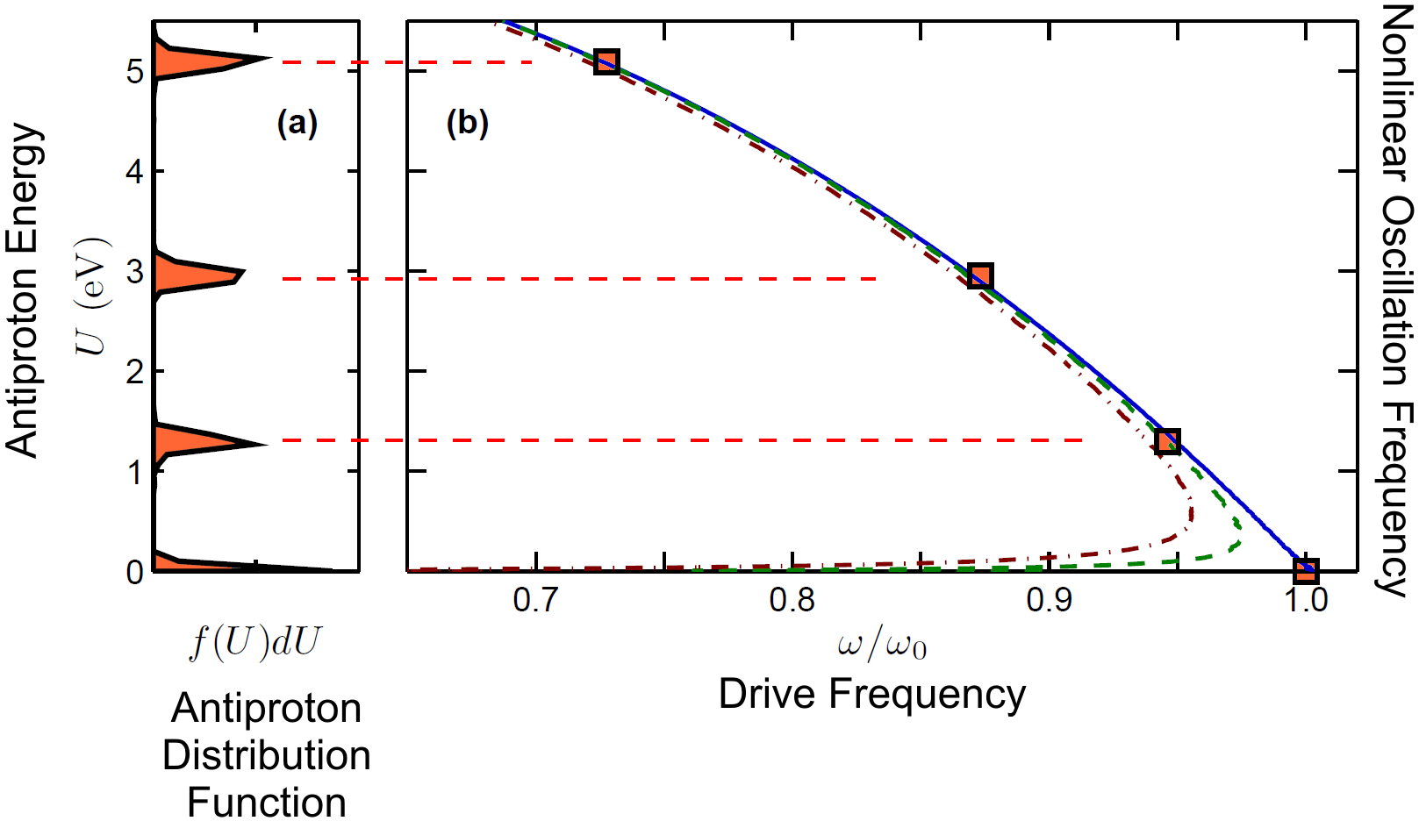
Autoresonant Mixing
~10,000 antihydrogen created from ~20,000 antiprotons but ~1 trapped (KE<.5K)
W. Bertsche, ALPHA, Autoresonant excitation of antiproton plasmas, Phys. Rev. Lett., 106 025002 (2011).
I. Barth, L. Friedland, E. Sarid, and A. G. Shagalov, Autoresonant Transition in the Presence of Noise and Self-Fields, Phys. Rev. Lett., 103, 155001 (2009).
Notes:
Not obvious that this should have worked as one might think that space charge should tear the antiproton cloud apart.

Slide 18
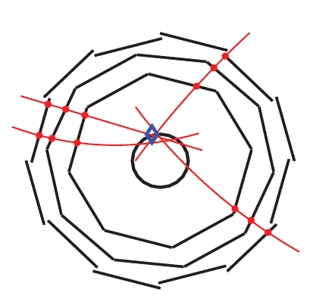
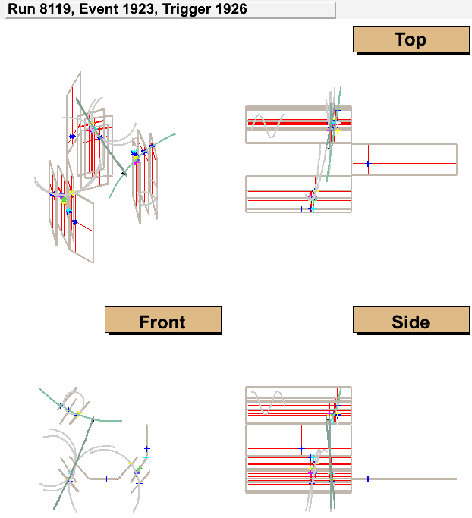
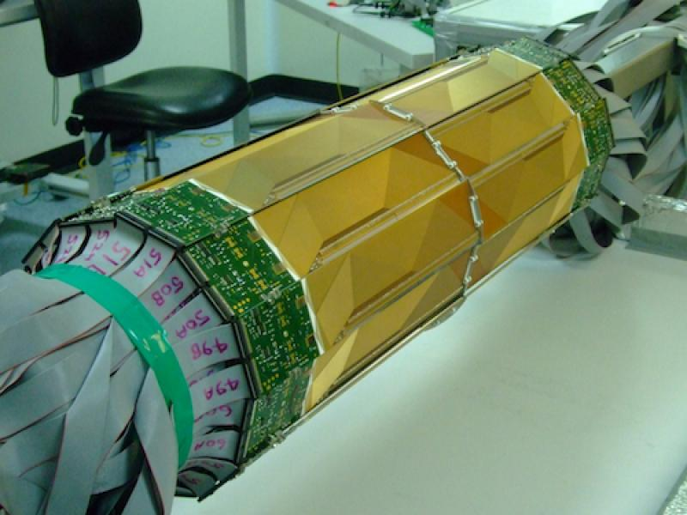
Antihydrogen Detection: anti-atoms Annihilate
Antiproton annihilation pion tracks.
ALPHA Vertex Imaging Detector
Detector is over 50% efficient, and locates annihilations to better than 10mm.
Notes:
Two to five pion tracks

Slide 19
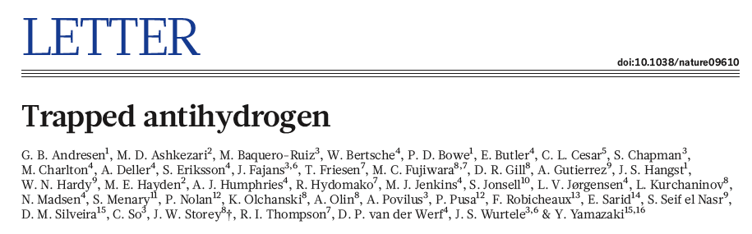
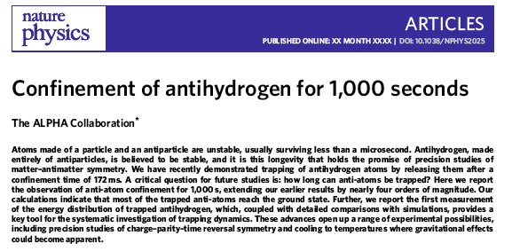
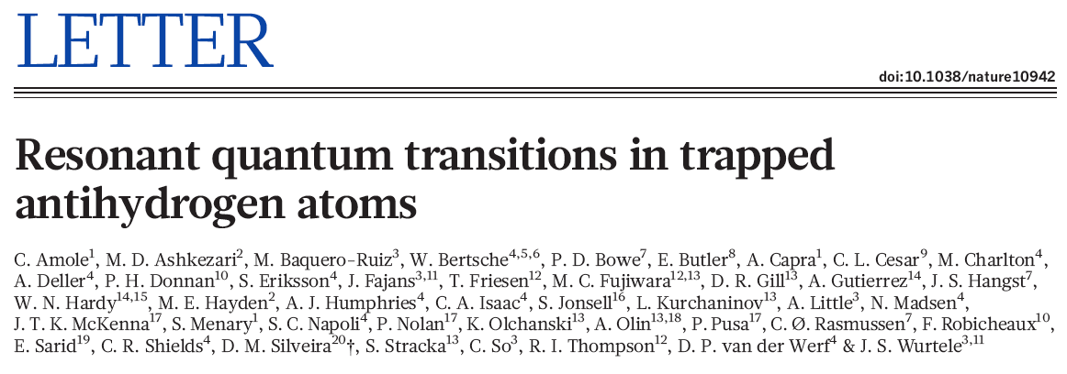
Physics one (anti-)atom at a time
Positron spin flip measurement
Shows that it is possible to do physics
with few atoms
…would like x10 (or higher) trapping
rate and laser cooling

Slide 20
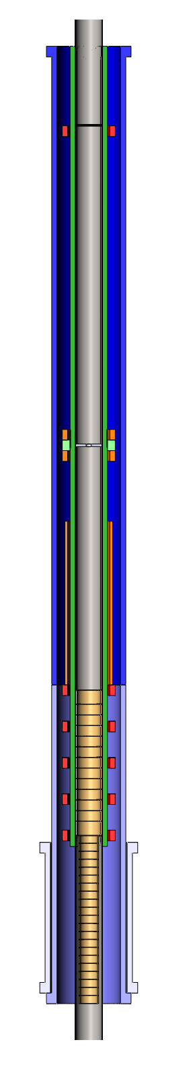
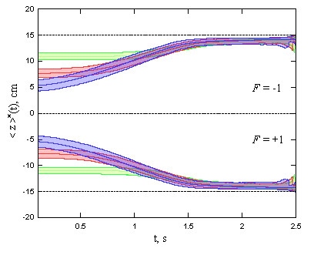
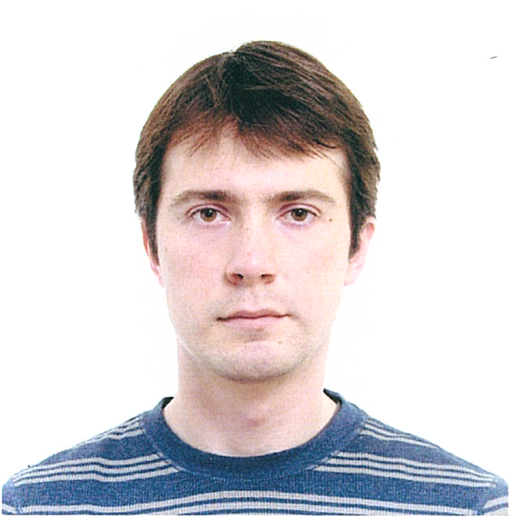
Gravity Measurements
Current direct bound (ALPHA) |M_{G}/M|~<100.
Future is a vertical trap.
  Laser cooling not necessary, though it helps.
  Slow down the magnet turnoff by a factor of ten.
  Turnoff the mirror coils only.
  Up-down, then to limit of ~5-10% measurement.
Octupole
Mirror Coils
Solenoids
T=300K
T=100K
Electrodes
T=30K
A. Zhmoginov, A. Charman, J. Fajans, and J.S. Wurtele Nonlinear dynamics of antihydrogen in magnetostatic traps: implications for gravitational measurements, Class. And Quantum Grav. 30 205014 (2013).

Slide 21
Antihydrogen Charge
Normal matter atoms are known to be charge neutral to remarkable precision: on the order of 10⁻²¹e.
CPT and quantum anomaly cancellation demand that antihydrogen be charge neutral to a similar level.
How well is the charge of antihydrogen known?
  Techniques used for normal matter atoms are inapplicable.
  Only prior direct limit on antihydrogen are at the 10⁻²e level.
  Using superposition:
    Charge of the antiproton is known to 710⁻¹⁰e.
    Charge of the positron is known to 2.510⁻⁸e.
    Given superposition: Charge neutrality limit of 2.510⁻⁸e
Greenland, P. T. Antimatter, Contemporary Physics 38, 181{203 (1997).
Notes:
Raman scattering when the Bragg condition is met.

Slide 22
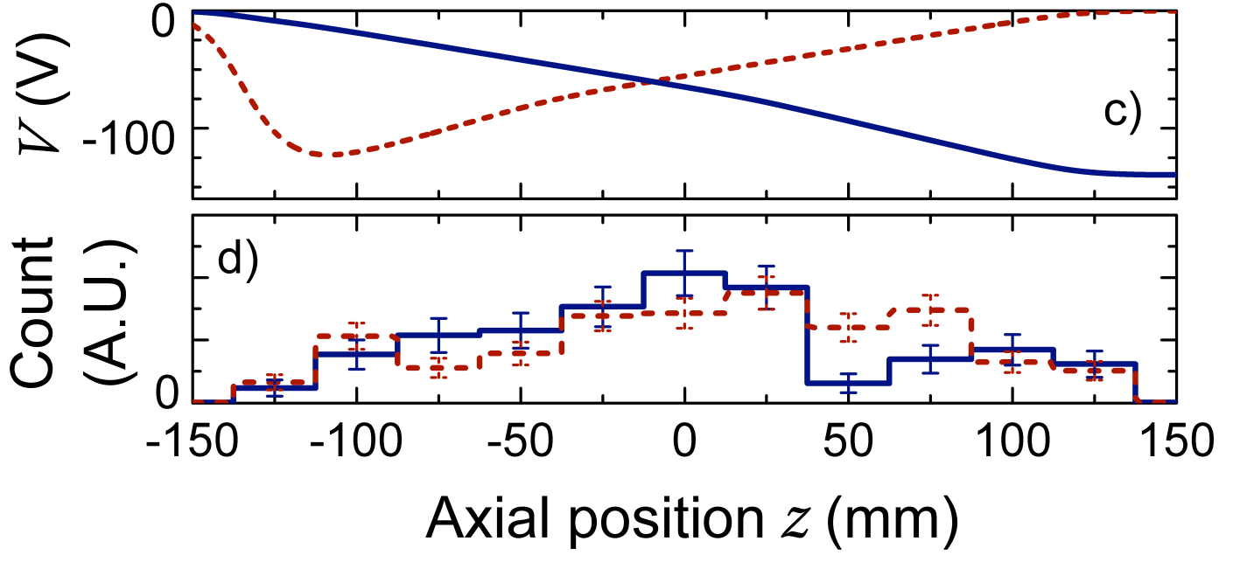
Antihydrogen annihilation vs Position sets bound on net charge
2014 ALPHA charge bound Q-antihydrogen <~2 10⁻⁸e.
ALPHA, Nat. Comm. 2014

Slide 23
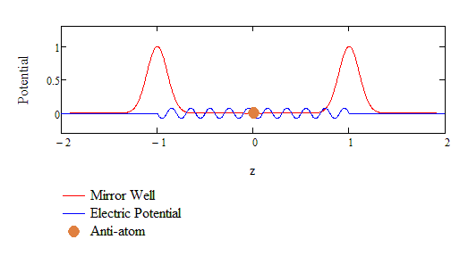
Improved Antihydrogen Charge Bound Using Stochastic Fields
Stochastic acceleration (Fermi acceleration) can eject charged anti-atoms from the trap.
Using stochastic acceleration, we expect that we can determine the charge to the 10⁻¹²e level.
M. Baquero-Ruiz, A.E. Charman, J. Fajans, A. Little, A. Povilus, F. Robicheaux, J.S. Wurtele, A.I. Zhmoginov, Measuring the electric charge of antihydrogen by stochastic acceleration, NJP (2014).
Notes:
Marcello’s thesis; Arielle little as an undergraduate.

Slide 24
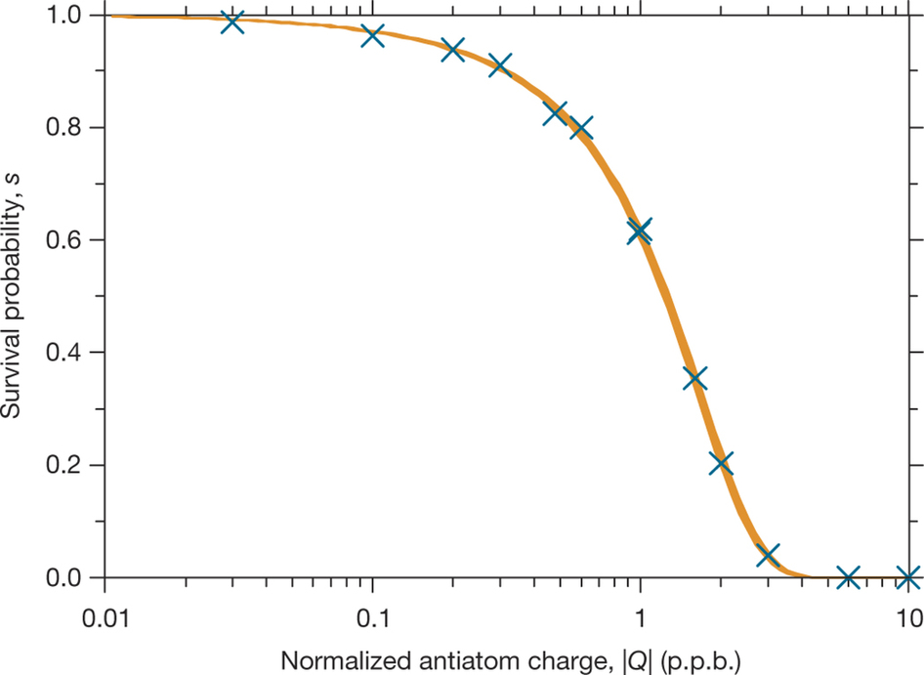
Simulated survival probability s as a function of |Q| for the stochastic trials
Notes:
Simulated survival probability s as a function of |Q| for the stochastic trials. The blue crosses are the number of antiatoms surviving at the given |Q| value divided by the number of antiatoms surviving at Q = 0 (the null simulation). The orange band of varying thickness is the 1σ confidence region from a Bayesian fit to this simulation data; see the Supplementary Information for further explanation.

Slide 25
 | Number of trials | Observed antiatoms
Stochastic trials | 10 | 12
Null trials | 10 | 12

Slide 26
Positron Temperature Problem
Leptons cool by cyclotron radiation.
At 1T, the predicted cooling time is 3.8s.
Leptons should cool to the temperature of the surrounding walls…but they don’t.
Typical final temperature is ~100K.
The reasons for this are not well understood.
Notes:
Steve Chapman

Slide 27



Cold Electron Plasma Experiment (CERES) Fajans Lab (Berkeley)
Purdue
Eric Hunter, Alex Povilus (now LLNL)

Slide 28
Cold Electron Experiment (CERES) in Fajans Lab (Berkeley)
Purdue
Eric Hunter, Alex Povilus (now LLNL)

Slide 29
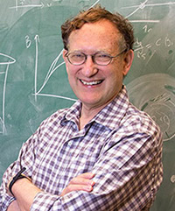
Happy Birthday Nat!
One way walls??
Notes:
Highly interdisciplinary research
Charge measurement is a precision measurement.

Slide 30
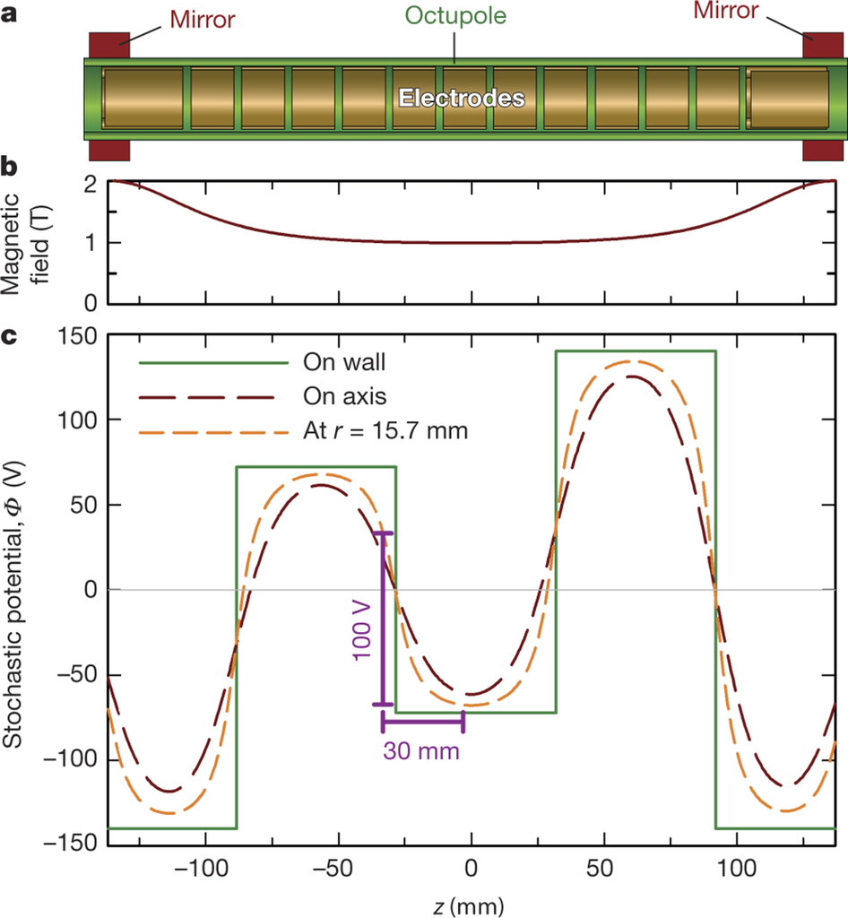
ALPHA-II Electrodes and B-field Coils
Notes:
a, Electrode structure of the ALPHA-2 trap, showing the approximate positions of the mirror and octupole coils. The particle detector (not shown) surrounds the octupole. (The vertical scale has been expanded for clarity.) b, Magnetic field on the axis (z) of the atom trap showing the axial magnetic potential well induced by the mirror fields. c, A snapshot of the applied stochastic electric-field potential Φ at several radii r as a function of z. ‘On wall’ indicates the wall of the Penning trap; ‘on axis’ indicates the axis of the trap (r = 0). The purple brackets indicate a typical travel distance and potential change experienced by an antiatom with 0.1 K of axial energy in 1 ms.

Slide 31

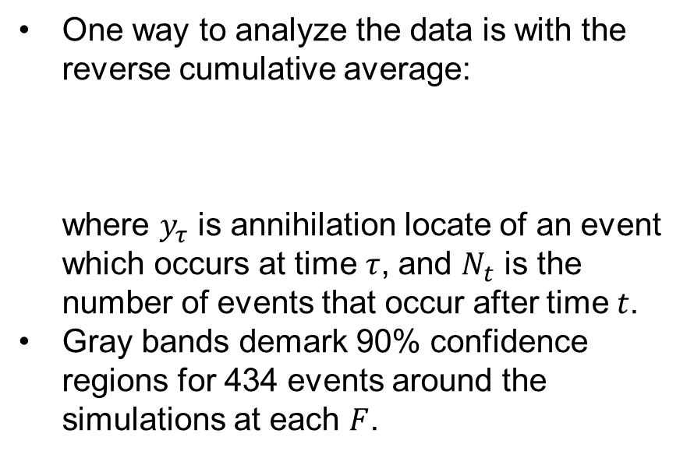
Can ALPHA See the Effects of Gravity?
Equation of motion for antihydrogen atoms in a magnetic trap and gravity:
Define the F to be the ratio of the gravitational mass to the inertial mass.
$F=1$ is standard gravity.
$F=−1$ is “standard’’ antigravity.
$F=100$ is anomalously strong gravity
Notes:
We did no explicit gravitational experiments. Gravity is not our immediate goal.
Decided to see if there was anything we could conclude…data mining exercise.

Slide 32
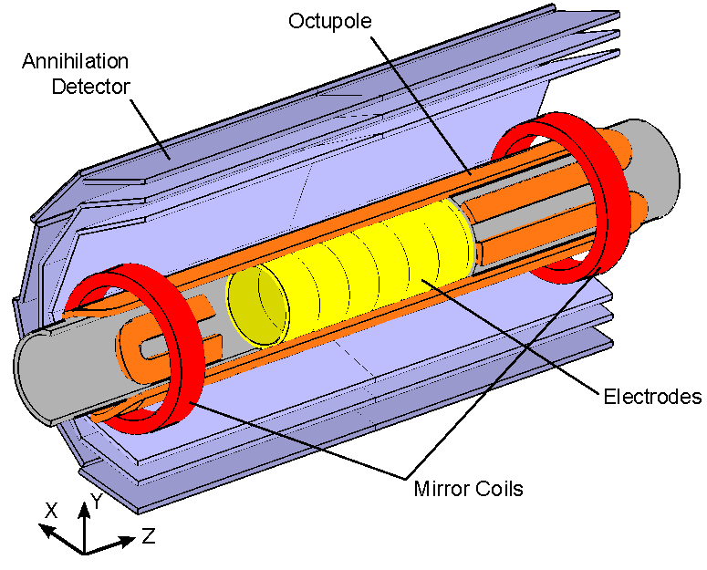
Effect of Gravity on the Anti-Atom Trapping Well
M_{G}/M =100
Bound the ratio of the gravitational mass M_{G} to the inertial mass of antihydrogen, M.
“Normal” gravity: M_{G}=M
Bottom
Top
Potential includes effect from both the magnet system and gravity.
The trap diameter is 44.55mm.
ALPHA, Description and first application of a new technique to measure the gravitational mass of antihydrogen, Nature Comm 4, 1785 (2013).
Notes:
Gravitational experiments typically vertical with much larger rises, or long path lengths

Slide 33
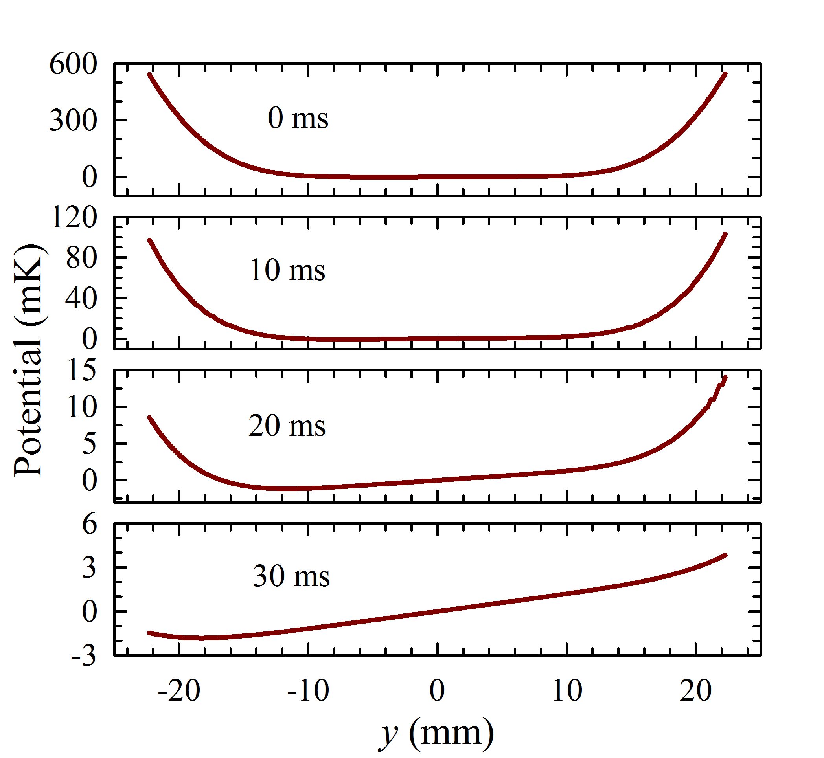
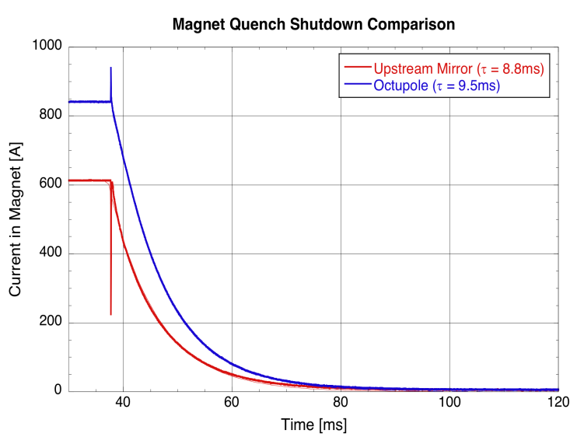
Potential Well After Magnet Shutdown
M_{G}/M=100
Notes:
Cooling can be ~10x
Multiple bounce allow Hbar to find hole….equivalent, in some ways, to a long path length.

Slide 34


Effect of Gravity on Anti-Atoms in a Diminishing Minimum-B Potential Well
M_{G}/M=100
Mean:
M_{G}/M=1
Mean:
M_{G}/M=100
Green dots---simulated annihilations
Red circles---434 Observed annihilations
Data Set:
All 434 observed antihydrogen atoms in 2010 and 2011 that were held for longer than 400ms.
All atoms were in the ground state.
ALPHA, Confinement of antihydrogen for 1000s, Nature Physics 7, 558 (2011).
Notes:
Don’t want to make bins too big for events

Slide 35
Effect of Gravity on Anti-Atoms in a Diminishing Minimum-B Potential Well
M_{G}/M=100
Green dots---simulated annihilations
Red circles---434 Observed annihilations
Basic Dilemma:
  The late escaping anti-atoms are most sensitive to gravity…
  But there are relatively few late escaping particles, so the statistics for these anti-atoms are poor.
How do we establish that the observed annihilations are not compatible with some assumed ratio of Gravitational to Inertial mass ?
Notes:
Don’t want to make bins too big for events

Slide 36
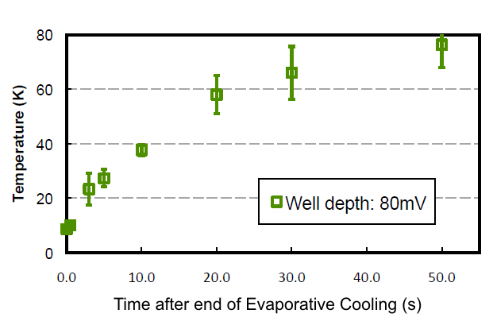
Positron Evaporative Cooling
To trap antihydrogen, we need to further cool our positron plasmas.
By making the positron well very shallow on one side, we allow the hottest positrons to escape.
  This cools the remaining positrons.
  Typically, we can get to sub 50K temperatures.
This is a temporary effect; after evaporative cooling, the positrons quickly warm back up…Use the cold positrons quickly.
ALPHA, 2010, preliminary.

