Slide 1
Solved and Unsolved Problems in Plasma Physics
----- A symposium in honor of Prof. Nathaniel J. Fisch
Understanding the L-H Transition in Fusion Plasmas
G.S. Xu
March 28-30, 2016
PPPL, Princeton, New Jersey, USA

Slide 2
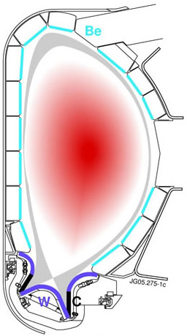
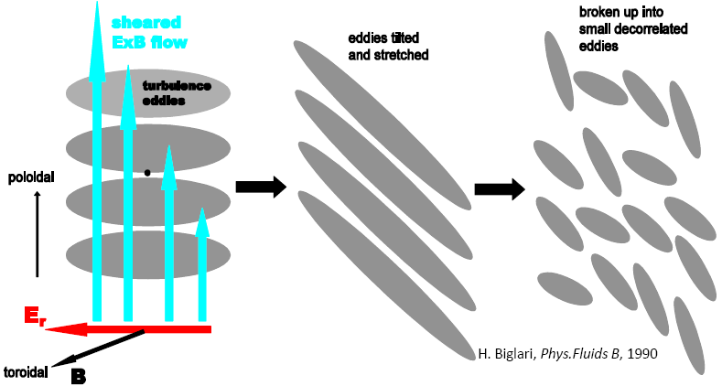
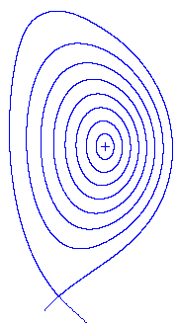
Introduction of the “L-H transition”
Plasma pressure
H-Mode
L-Mode
Transport Barrier
0 1
r/a
F. Wagner et al., PRL 49, 1408 (1982)

Slide 3
Two central questions
Mechanism for turbulence quick suppression
Mechanism for the sheared-flow generation

Slide 4

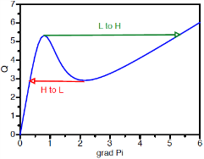
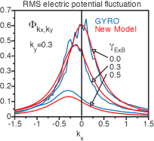
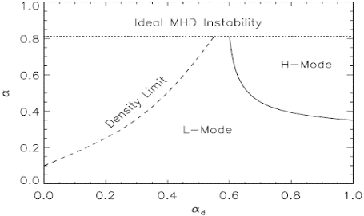
Mechanism for turbulence quick suppression
Mean flow bifurcation + shear decorrelation → bifurcation of momentum equilibrium
Stringer 1969, Itoh, Shaing, Biglari, Hinton
Inverse cascade to zonal flows → prompt increase of energy transfer through
Diamond predator-prey model
k_{r} spectrum shift and tilt of eddy structure → scatter turbulence energy to high k⊥ region
Staebler, Waltz quench rule
Across instability boundary → resistive drift-ballooning mode turbulence in L mode
Rogers, Bourdelle
Stringer
S-curve
Edge plasma phase space

Slide 5
Mechanism for the sheared-flow generation
Radial force balance:
Diamagnetic mean flow
In the H-mode pedestal, the diamagnetic mean flow dominates. However, in the L mode they may be comparable.
Neoclassical-driven mean flow
Total
E×B flows
Turbulence-driven mean flow
determined by neoclassical and turbulent poloidal and toroidal momentum transport.
Turbulence-driven zonal flows

Slide 6
Momentum transport and boundary conditions
Reynolds Stress
Turbulent transport
Neoclassical transport
Poloidal neoclassical stress is strong due to the very strong magnetic pumping.
Toroidal neoclassical stress is relatively weak, however, can shift the threshold.
X.Q. Wu, G.S. Xu, Nucl. Fusion 55, 053029 (2015)
Boundary conditions:
E_{r} in the SOL is positive due to sheath;
Poloidal mean flow near the separatrix significantly deviates from neoclassical;
A viscous boundary layer is needed inside the separatrix to transition from the SOL poloidal flow to the neoclassical solution in the core.
V. Rhozhansky and M. Tendler, Phys. Fluids B4, 1877 (1992)

Slide 7
Momentum transport and boundary conditions
Reynolds Stress
Turbulent transport
Neoclassical transport
Poloidal neoclassical stress is strong due to the very strong magnetic pumping.
Toroidal neoclassical stress is relatively weak, however, can shift the threshold.
X.Q. Wu, G.S. Xu, Nucl. Fusion 55, 053029 (2015)
Boundary conditions:
E_{r} in the SOL is positive due to sheath;
Poloidal flow near the separatrix significantly deviates from neoclassical;
A viscous boundary layer is needed inside the separatrix to transition from the SOL poloidal flow to the neoclassical solution in the core.
Zonal-flow
V. Rhozhansky and M. Tendler, Phys. Fluids B4, 1877 (1992)

Slide 8
The poloidal mean flow increases in the ion-diamagnetic direction at the plasma edge across the L-H transition
Mainly due to the boundary condition change, i.e., significant increase of the pressure gradient and diamagnetic mean flow on the separatrix.
DIII-D
Edge E_{r} becomes more negative in H mode mainly due to significant increase of the diamagnetic mean flow. However, its boundary value on the separatrix is still clamped at a positive value due to sheath in the SOL.
X.Q. Wu, G.S. Xu, Nucl. Fusion 55, 053029 (2015)
J. Kim, Plasma Phys. Control. Fusion 36, A183 (1994)

Slide 9
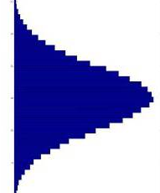
The role of zonal flows in the L-H transition
→ reduce the transition threshold
E_{r} shear
Trigger the transition
Transition threshold
Mean-flow shear
Zonal-flow shear
Time
Zonal flows are superimposed on the mean flow, which can trigger the transition when the mean-flow shear is still far below the transition threshold.
If the zonal-flow amplitude is much smaller than the mean flow, the effects of zonal flows may be negligible, and the transition will be solely determined by the mean-flow shear.

Slide 10
When zonal-flow amplitude is much smaller than the mean flow, transition is solely determined by the mean-flow shear
E_{r} minimum does not change with n_{e}
E_{r} minimum is also independent of the heating power and even wall materials
In ASDEX Upgrade
P. Sauter, E. Wolfrum, Nucl. Fusion 52, 012001 (2012)
L.M. Shao (my student), PPCF 58, 025004 (2016)

Slide 11
Small dithering (not the normal dithering in I-phase) prior to the L-H transition near the power threshold → zonal flows?
The normal dithering in I-phase has strong n/m = 0/1 magnetic perturbations, |δB_{θ}| ~ 1 Gauss
Small dithering is also observed in ASDEX Upgrade before the I-phase
Very weak magnetic perturbations for small dithering ~2kHz, |δB_{θ}| ~ 0.1 Gauss
Turbulence suppression
Reynolds stress modulation
G.S. Xu, Nucl. Fusion 54, 103002 (2014) “Dynamics of L–H transition and I-phase in EAST”
G.S. Xu, PRL 107, 125001 (2011)
“First Evidence of the Role of Zonal Flows for the L-H Transition at Marginal Input Power in the EAST Tokamak”
L.M. Shao PHD thesis.
S.H. Müller, Phys. Plasmas 21, 042301 (2014) Fig. 6

Slide 12
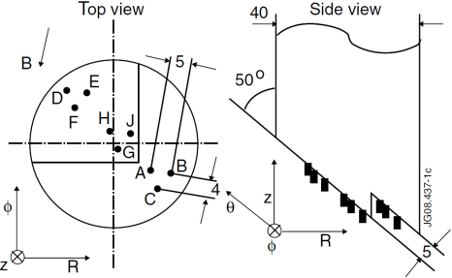
Turbulence transports positive poloidal momentum (ion-dia) out, which enhances the edge mean-flow shear in L mode
Reynolds Stress
Poloidal mean flow on the separatrix is determined by the boundary condition:
Measured by a reciprocating Langmuir probe array
G.S. Xu, Nucl. Fusion 49, 092002 (2009) in JET

Slide 13
Turbulence-driven mean flow can enhance the edge mean-flow shear, thus trigger the L-H transition
Sometimes, we see the turbulence level, turbulent Reynolds stress, mean flow and mean flow shear increase prior to the L-H transition.
How strong can the turbulence-driven mean flow influence the transition threshold? We think it is a problem of the relative contribution to the total flow shear.
G.S. Xu, Nucl. Fusion 54, 103002 (2014) EAST probe
P. Manz, G.S. Xu, Phys. Plasmas 19, 072311 (2012) EAST probe
G.R. Tynan et al., Nucl. Fusion 53, 073053 (2013) DIII-D probe
Z. Yan et al., PRL 112, 125002 (2014) DIII-D BES
I. Cziegler et al., PPCF 56, 075013 (2014) C-Mod GPI

Slide 14
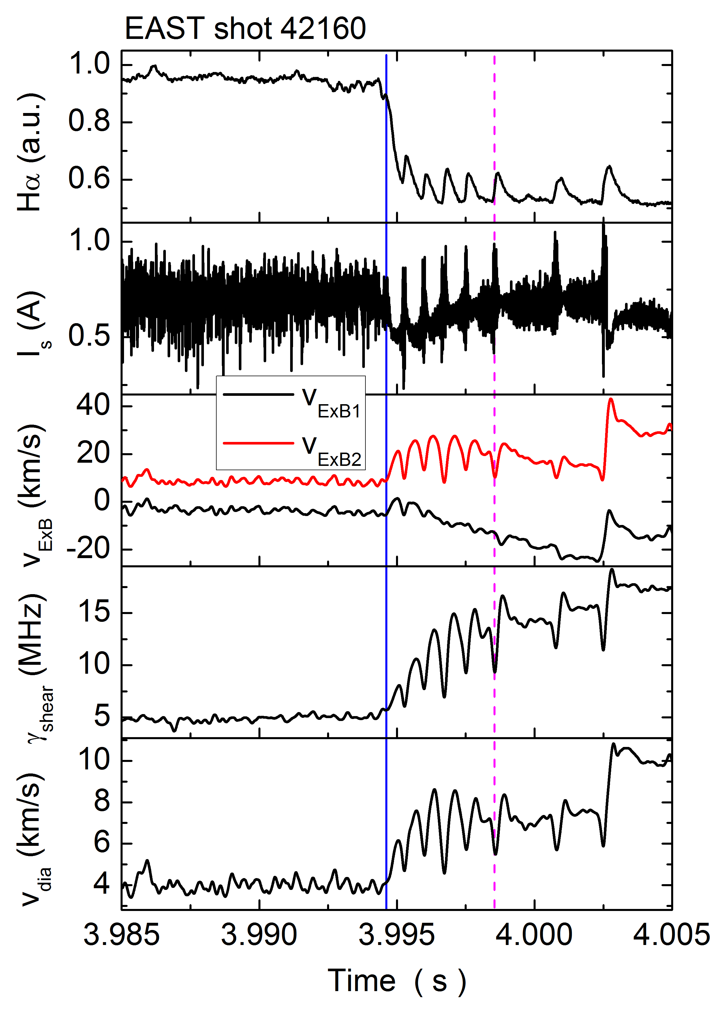
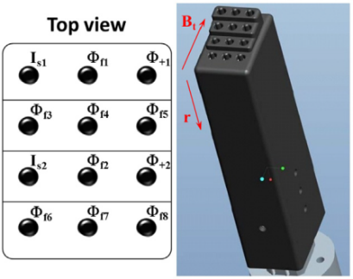
ExB flow and flow shear change during the transition
Mean ExB flow near the separatrix changes towards ion-diamagnetic direction, and flow shear increases at the same time of turbulence suppression.
Since the turbulence-driven mean flow will disappear when the turbulence is suppressed, and the pressure gradient increases near the separatrix. This may lead to the recovery of the turbulence level and the formation of the Limit-Cycle Oscillation (LCOs).
Since the turbulence is suppressed, the diamagnetic mean flow builds up, and finally locks in the H mode.
If the diamagnetic mean flow cannot immediately take over (pressure gradient increase is very slow in marginal power case), a LCO will appear.
3×4 probe array in EAST
G.S. Xu, Nucl. Fusion 54, 103002 (2014)

Slide 15
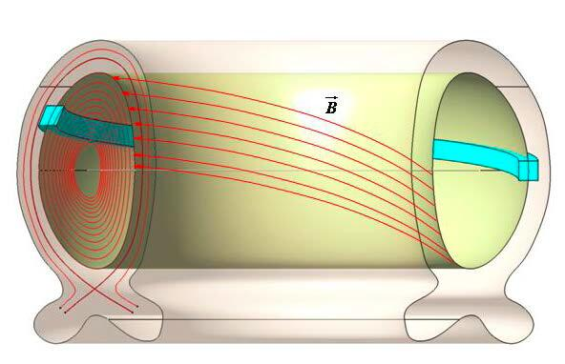
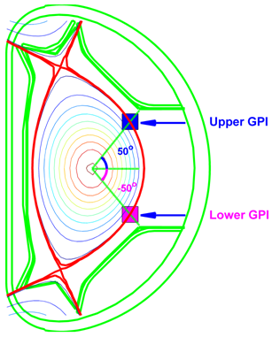
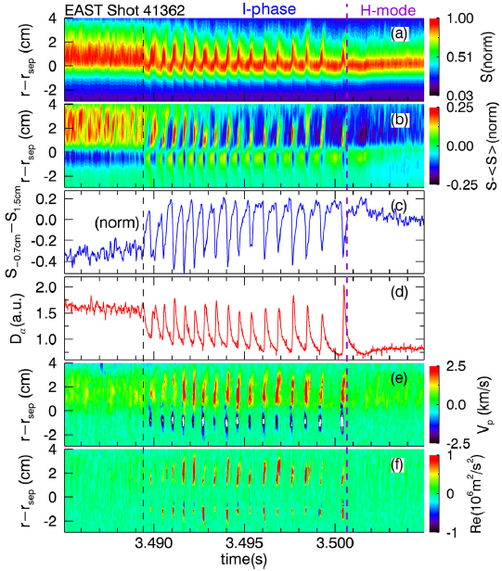
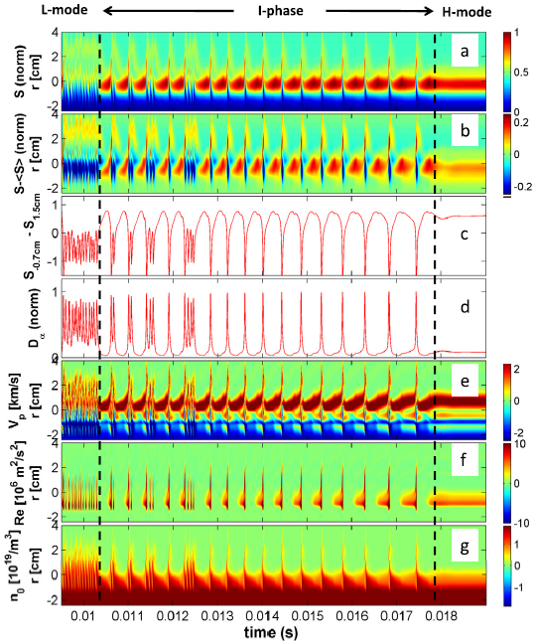
Understanding the Limit-Cycle Oscillations in I-phase
GPI measurement in EAST
HESEL code modeling
Successfully reproduce the L-I-H transition and back transition using a 4-field 2D drift-MHD code.
Recovers the transition power threshold as well as the decrease in power threshold switching from single to double null configuration observed in the EAST experiments.
generalized vorticity
– from polarization current
This term is essential for setting up and sustaining the “mean flow”, which locks in the H mode
A.H. Nielsen, G.S. Xu, Phys. Lett. A 379, 3097 (2015)
J. Juul Rasmussen, PPCF 58, 014031 (2015)
B. Li, Phys. Plasmas 22, 112304 (2015)
G.S. Xu, Nucl. Fusion 54, 013007 (2014)
L.M. Shao, G.S. Xu, PPCF 55, 105006 (2013)

Slide 16
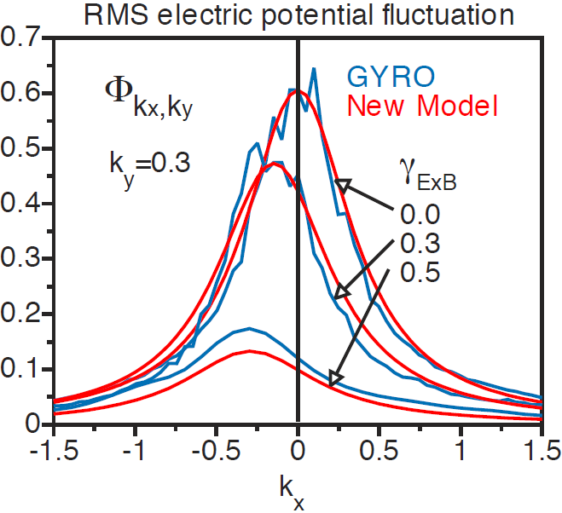
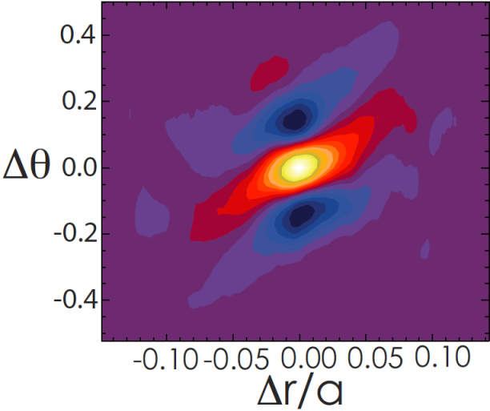
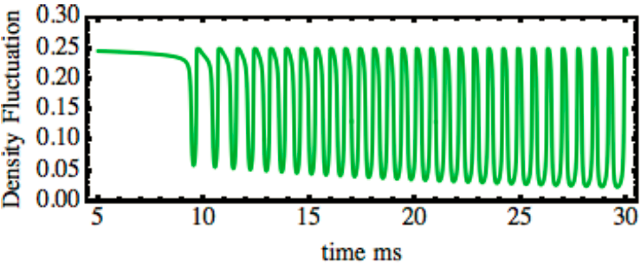
How does flow shear suppresses the turbulence?
Physics behind the “Waltz’s quench rule” γ_{E×B} > γ_{lin,max}
Turbulence suppression in experiments usually occurs very fast (typically ~ 100 μs).
Shear decorrelation of Shaing or Biglari needs a significant increase of the mean flow shear in a very short time scale to suppress the turbulence at the transition.
However, mean flow change prior to the transition is usually small → causality problem?
k_{r} spectral shift and tilt of 2D eddy structure due to breaking down of the ballooning symmetry in a torus by the flow shear → scatter turbulence energy to the high k⊥ region
Model reproduces the fast L-H transition and LCOs in I-phase
PPCF 57, 014025 (2015)
Nucl. Fusion 55, 073008 (2015)
G.M. Staebler, Phys. Rev. Lett. 110, 055003 (2013)

Slide 17
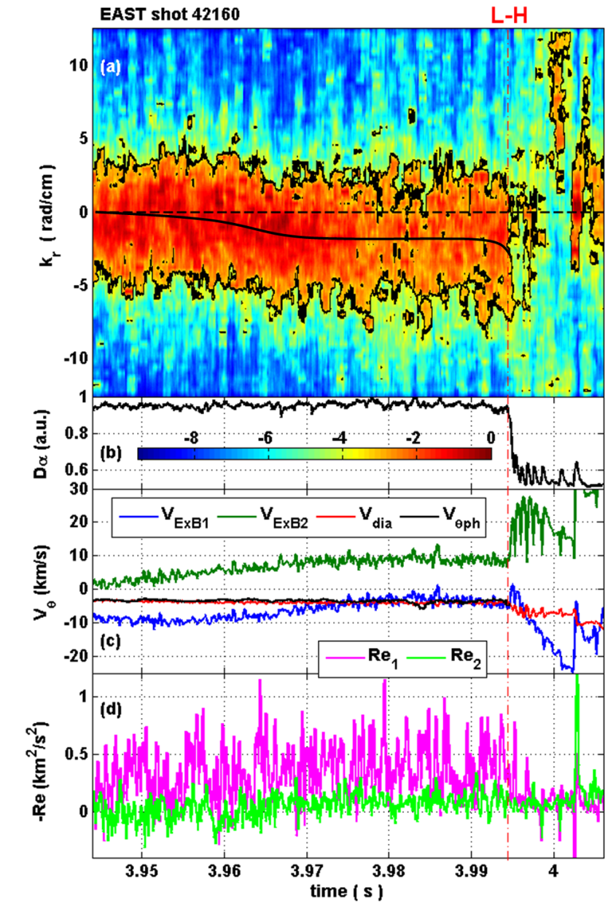
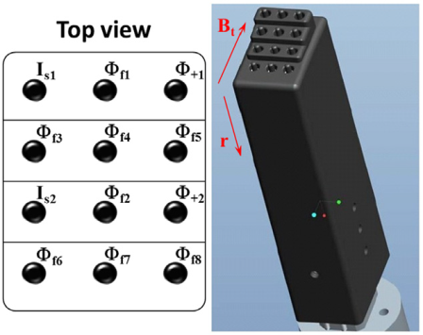
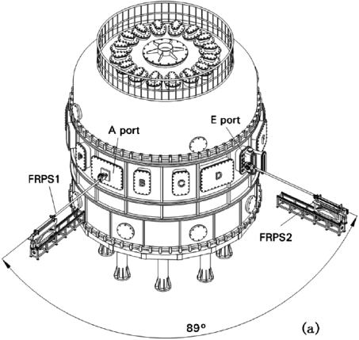
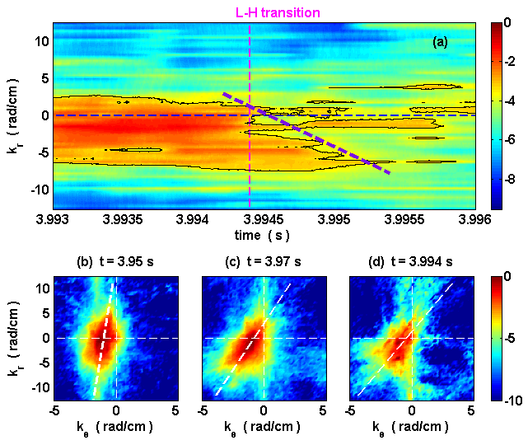
First direct observation of L-H transition mediated by turbulence k_{r} spectral shift and eddy tilting in EAST
Reciprocating Langmuir probe array
Shift accelerates at the transition, accompanied by turbulence suppression.
Eddy tilt increase as approaching the L-H transition.
G.S. Xu, PRL 116, 095002 (2016)

