Slide 1
Challenge in LHCD capability at high density regime
Solved and Unsolved Problems in Plasma Physics
A symposium in honor of Nathaniel J Fisch, March 28~30, 2016, Princeton, NJ
B J Ding, M H Li, J G Li and B N Wan
for EAST team and international collaboration team*
Institute of Plasma Physics, Chinese Academy of Sciences, Hefei 230031,China
* CEA, IRFM, 13108 St. Paul-lez-Durance, France
ENEA, Centro Ricerche Unità Fusione Frascati c.p. 65, 00044 Frascati, Italy
PSFC, NW16-240, MIT, Cambridge, MA 02139, USA
PPPL, Princeton, New Jersey 08544, USA

Slide 2
Aiming at fusion reactor, two issues must be solved for LHCD
Effective coupling
Effective current drive at high density
Some efforts in EAST will be presented.
2

Slide 3

Coupling problem
Plasma density at the grill mouth and its gradient are two key factors determining wave-plasma coupling. (The LHW power cannot be effectively coupled to the plasma if the plasma density at the grill is below the cut-off density ω_{p}≥ω₀)
In fact
1. In order to avoid heavy heat load and to satisfy different plasma configurations, it is necessary to increase the distance between antenna and plasma.
2. In the H-mode plasma, the edge density will decrease rapidly enough that the density at the grill mouth does not satisfy the wave-plasma coupling condition,
resulting in a large reflection.
Therefore, bad coupling is inevitable.
To improve the coupling between LHW and plasma, a kind of neutral gas (e.g., CD4 (methane), D2 (deuterium)) is utilized to increase the grill density.
JT-60U, ASDEX, JET, Tore-supra, HT-7 and EAST
3

Slide 4
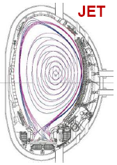
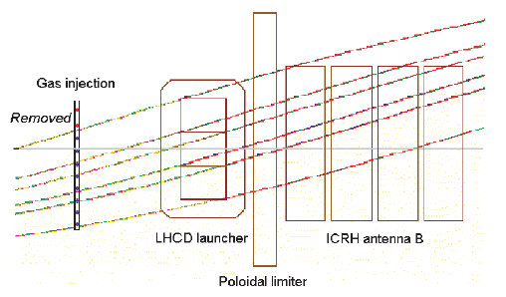
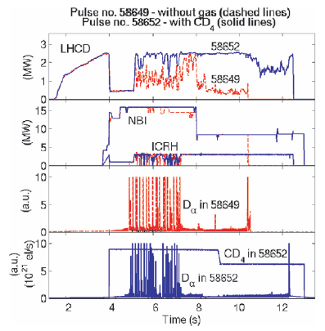
Long distance coupling is improved by gas puffing in JET（~14cm)
4

Slide 5
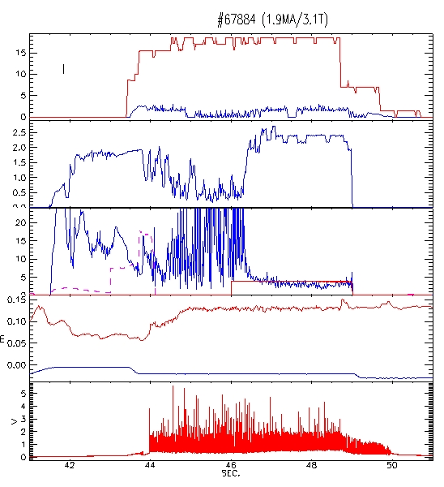
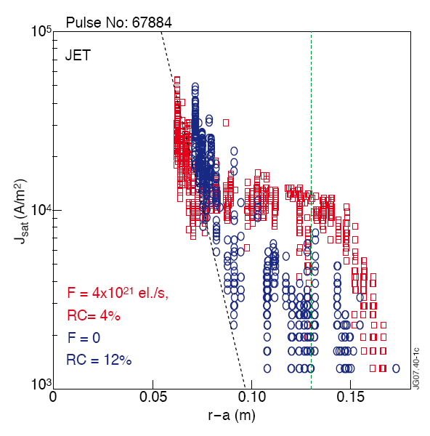
Used routinely for LH in JET H-mode plasmas
A. Ekedahl et al., PPCF, 51 (2009)
Good LH coupling obtained at plasma-launcher distance up to 15cm,
using local gas injection (GIM6) in H-mode plasmas.
P_{LHCD} (MW)
RC (%)
GIM6
12-13cm
-2cm
D_{α}
Reciprocating Langmuir probe measurements show a flattening of the SOL density profile.
5

Slide 6
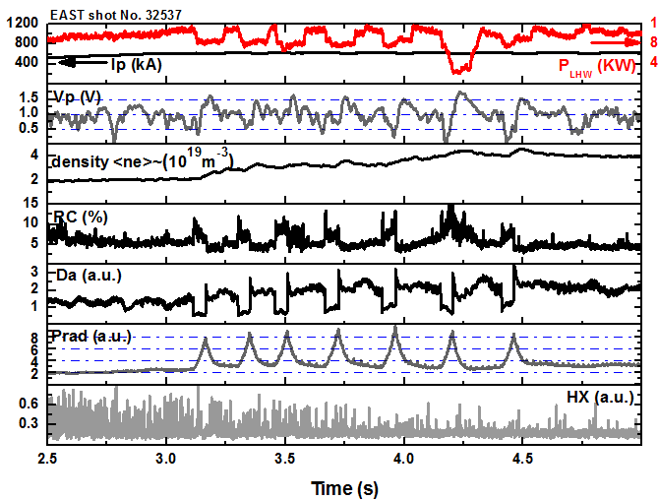
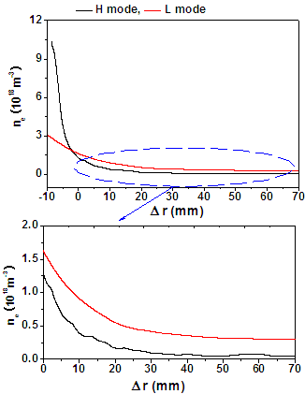
Experiments of LHW coupling w/o local gas puffing
B J Ding et al., Nucl. Fusion 53 (2013) 113027
Typical L-H-L waveform
Density profile in SOL
Plasma-wave coupling deteriorates as the transition of L-H occurs and plasma radiation has a corresponding behaviour during L-H and H-L transition.
Such change of radiated power and coupled LHW power leads to the multiple L-H-L transitions, suggesting that the net power for H-mode plasma is marginal.
Therefore, it is necessary to improve LHW-plasma coupling to sustain H-mode plasma, eg., by means of local gas puffing.
6

Slide 7
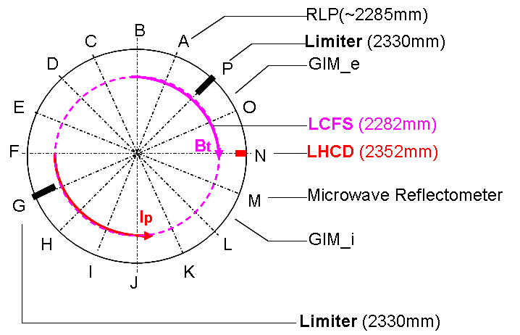
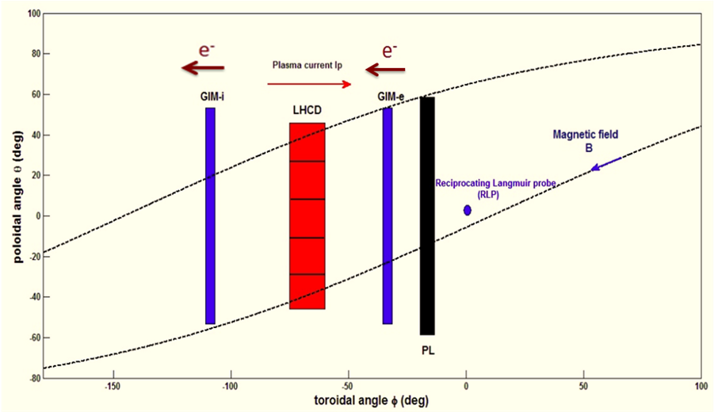
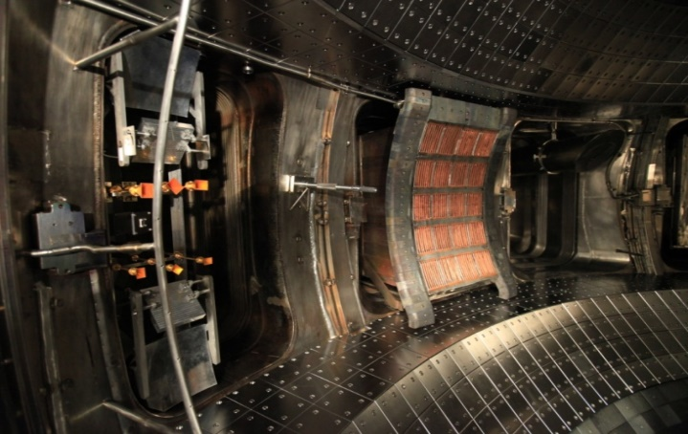
Experiment arrangement of gas puffing in EAST (2.45GHz)
After ionization, the electron moves to antenna with GIM-e, whereas it moves outwards to antenna with GIM_i, possibly leading to different coupling.
Arrangement of local gas puffing
M
O
N
Topology in toroidal and poloidal direction
P
7

Slide 8
Effect of gas puffing on coupling from GIM_i and GIM_e
B J Ding, et al., Nucl. Fusion 53 (2013) 113027; Physics of Plasmas 20, 102504 (2013)
Higher density and lower RC with GIM_e puffing, meaning that it is more efficient to improve density in this case.
For a same density at the LCFS, RC in the case of GIM_e puffing is a little smaller than that in the case of GIM_i puffing, implying a higher density at the grill mouth when gas puffing from electron-side.
Gas puffing from electron-side is more efficient to improve LHW-plasma coupling, due to different movement direction of ionized electron compared to LH grill.
8

Slide 9
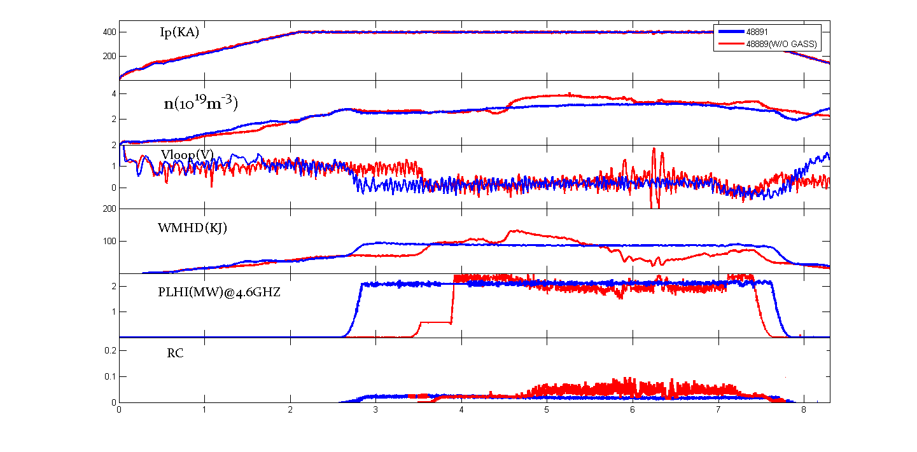
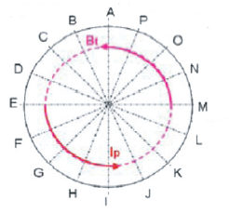
GIM_e gas puffing is utilized for coupling in EAST
Local gas puffing
4.6 GHz LHCD
2.45GHz LHCD
Local gas
puffing
Top-view
With local gas puffing
Without local gas puffing
RC is smaller in the case of local gas puffing.
9

Slide 10
Coupling is improved by GIM_e puffing
Good coupling is obtained by means of configuration optimization, local gas puffing.
10

Slide 11
LHW-plasma coupling can be improved by local gas puffing.
Grill density feedback-control is under process.
11

Slide 12
High density problem
Poor accessibility
(This could be acceptable for the off-axis power deposition)
More importantly, Current drive efficiency could be degraded sharply with density increasing, due to PI, CA and SDF
12

Slide 13
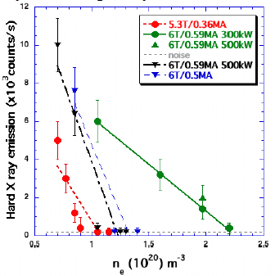
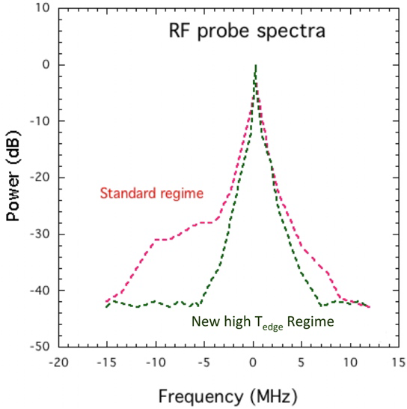
High Te in edge region may improve CD efficiency at high density (FTU)
HXR emission for the low Te (dash line) and high Te with Li coating (solid line)
Frequency spectra
by antenna probe
PI is very likely the underlying mechanism for low CD efficiency
R Cesario, Nature Commun. (August 2010) http://dx.doi.org/10.1038/ncomms1052
13

Slide 14
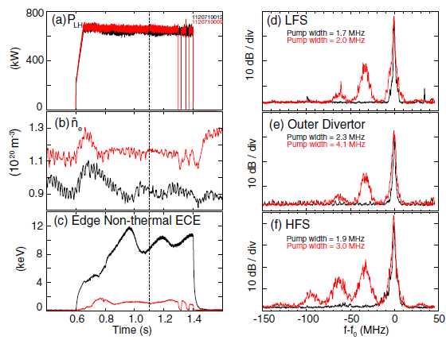
PI measured by Langmiur Probes in C-mod
S G Baek, et al., Plasma Phys. Control. Fusion 55 (2013) 052001
ne=0.9 x10²⁰ m⁻³ (black) , ne=3.3x10²⁰ m⁻³ (Red)
● PI occurs at higher density.
● PI can occur in either HFS or LFS.
14

Slide 15
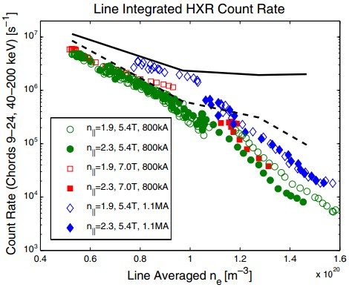
CA in SOL may decrease CD efficiency (GENRY/C3QLD)
Including the effects of collisional damping
Without
G M Wallace et al., Phys. of Plasmas 17 (2010) 082508
15

Slide 16
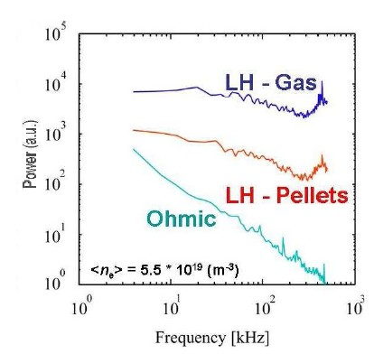
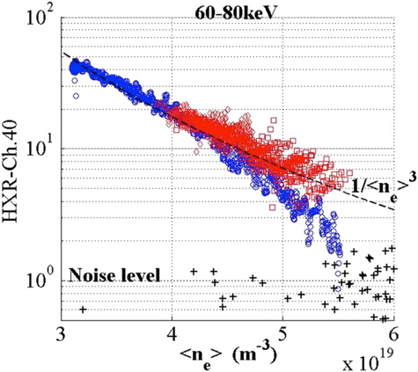
Density fluctuation in edge region may affect CD effect （TS）
Pellet (red） Gas（blue）
Density fluctuation spectrum for pulses
fuelled with gas and pellets
M. Goniche et al., Nucl. Fusion 53 (2013) 033010
16

Slide 17
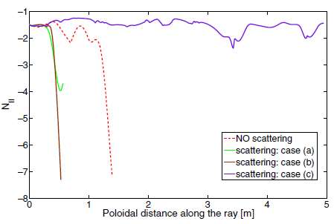
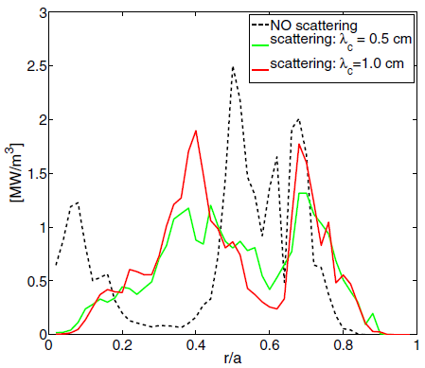
Wave scattering due to density fluctuation may improve or decrease CD efficiency, depending on N// upshift and power deposition
Effect of density fluctuation on N//
Effect of density fluctuation on power deposition
17
N. Bertelli, et al., PPCF 55 (2013) 074003

Slide 18
Similar to the above studies in different devices,
joint experiments in EAST are investigated as follows, including density fluctuation, CA and PI.
B J Ding et al., Nucl. Fusion 53 (2013) 113027
B J Ding et al., Nucl. Fusion 55 (2015) 093030
18

Slide 19
Hard X-ray emission vs density
Comparison: 1. Strong and poor lithiation (gas puffing)
2. Density feedback by gas puffing and SMBI (strong)
1. Strong lithiation is better than poor lithium coating.
2. Gas puffing is better than SMBI.
19

Slide 20
Profiles in SOL measured by Reciprocating probe
● Large density fluctuation @SMBI.
Favourable for Wave scattering
● Higher density and lower temperature @ poor lithiation and SMBI
Favourable for CA and PI
42035 (Gas puffing/strong Li.)
42211 (SMBI/strong Li.)
43772(Gas puffing/poor Li.)
20

Slide 21
Effect of density fluctuation on CD efficiency (C3PO/LUKE)
Tailmodel means the fluctuating spectrum due to density fluctuation.
The fluctuating spectrum makes the power deposition move inward, but the total value of driven current decreases (~30%)
Large density fluctuation in egde region is one possible candidate for the low CD efficiency in SMBI case.
21

Slide 22
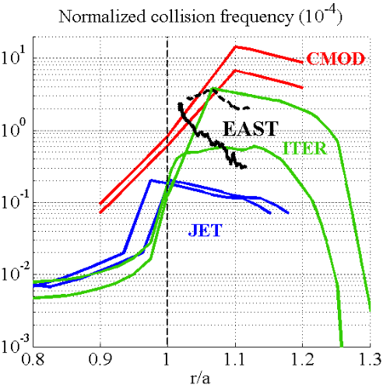
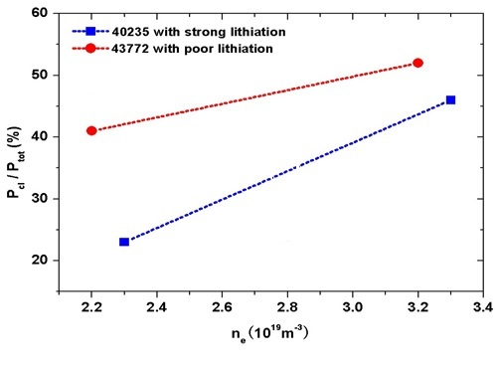
Simulation by GENRAY suggests that collision absorption is one of possible candidates for the decreasing CD efficiency
C Yang, P. T. Bonoli
M. Goniche, et al
● More LHW power is absorbed in SOL by collision in the case of poor lithiation.
● Normalized collision frequency is higher in the case of poor lithiatiuon.
● The frequency is comparable with C-mod and ITER, but higher than JET.
22

Slide 23
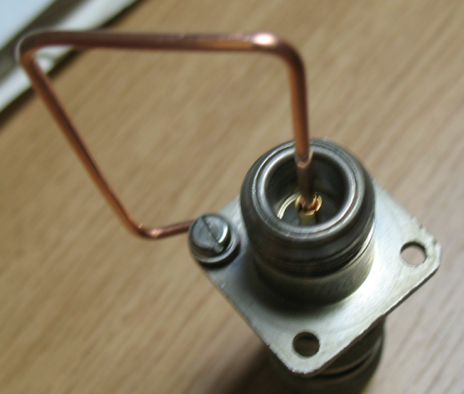
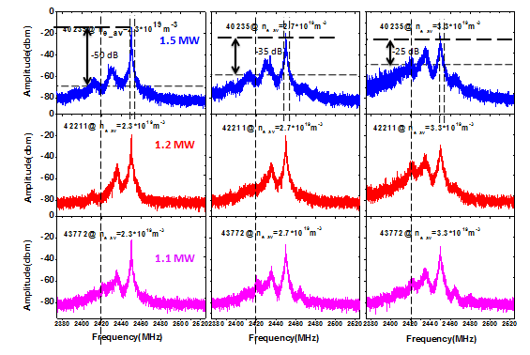
PI comparison measured by RF antenna in EAST
Typical Features of PI are indicated by:
Peaks at ω₂ (ion cyclotron and ion-sound driven)
Spectrum broadening around ω₀ (ion-sound driven)
ω₀
Power separation
ω₂
Frequency width of LH pump
With the density increase, PI behaviour increases.
23

Slide 24
The sharp decay of HXR counts is correlated with PI behaviour
Local f_{ci} in the edge, where PDI could be strong.
The dependences of CD effect on density are nearly consistent with the tendency of IC sideband frequency change.
24

Slide 25
PI modelling show that mode growth rate is large in the case of poor lithiation, linearly in agreement with the measurements.
Results from LHPI code by ENEA
Poor lithiation
Strong lithiation
25
Results from PI code by MIT

Slide 26
The mechanisms affecting CD efficiency show that edge parameters play an important role.
However, how to effectively control the parameters is not so easy, since coupling and current drive both depend on edge parameters.
26

Slide 27
Effect of LH frequency on LHCD
Higher LH frequency is preferred for LHCD at high density.
27

Slide 28
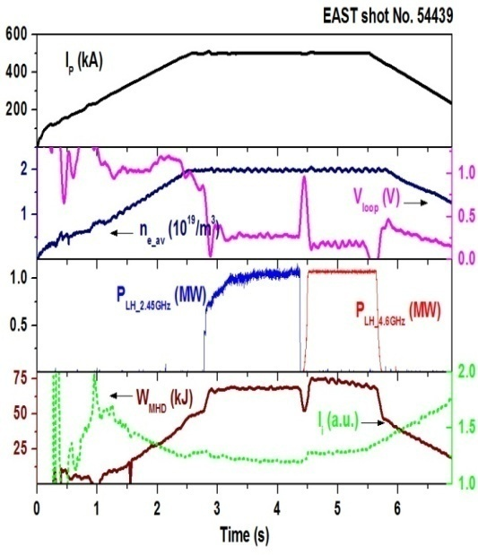
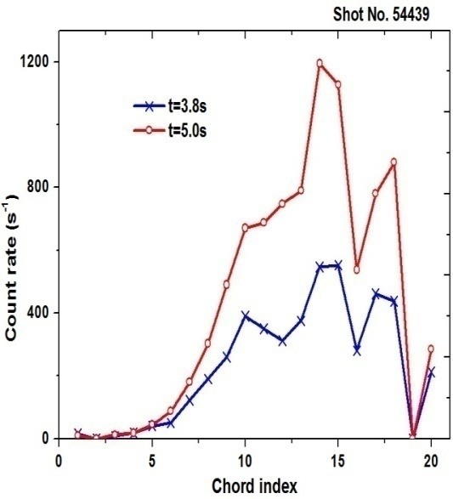
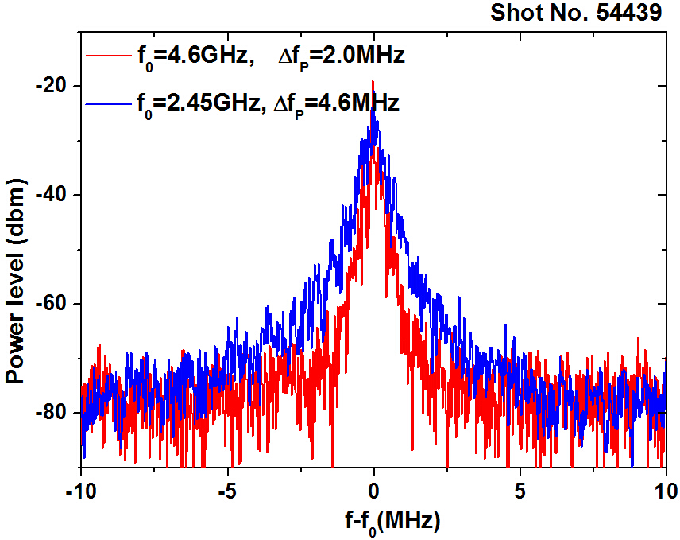

Comparison between 2.45GHz and 4.6GHz LHCD
(same target plasma)
1. Higher CD efficiency with 4.6GHz LHW
2. Peaker current profile with 4.6GHz LHW
3. Less parametric instability behaviour with 4.6GHz system
28

Slide 29
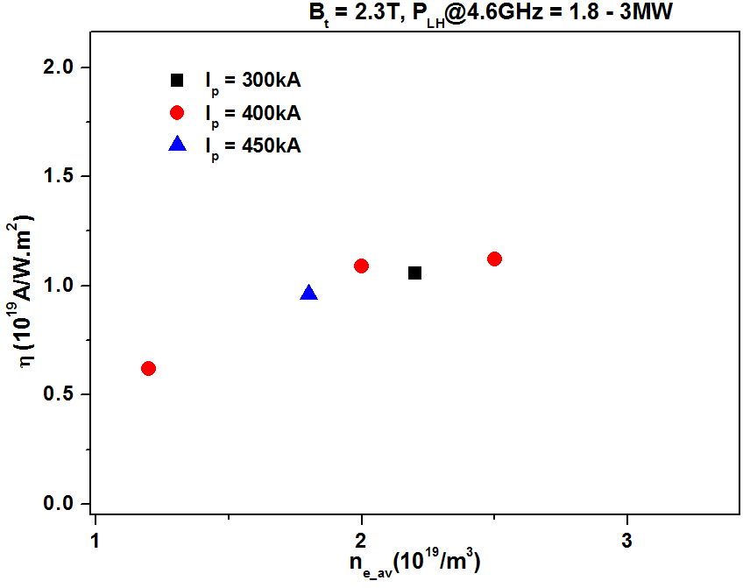
CD efficiency is a little higher with 4.6GHz LHCD system
Comparison of current drive efficiency
f=2.45GHz
f=4.6GHz
η _{4.6GHz} ~1.1×10¹⁹Am⁻²W⁻¹ ， η _{2.45GHz} ~0.8×10¹⁹Am⁻²W⁻¹
29

Slide 30
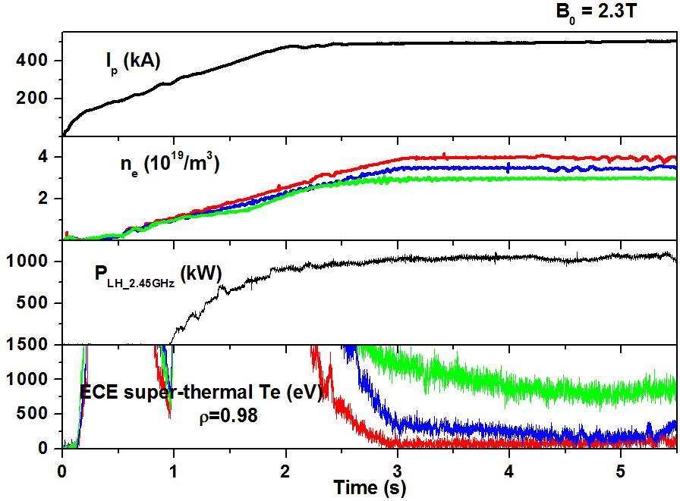
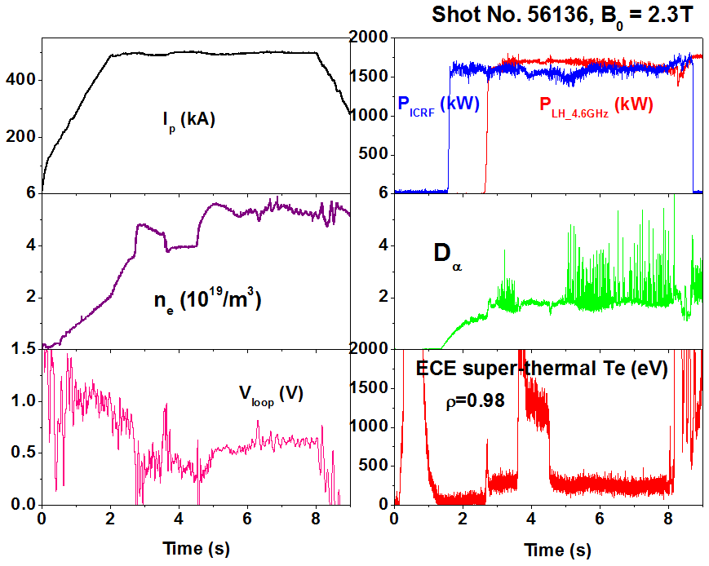
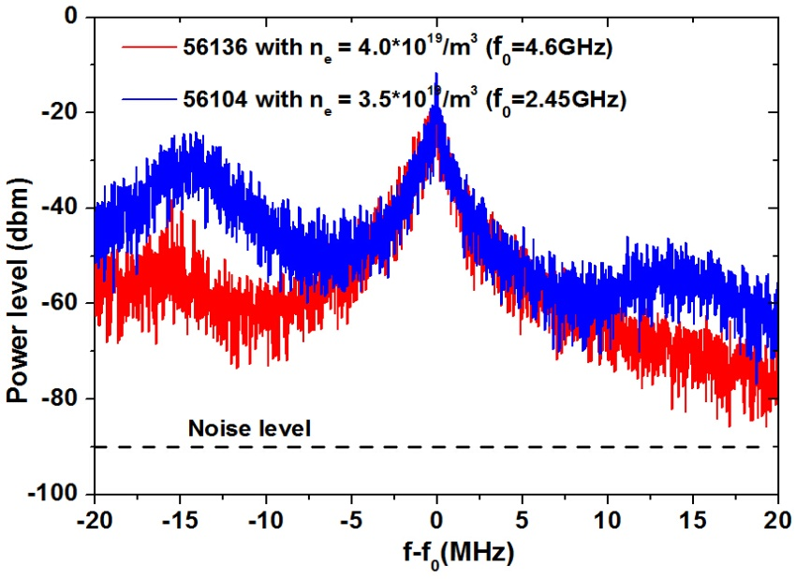
Comparison at high density experiments
2.45GHz
4.6GHz
CD effect is very marginal with density larger than 3.5*10¹⁹/m³
CD effect still exists with density ~ 4.0*10¹⁹/m³
Larger spectrum broadening with 2.45GHz LHW, suggesting less PI with 4.6GHz LHW
30

Slide 31
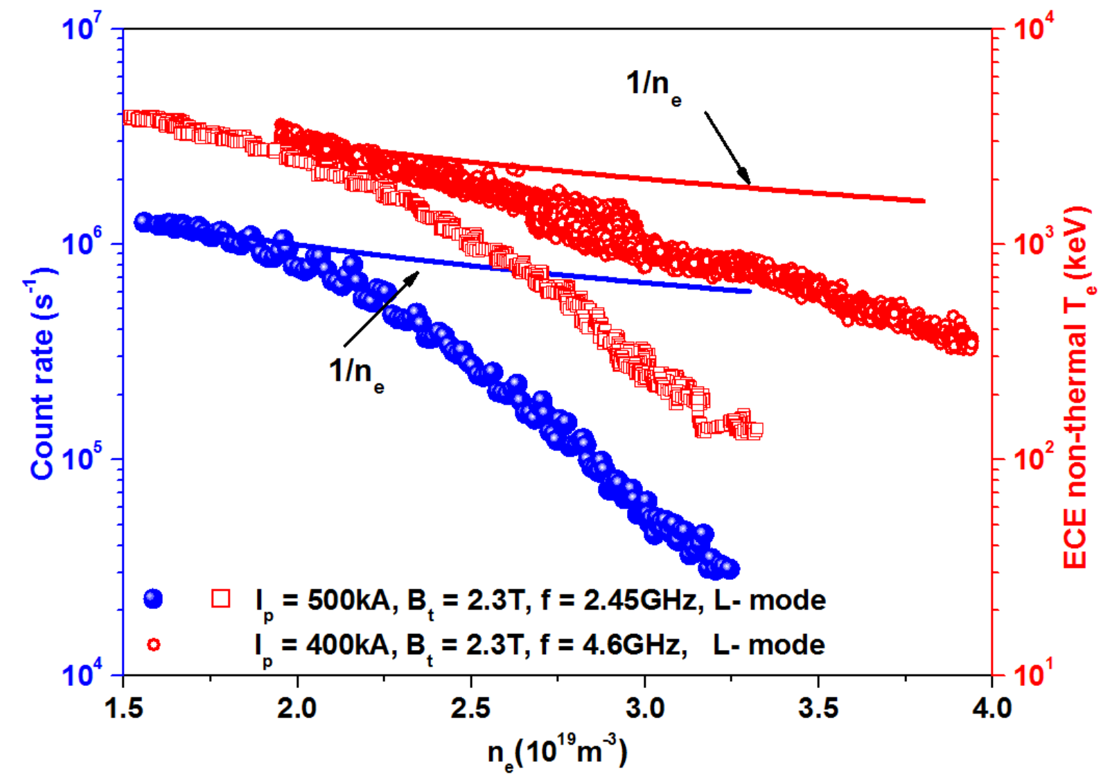
Fast electron behavior (2.45GHz vs 4.6GHz)
Higher density at which the fast electron emission deviates from 1/ne with 4.6GHz LHW
Possibly relevant to PI (nonlinear)!
31

Slide 32
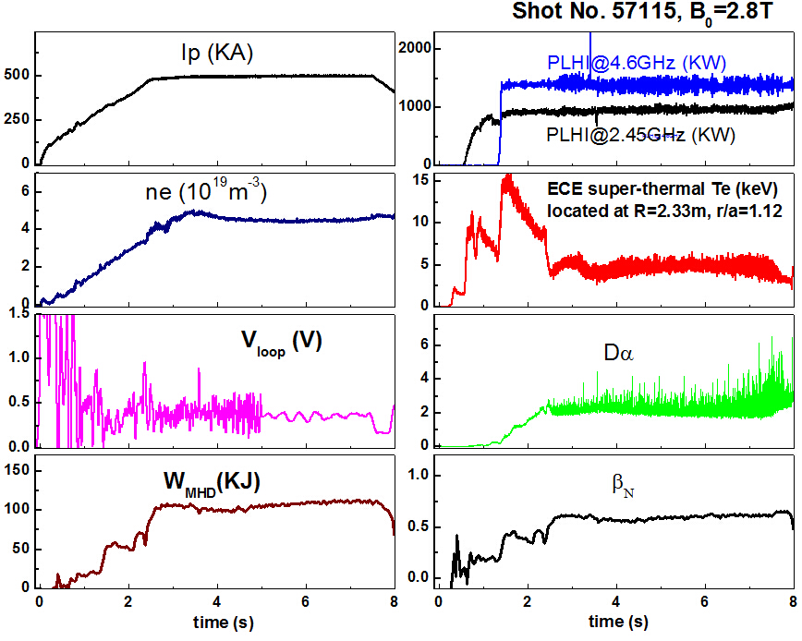
H-mode at high density obtained with LHCD
Seen from ECE, even if at ne~4.5e19m-3, part of current is driven by LHW!
32

Slide 33
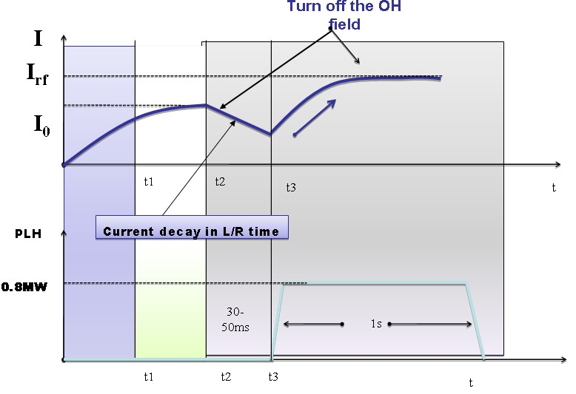
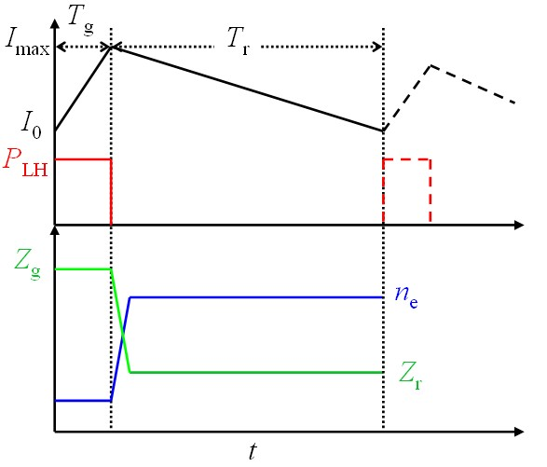
Cyclic operation of lower hybrid current drive
Due to the density limitation of LHCD, cyclic operation could be one alternative candidate
Fisch N J, 2010, J. Plasma Phys., 76: 627
Key points:
Fast over-driven at low density and slow decay at high density
Without OH field
Density and impurity control
33

Slide 34
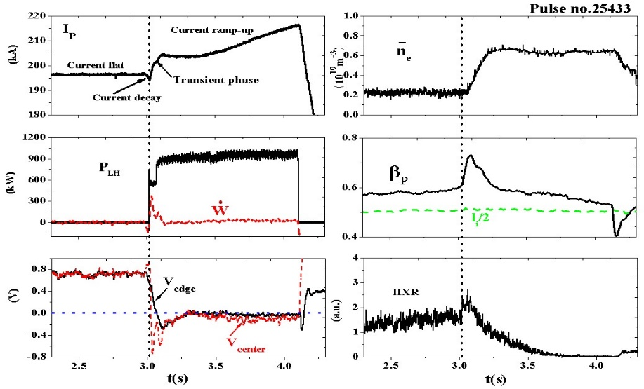
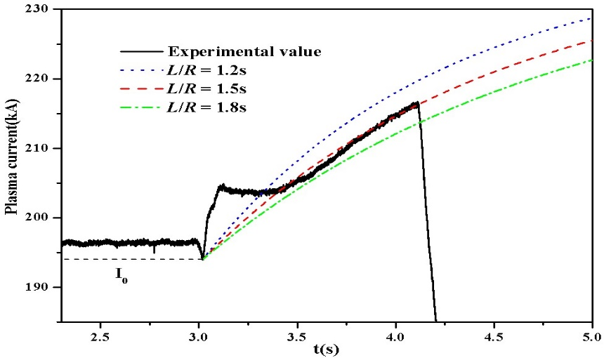
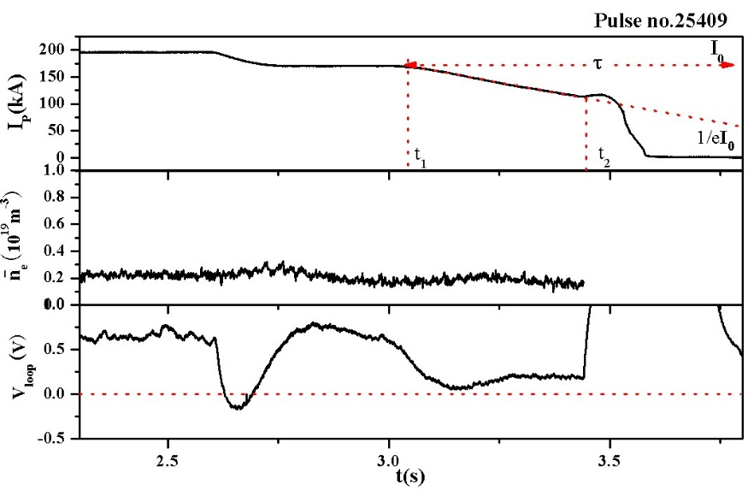
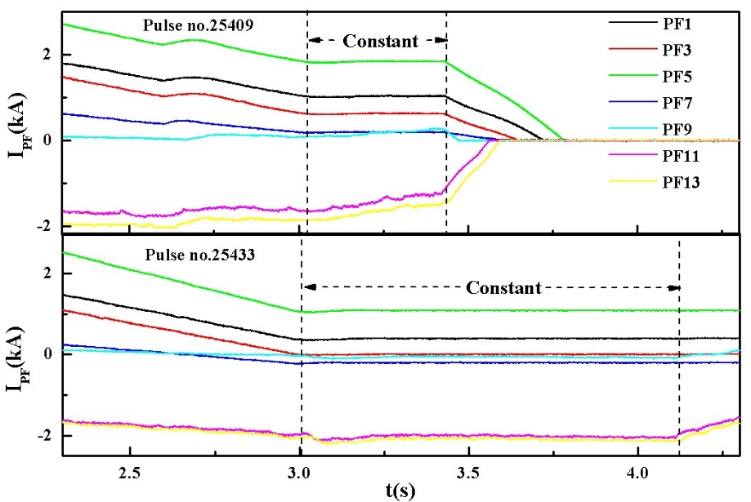


Current ramp-up without Ohmic heating and transformer recharging have been demonstrated for the first time in EAST
18 kA/s
B J Ding N J Fisch, et al., Phys. Plasma 19, 122507 (2012)
Challenge in EAST
1) Very difficult to turn-off OH field completely, since it and eq. field are coupled each other!
2) Ramp-up rate is slow because the L/R times are relatively large due to the large size of EAST (Increase I_LH, or reduce L/R by increasing impurity)
34

Slide 35
Conclusion
□LHW-plasma coupling can be improved by local gas puffing. Grill density feedback-control is under process.
□The mechanisms affecting CD efficiency show that edge parameters play an important role. However, how to effectively control the parameters is a challenge, since coupling and current drive both depend on edge parameters.
□Higher LH frequency is preferred for LHCD at high density.
□Cyclic operation of LHCD could be one alternative candidate at high density. Further demonstration is necessary.
35

Slide 36
Happy Birthday to Nat Fisch!
36

