Slide 1
Challenges and Opportunities in High Energy Density Physics
Princeton University
Solved and Unsolved Problems in Plasma Physics
Mark C Herrmann
National Ignition Facility Director
Thanks to the NIF team and D Casey, GW Collins, R Kraus R Linford, B Remington
March 28, 2016

Slide 2

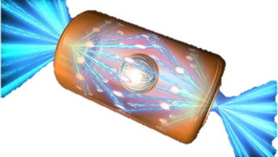
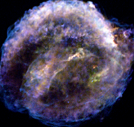
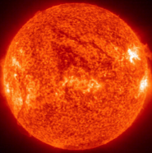
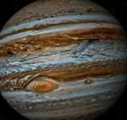

Matter at high energy density (HED) conditions is found throughout the universe
HED regime
P>1Mbar
DD fusion
8
M=60 sun
Inertial fusion
Super Nova
remnant
Sun
Important to understand:
Equation of State
Phase
Strength
Opacity
Ionization
Transport
Kinetics
Chemistry
6
atomic pressures ~ E_{h}/a_{B}³
Brown dwarf
pressure = 1 Mbar
Log Temperature (K)
Jupiter
4
Giant Planet
Earth’s
core
2
-5
0
5
Log density(g/cm³)
For the first time in history we can produce and accurately characterize the states and processes over this broad range of conditions
2

Slide 3
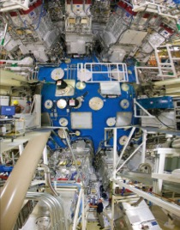
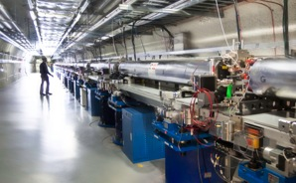
A number of new tools have been developed/refurbished to study high energy density science
National Ignition Facility
Omega and Omega EP Laser Facilities
Z Pulsed Power Facility
LCLS
Of course there are many, many lab scale facilities making major contributions
Major international facilities have come on line recently or will be on line soon (Orion, Laser Megajoule, Shenguang 3, SACLA, XFEL, ELI …)

Slide 4
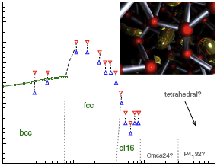
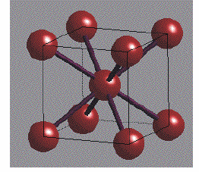
Just a few years ago, ultra-high pressure phase diagrams for materials were very simple
Melt curves typically followed a Lindeman law
and high pressure structures were simple
Physics
Gets
Simple!
900
Fluid
Melt curve
Lithium
Temperature (K)
500
Tetrahedral?
FCC
BCC
Cmca24?
P4₁32?
Cl16
100
.001
0.1
1
10
Pressure (Mbar)
Notes:
Put conductivity on this somehow

Slide 5

As we study this regime in more detail, complexity emerges
Core electrons have a profound effect on structure and melt at high pressure
900
Lithium
Many materials exhibit this complexity
Extends beyond phase to affect all basic properties
Fluid
Temperature (K)
500
Tetrahedral?
FCC
BCC
Cmca24?
P4₁32?
Cl16
100
.001
0.1
1
10
Pressure (Mbar)
Neaton and Ashcroft, Marqués, Hanfland et al, Syassen, K, Gregoryanz, E., J. Raty et al)

Slide 6
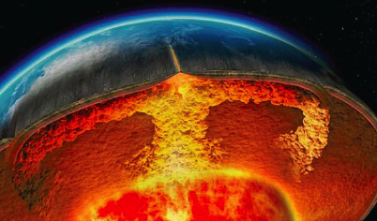
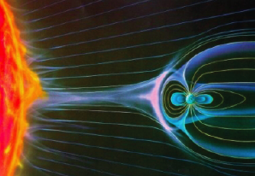
Material properties at high pressure play a key role in the evolution of habitable planets: protective magnetosphere, plate tectonics..
(R. Kraus et al.)

Slide 7

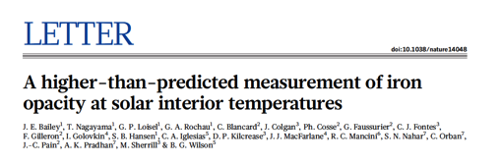
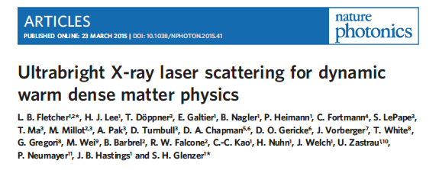

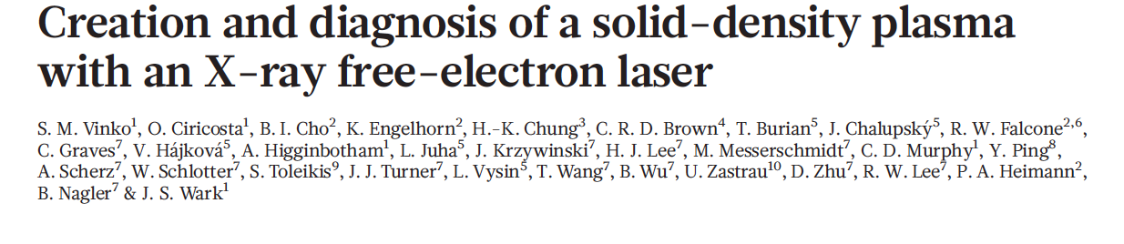
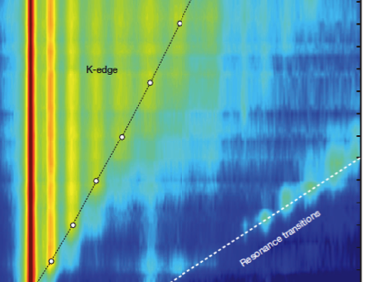

HED scientists are exploiting new experimental capabilities to understand matter at extreme conditions

Slide 8
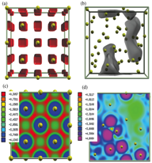
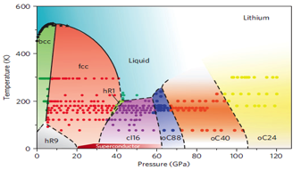
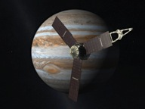
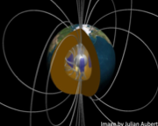
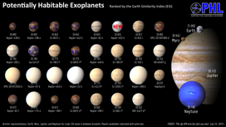
There are many exciting scientific directions for future HED research in understanding matter at high pressure
Phase Diagram of Li
“Electrides”
Shedding light on materials behavior at high pressures, addressing fascinating complexity in quantum behavior of solids under compression. Could there be new metastable material forms that can be generated only under HED conditions?
Helping (via measurements of material properties) address fundamental questions regarding planetary structure, supporting both solar system planetary missions and exo-planet research. Can we help provide constraints on which exoplanets may have magnetic fields, potentially enabling life?
Guillaume, et al. , Nature Physics, 2011
Dai, et al. PRL 109, 175701 (2012)
Juno Mission

Slide 9
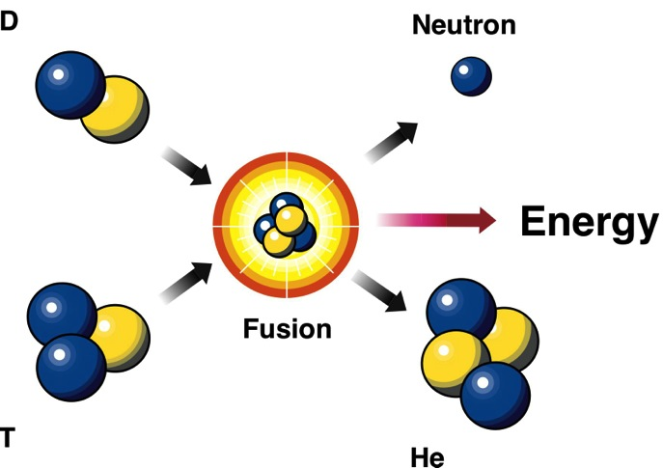
Like many areas of plasma physics, we not only want to understand nature, we want to bend it to our will
14.1 MeV
ρ, R, T
3.5 MeV
The fractional burn up of the DT (for small burn up) is:
At sufficiently high ρR and T the fractional burn up becomes significant and the energy deposited by alpha particles heats the fuel further leading to a runaway reaction (“ignition”)
Typical conditions are:

Slide 10
For hot spot ignition fusion fuel must be brought to a pressure of a few hundred billion atmospheres
For ignition conditions:
ρ, R, T
and
Can high velocity implosions achieve these conditions?

Slide 11
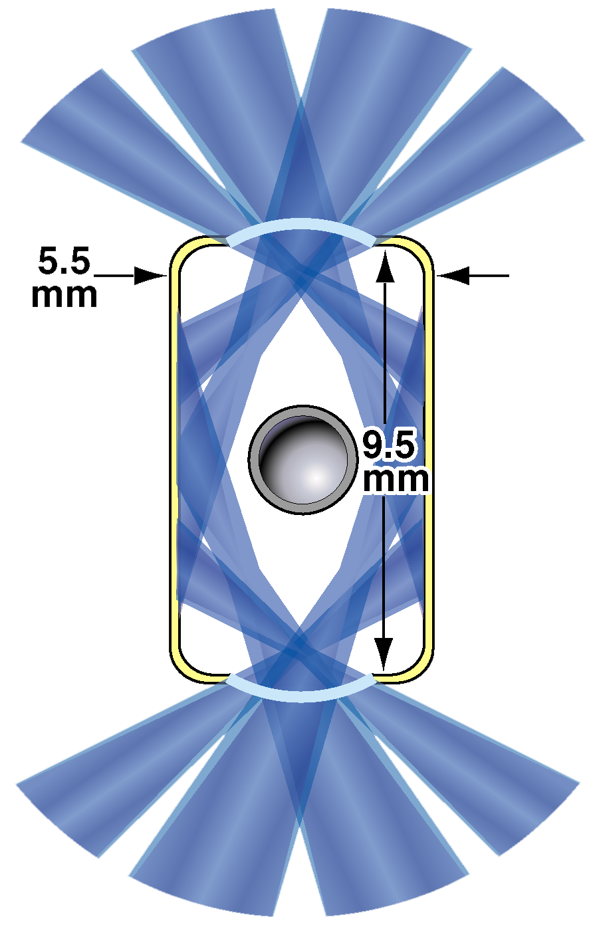

High velocity, low adiabat thin shells are the most common approach to reach these conditions
In either direct or indirect drive, peak drive pressures are of order ~ 50-150 MBars
We need to get pressures to > 1000X that for ignition!
Spherical implosions enable us to store energy in the fusion fuel in the form of kinetic energy, which is converted to pressure at stagnation
Indirect Drive (X-ray)
Direct Drive (Laser)
Actual high Mach number implosions do not stagnate adiabatically
A fundamental and open question is how efficiently
do implosions stagnate in nature

Slide 12
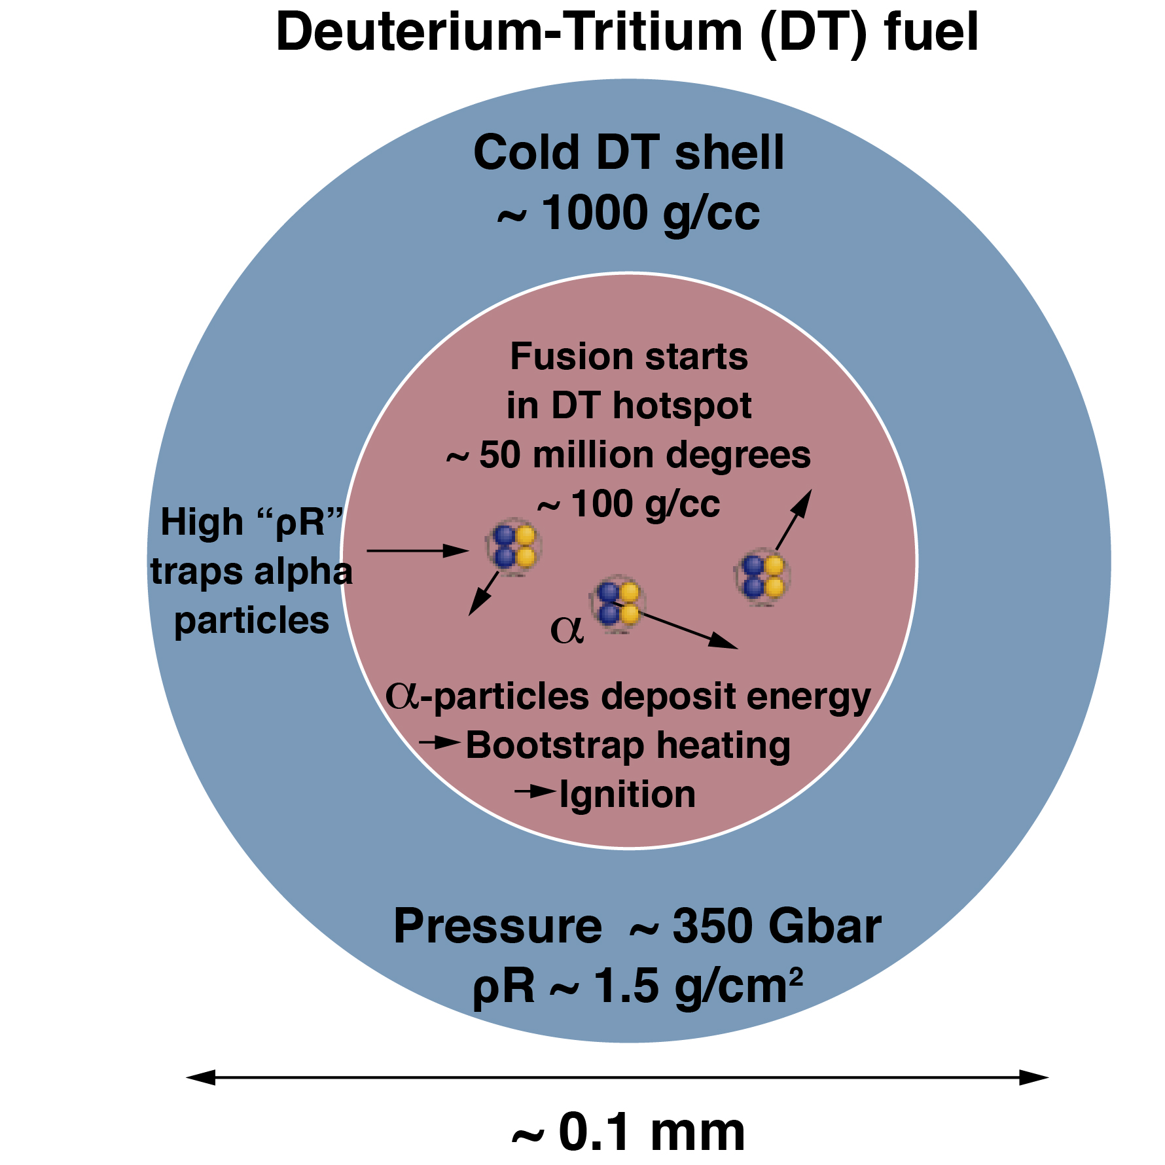
Current NIF implosions reach ~200 Gbar at stagnation, ~2x away from the 400 Gbar needed for ignition
Best performance
on single shot
~ 27kJ <<1.8 MJ
~ 500 g/cc
~ 40 g/cc, ~5 keV
~ 180 Gbar
~ 0.75 g/cm ²
∗ρR = Areal density

Slide 13
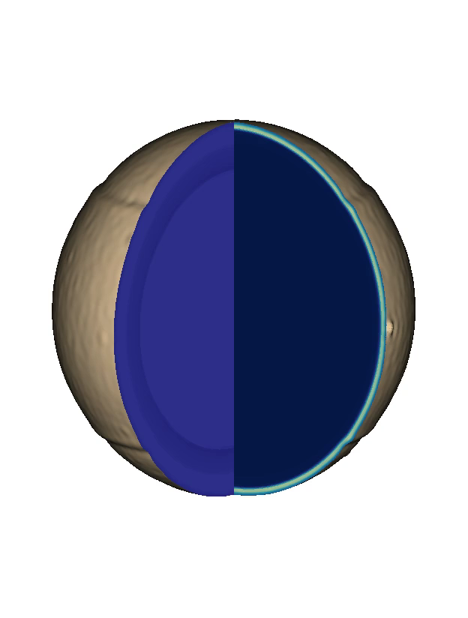
Simulations provide critical insight. A grand challenge is to diagnose these implosions and constrain modeling in these extreme conditions
Simulations of implosions suggest that perturbations from engineering features and low mode asymmetry are disrupting the stagnation
Temperature
Density
3D HYDRA simulation of final stagnation phase
D. Clark –
3D Simulation of low foot N120405
C. Weber –
Postprocessed movie

Slide 14
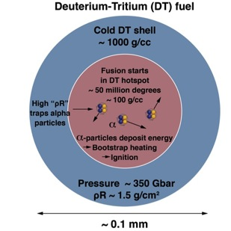
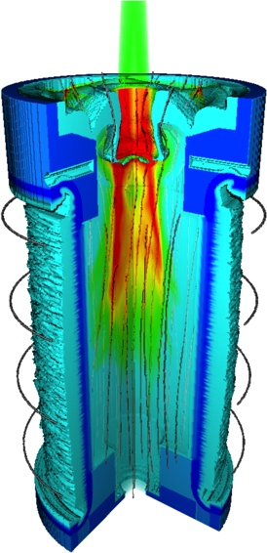
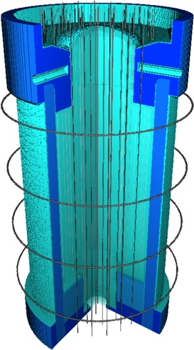
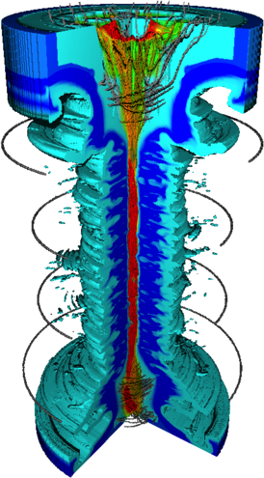
Ignition is a grand scientific challenge and a critical enabling capability for HED science
Creating, controlling, and diagnosing matter at the energy densities needed for ignition in the laboratory is a daunting challenge.
Our goal on NIF is to achieve ignition or understand the science well enough to answer the question of what capability would be needed to achieve it
Achieving/Understanding what is required for ignition provides the most stringent constraints on our entire field. In doing so it pushes diagnostics, codes, drivers, optics, targets, capabilities and operations
There is lots of room for innovation in the quest for ignition:
  How do we take advantage of the additional energy coupling from direct drive
  Can ultra strong magnetic fields (10’s of Megagauss) significantly reduce the pressure needed for ignition
  Many alternate approaches (fast ignition, shock ignition, etc.)
If achieved, ignition will open a whole new window into the HED science that can be performed in the laboratory, and may pave the way for even more extreme capabilities in the future
Magnetization
Laser
Heating
Compression

Slide 15
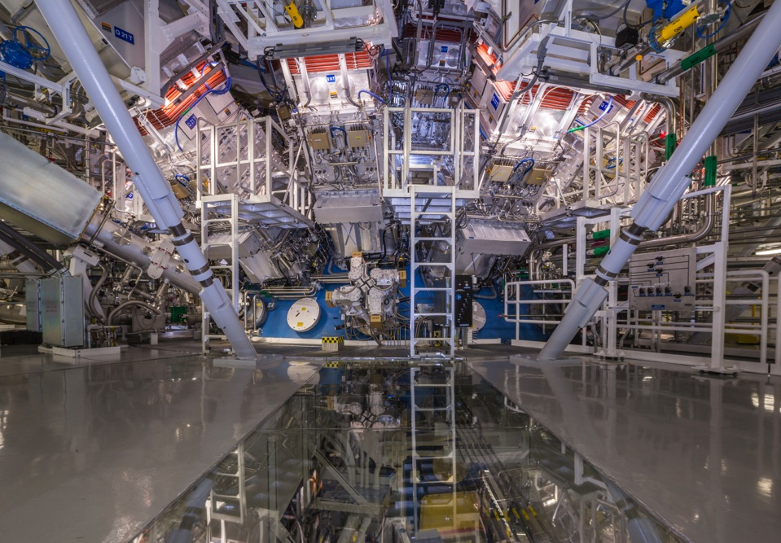




































Slide 16
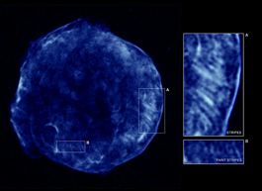
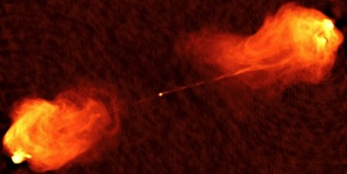
There are many exciting scientific directions for future HED research (Plasma Astrophysics and Radiation Hydrodynamics)
Collisionless Shock
Creating and diagnosing in the laboratory plasmas that can help explain ubiquitous processes in the universe, like collisionless shocks, generation of cosmic rays, generation and amplification magnetic fields.
Generating and explaining jets that are extraordinarily collimated and appear in many astrophysical situations
Illuminating fundamental issues in the evolution of nonlinear HED flows and the transition to turbulence.
Tycho A
Astrophysical Jet
Cyg A
2D bubble merger simulations (G. Malamud 2014)

Slide 17

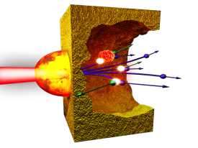
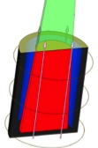
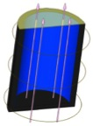

There are many exciting scientific directions for future HED research (High intensity laser matter interactions and magnetic fields)
Creating and understanding well behaved high intensity laser heated plasmas that have sufficient control for the application at hand and that enable applications beyond what is currently possible
Exploring the limits of high intensity laser science, the unique sources that can be created, and generating new plasmas such as dense electron positron pair plasmas
Studying the effect of magnetic fields on the plasma astrophysics and radiation hydrodynamics. Exploring the limits of what field can be produced in the laboratory.
Assessing whether or not magnetic fields can significantly reduce the pressure needed for ignition

Slide 18
The HED Science community is delivering on the promise that was identified in the 2000’s
Impact factor > 10, e.g. Nature, Science, etc., does not include PRL’s
Courtesy of Rulon Lindford )
Notes:
1. Carbon and Iron Equation of State (Tom Duffy, Princeton; Ray Smith, LLNL)
2. Novel Phases of Compressed Diamond (Justin Wark, Oxford; Amy Lazicki, Jon Eggert, LLNL)
3. Hydrogen at Ultra High Pressures (Raymond Jeanloz, UC Berkeley, Russ Hemley, Carnegie Institution of Washington; Marius Millot, Peter Celliers, LLNL)
4. Gbar Equation of State (Roger Falcone, UC Berkeley, Paul Neumayer, GSI Darmstadt; Tilo Doeppner, Damian Swift, Andrea Kritcher, LLNL)
5. Ablative Rayleigh-Taylor Instability (Alexis Casner, CEA, France; David Martinez, LLNL )
6. Eagle Nebula Experiment (Jave Kane, David Martinez, LLNL)
7. Supernova Hydrodynamics: The Effects of a Radiative Shock on Hydrodynamic Instabilities (Carolyn Kuranz, Univ. of Michigan; Hye-Sook Park, LLNL)
8. Astrophysical collisionless shocks (Youichi Sakawa, Osaka; Gianluca Gregori, Oxford; Steve Ross, Hye-Sook Park, LLNL)

Slide 19
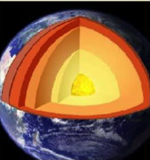
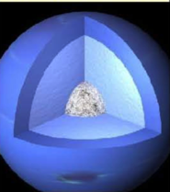
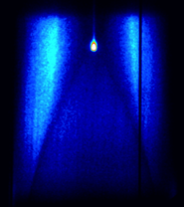
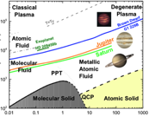
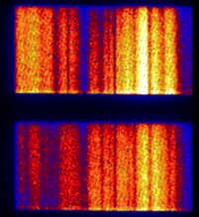
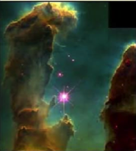
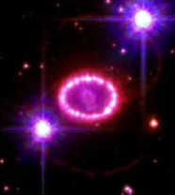
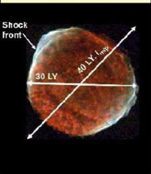
NIF allocates a small fraction of the facility’s time to
“Discovery Science”
C, Fe EOS at planetary
interior pressures
High pressure
phases of carbon
High pressure
hydrogen properties
CH and carbon at
near Gbar pressures
Hydrogen phase diagram
Temperature (K)
Pressure (Mbar)
Duffy (Princeton), Jeanloz (UCB) Wark (Oxford) Jeanloz (UCB), Hemley (CIW) Falcone (UCB), Neumayer (GSI)
Planar ablation front
Rayleigh-Taylor growth
Molecular cloud
radiative dynamics
Supernova explosion
rad. hydrodynamics
Collisionless
astrophysical shocks
Casner (CEA) Kane (LLNL), Pound (Maryland) Kuranz, Drake (Mich) Sakawa (Osaka), Takabe (HZDR)
Discovery Science had 44 target shots in FY15 versus
26 DS shots total in FY10-FY14
Notes:
HZDR = Helmholtz-Zentrum Dresden-Rossendorf, Germany

