Slide 1
Spheromaks and How Plasmas May Explain the Ultra High Energy Cosmic Ray Mystery Ken Fowler, UC Berkeley Hui Li, LANL

Slide 2
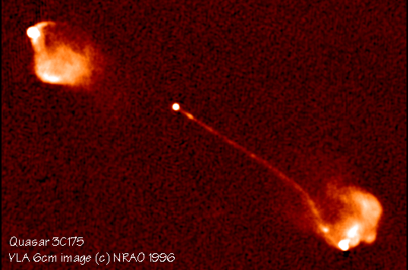
Stirling thought AGN jets are powerful cosmic ray accelerators [S. A. Colgate and H. Li, Comp. Ren. Phys. 5, 431 (2004)]

Slide 3
New papers coauthored with Stirling
S. A. Colgate, T. K. Fowler, H. Li, J. Pino, “ Quasi-Static Model of Collimated Jets and Radio Lobes I: Accretion Disks and Jets,” ApJ 789,144 (2014)
S. A. Colgate, T. K. Fowler, H. Li, E. B.Hooper, J. McClenaghan, Z.Lin, “Quasi-Static Model of Collimated Jets and Radio Lobes II: Jet Structure and Stability,” ApJ, 813, 136 (2015)
S. A. Colgate, T. K. Fowler, H. Li, “Cosmic Ray Acceleration by Jet/Radiolobes Created by Active Galactic Nuclei” – in preparation

Slide 4
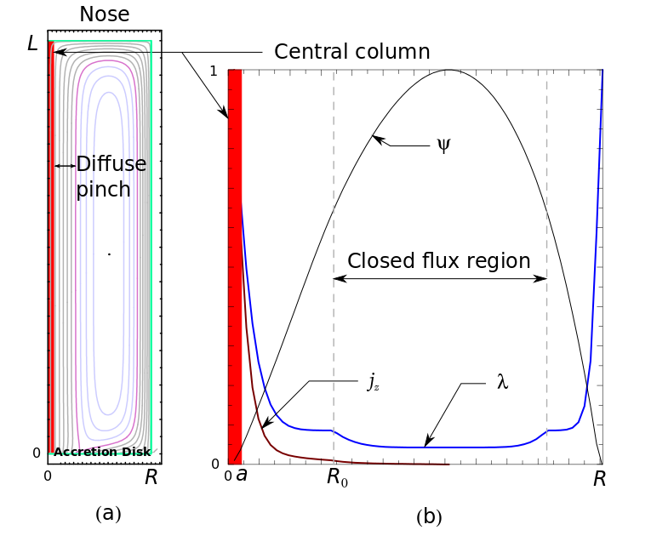
We have used Stirling’s ideas to create a simple model of jets as accelerators

Slide 5
Our jet is a self-accelerated ion beam
Quasi-DC Acceleration, by Diffusion
Central Column: 3D kinks, D_{r} = a²/t
E_{z} = (D_{r}/ac)B_{φ}= V/ct = (V/L) (L/ct) = 0.01 V/L
Nose: cyclotron resonance, D_{r} = D_{z} = r_{L}² ω_{c}
E_{r} ≈ (D_{z}/Δ_{z}c)B_{φ} ≈ (D_{z}/r_{L}c)B_{φ} ≈ (V – 0.01V)/r

Slide 6
DIFFUSION IS HYPER-RESISTIVITY
E + v x B = R
In the disk: R = MRI? (don’t need to know)
In the jet: R = Kinks
In nose: R = Drift Cyclotron Loss Cone
Instability

Slide 7
Example Calculations
Accretion Disk as a Dynamo
∂j_{r}/∂t = ∂²R_{r}/∂z² = - ∂²R_{φ}/∂z² = B_{z} ∂²v_{r}/∂z²
Cosmic Rays
E_{r} = (D_{z}/Δ)B_{φ} ; I(E) = ∫dx ∂/∂z D_{z} ∂f/∂z

Slide 8
Cosmic Ray Spectrum
I(E) = ∫_{R(E)}^{R} dr f (D_{z}/Δ²) ≈ ∫_{R(E)}^{R} dr f(rv_{r}/Δ²)
Δ(r) = r_{Lmax} = (E_{max}(r)/eB_{φ}) = r(E_{max}/eV)
cD_{pr}∂f/∂E = eE_{r} f = eB_{φ}(D_{z}/cΔ)f = (cD_{pr}/E_{max})f
f = (I/e E_{max}v_{r}) exp Y ; Y = E/E_{max}
I(E) ≈ (I/E³ ) ∫_{E/eV} ¹ dY Y² exp Y → I/E^{2.7}

Slide 9
Predictions
Jet Length L = 10²⁴ cm = 0.3 Mpc
Cosmic Rays (for M = 10⁸Suns, scales M^{1/2})
E = 10²⁰ eV, I = 2x10¹⁸ A, I(E) ≈ I/E^{3→2.7}
Intensity on Earth ≈ 1/yr km² (>10¹⁹eV)
Synchrotron: λ < 10 cm, Power = 0.01 IV, I(E) ≈ E exp(- E³),Light cone ≈ 0.01 radians

